Slide 1
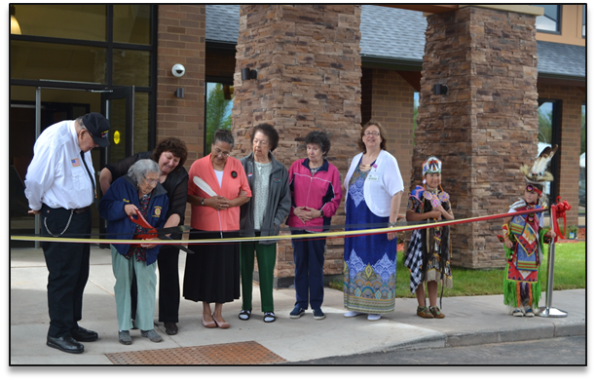
COUNCIL FOR TRIBAL EMPLOYMENT RIGHTS
Home Office:
7308 Aspen Lane N.
Brooklyn Park, MN 55428
Doug Niesen: 952-808-8662
Doug@Woodstoneinc.com

Slide 2
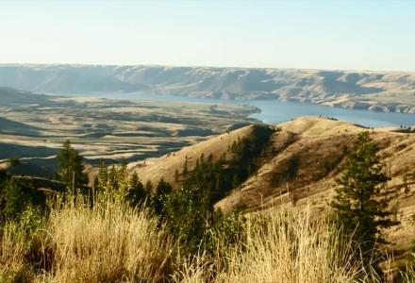
CTER Legal Update Convention
Presentation Agenda
August 11th & 13th , 2021
Introductions
Who is Woodstone, Inc.
Woodstone, Inc. Project Experience
Job Fairs
Tribal Hiring Success
Pre-Bid Meetings
Closing & Questions

Slide 3
WHO IS WOODSTONE, INC.

Slide 4
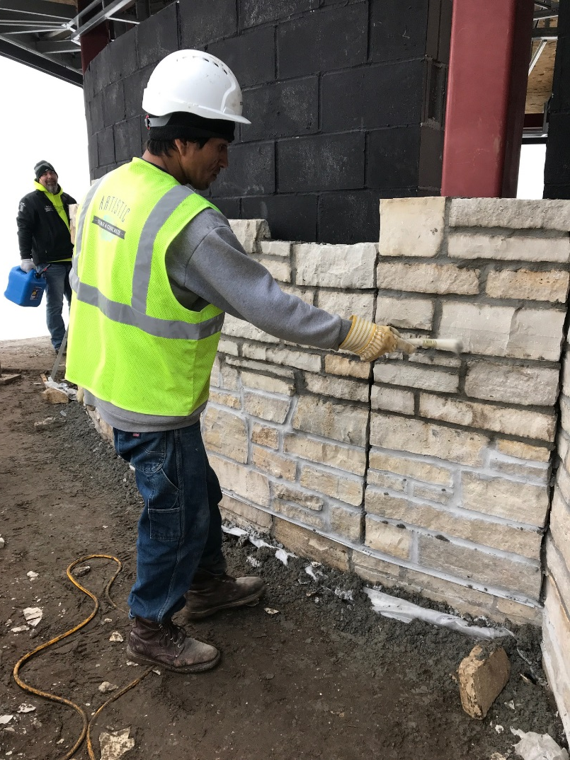
WHO IS WOODSTONE
NATIVE OWNED COMPANY
Highly experienced in the development and construction management of gaming, hospitality and entertainment projects.
Our team has completed a multitude of gaming projects of similar size or larger, and has an experienced staff that has worked on over 25 Native American gaming projects totaling 1,500,000 square feet
Projects benefit from our combined forces and extensive knowledge of gaming, hospitality, convention center, entertainment and Native American operations.

Slide 5
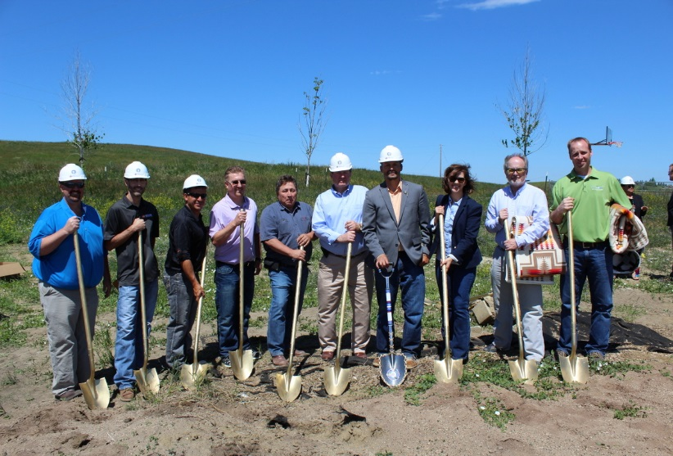
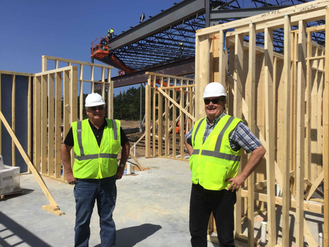
WHO IS WOODSTONE
Many different types of projects:
Schools
Health Care
Retail
Industrial
Restaurants
Single and Multi-Family Housing
Gaming
Government
Tribal

Slide 6
WOODSTONE APPROACH
We have industry experts on our team that will work closely with your team.
These experts will work with your Tribe to achieve the goals you envision while respecting your sovereign status, leadership, and members.
Woodstone’s process is built on respect.
We demonstrate this respect for the tribe by placing special emphasis on building a consensus between the tribe’s project leaders and Woodstone personnel.
Woodstone sees respect for its tribal partners as fundamental to the process of construction. This entails respect for the tribe’s sovereign status including, but not limited to:
Respect for the tribe’s culture and traditions
Respect for the tribe’s natural and human resources
Respect for all tribal employment
Respect for the tribe’s courts

Slide 7
WOODSTONE APPROACH
Community Involvement
Woodstone’s Philosophy is based on building long lasting relationships with the local community. We enjoy sharing the building progress with tribal members and even offer site tours on some job sites.
Tribal Employment (TERO)
Woodstone works with the local tribal workforce and subcontractors to ensure that the Tribe’s money is going into member households.
Site Safety
Safety is as critical to Woodstone operations as planning, scheduling, or billing. It is an integral part of our routine operations. Woodstone is committed to maintaining a safe and healthful workplace, and to protect the public against any potential hazards cause by our operations.

Slide 8
WOODSTONE APPOACH
WOODSTONE’S PHILOSOPHY
“Building buildings is easy,
but what really matters in life
is building people and relationships.”

Slide 9
WOODSTONE’S PROJECT EXPERIENCE

Slide 10
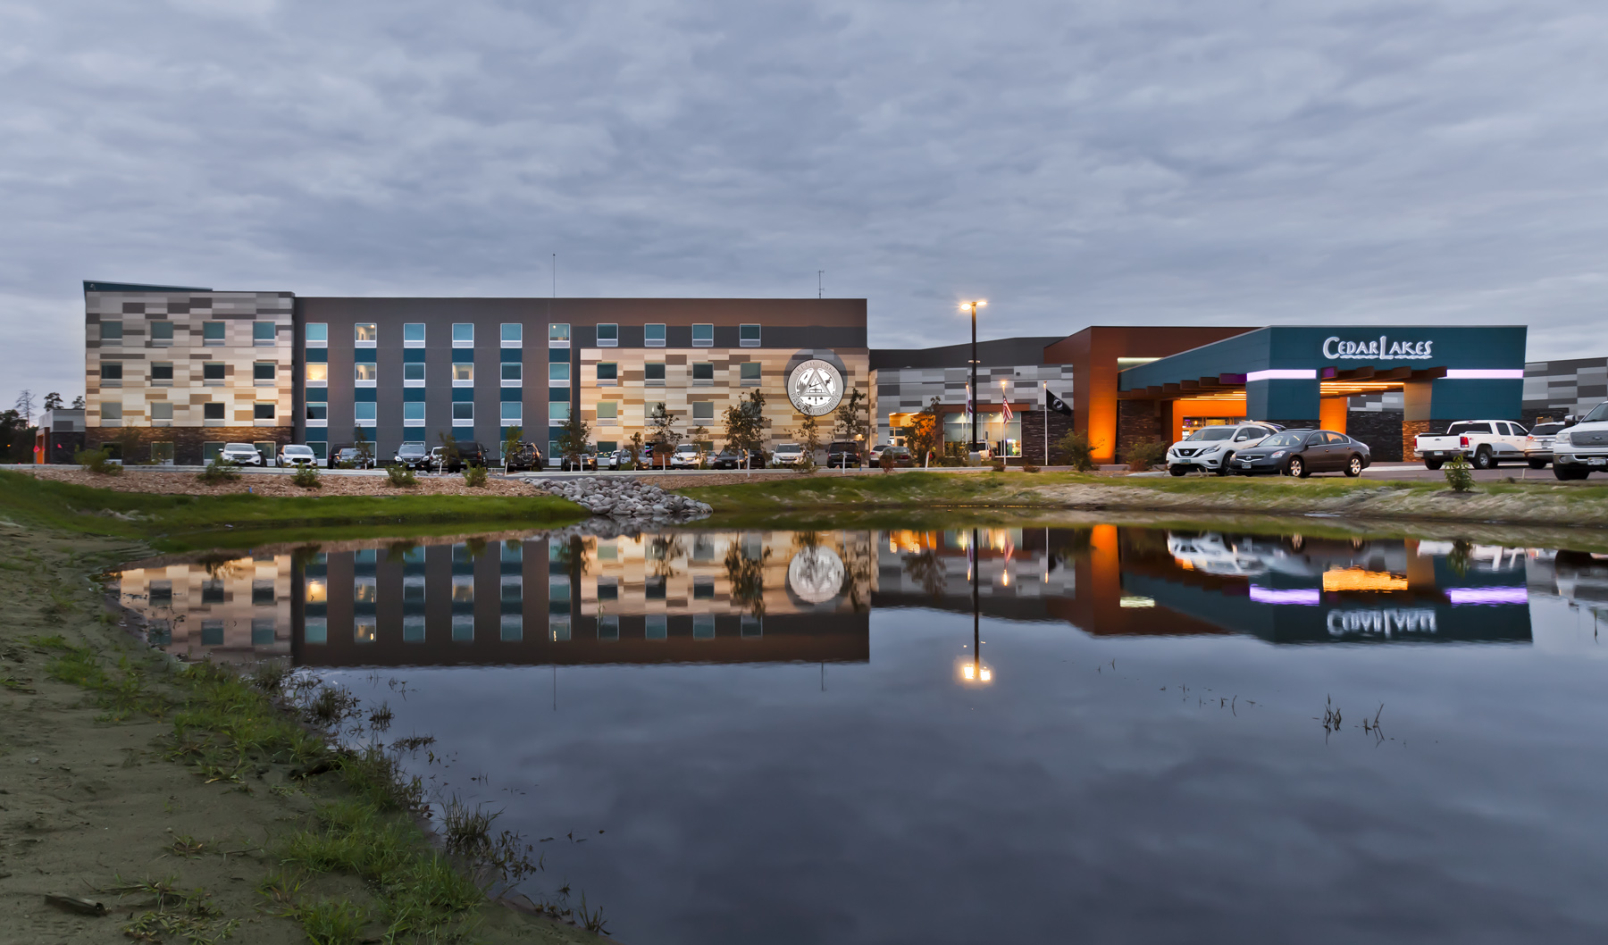
CEDAR LAKES HOTEL & CASINO
Cass Lake, MN

Slide 11
OMAK HOTEL & CASINO
Omak, WA

Slide 12
OMAK HOTEL & CASINO
Omak, WA

Slide 13
OMAK HOTEL & CASINO
Omak, WA

Slide 14
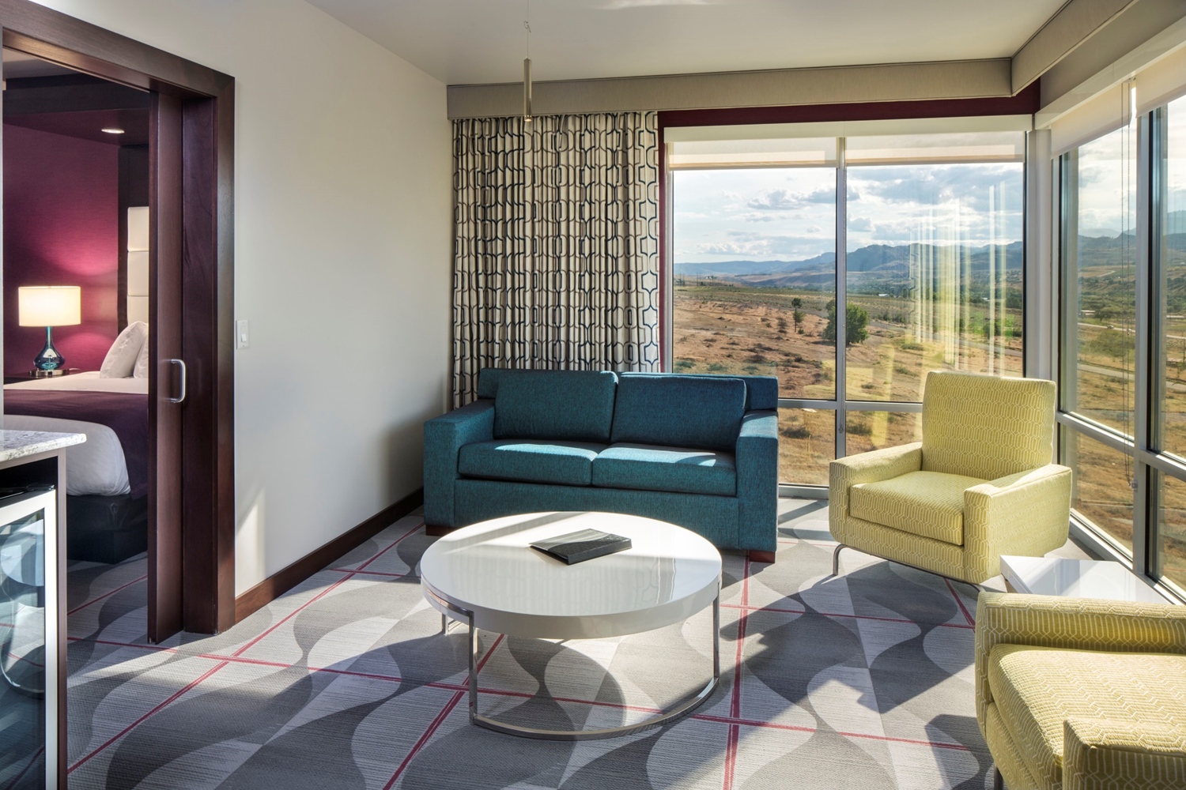
OMAK HOTEL & CASINO
Omak, WA

Slide 15
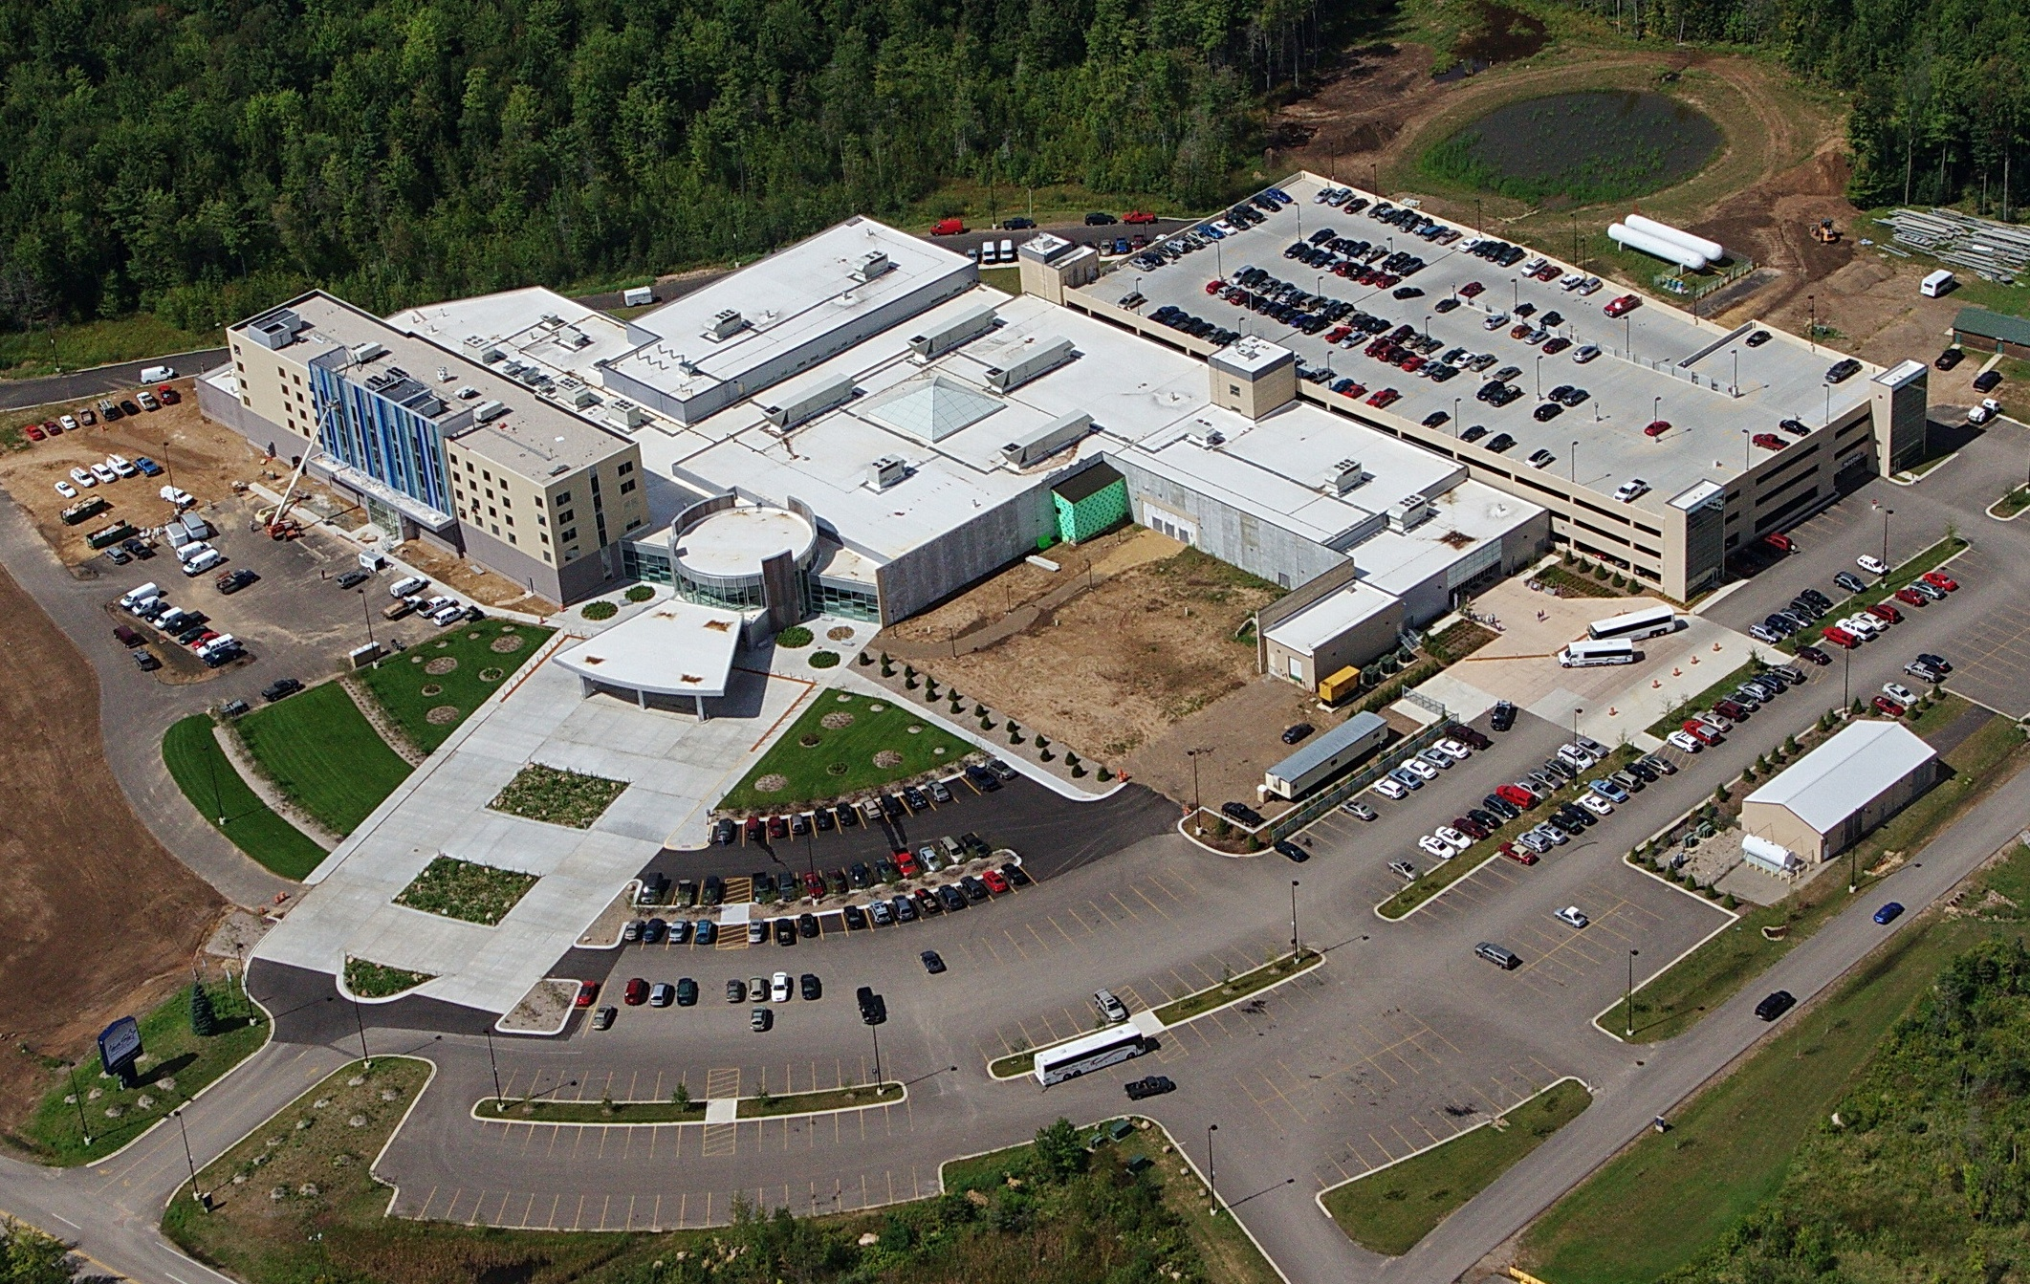
NORTH STAR CASINO
Bowler, WI

Slide 16
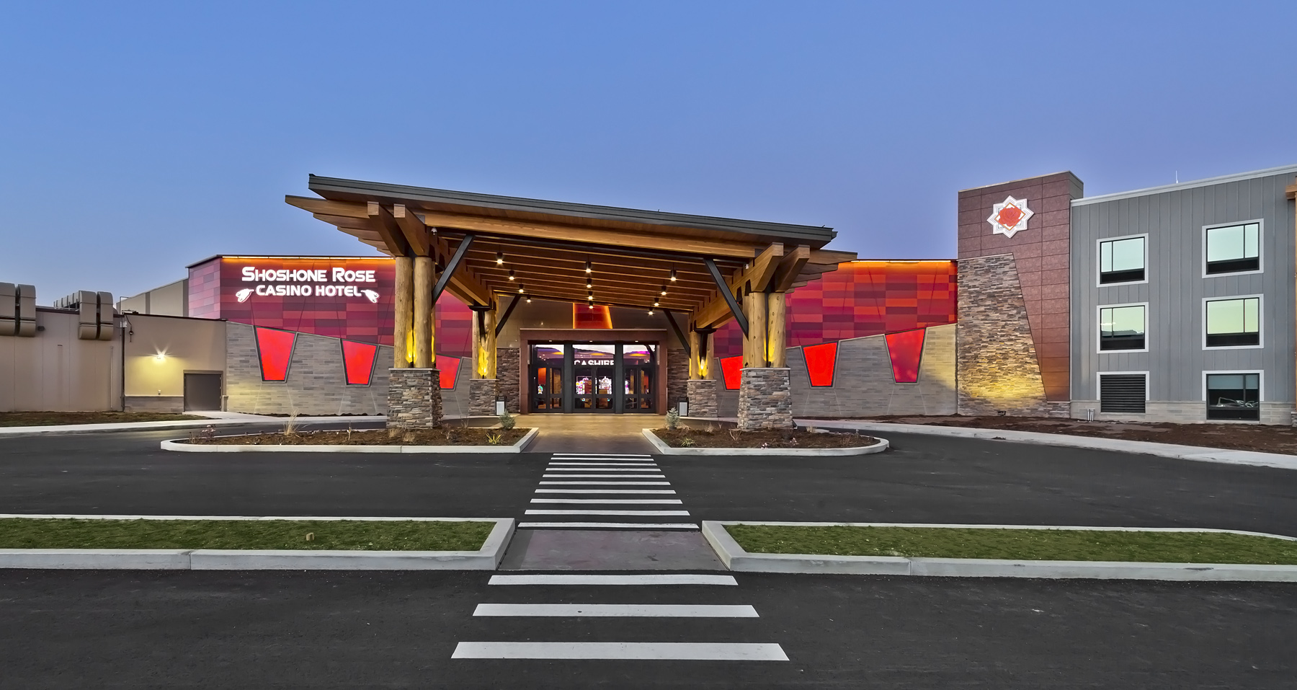
SHOSHONE ROSE CASINO
Lander, WY

Slide 17
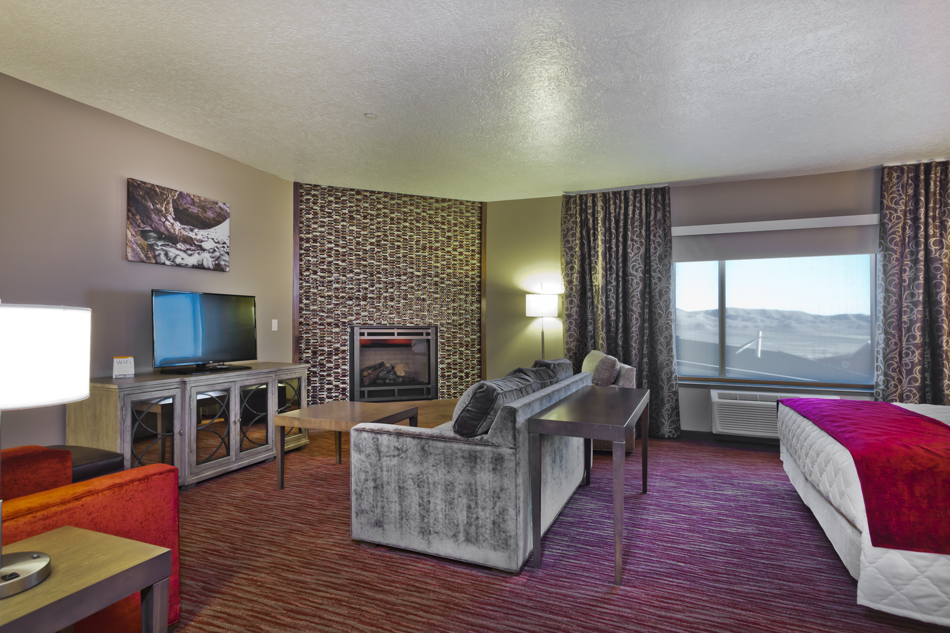
SHOSHONE ROSE CASINO
Lander, WY

Slide 18
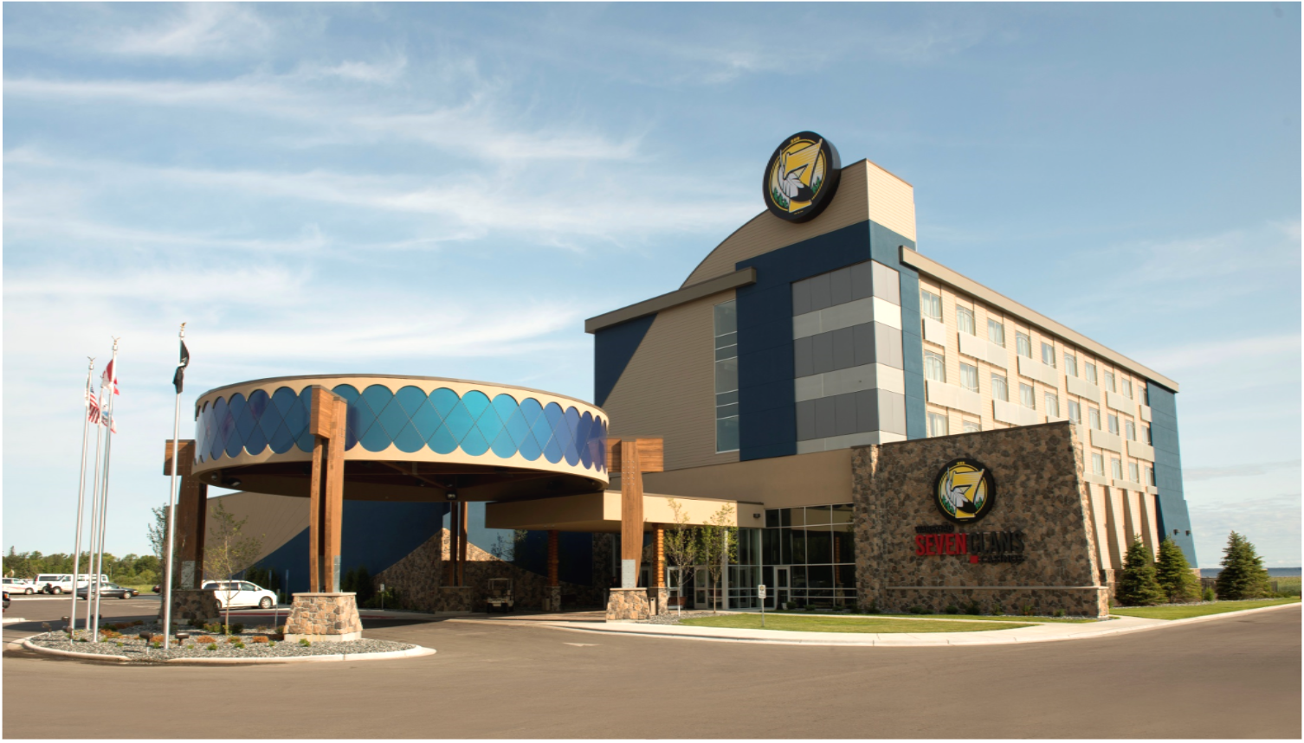
SEVEN CLANS CASINO WARROAD
Warroad, MN

Slide 19
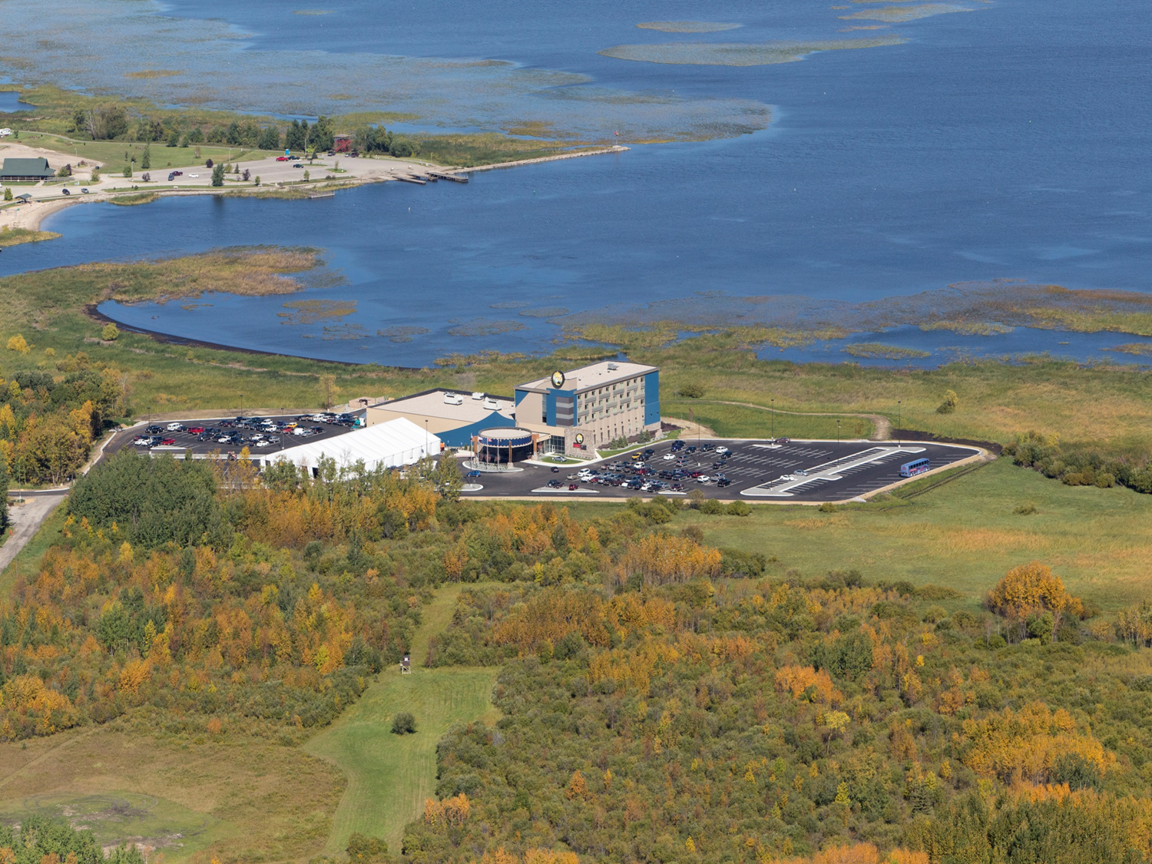
SEVEN CLANS CASINO WARROAD
Warroad, MN

Slide 20
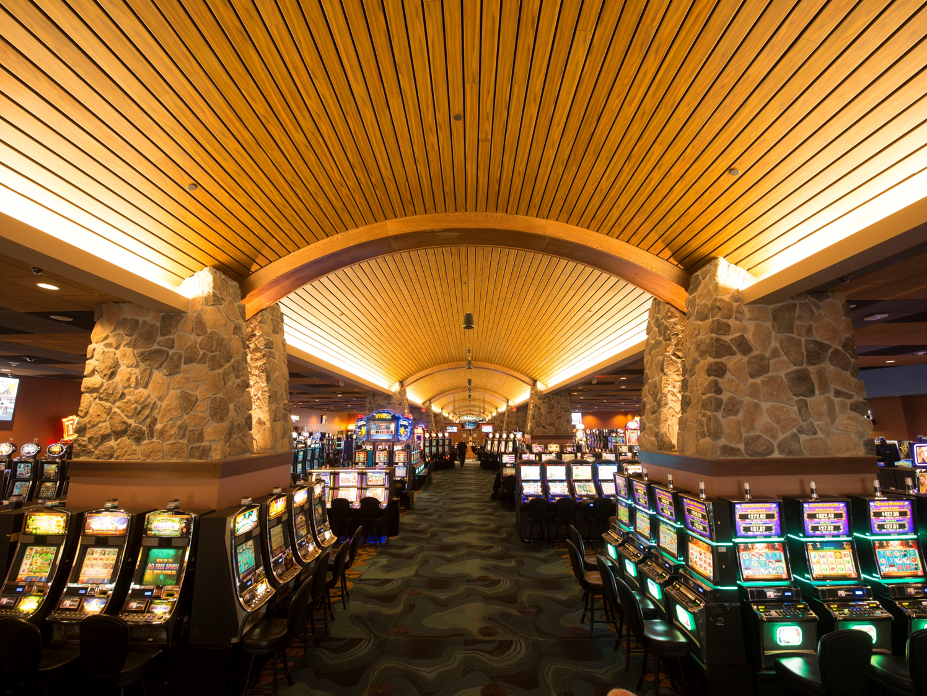
SEVEN CLANS CASINO WARROAD
Warroad, MN

Slide 21
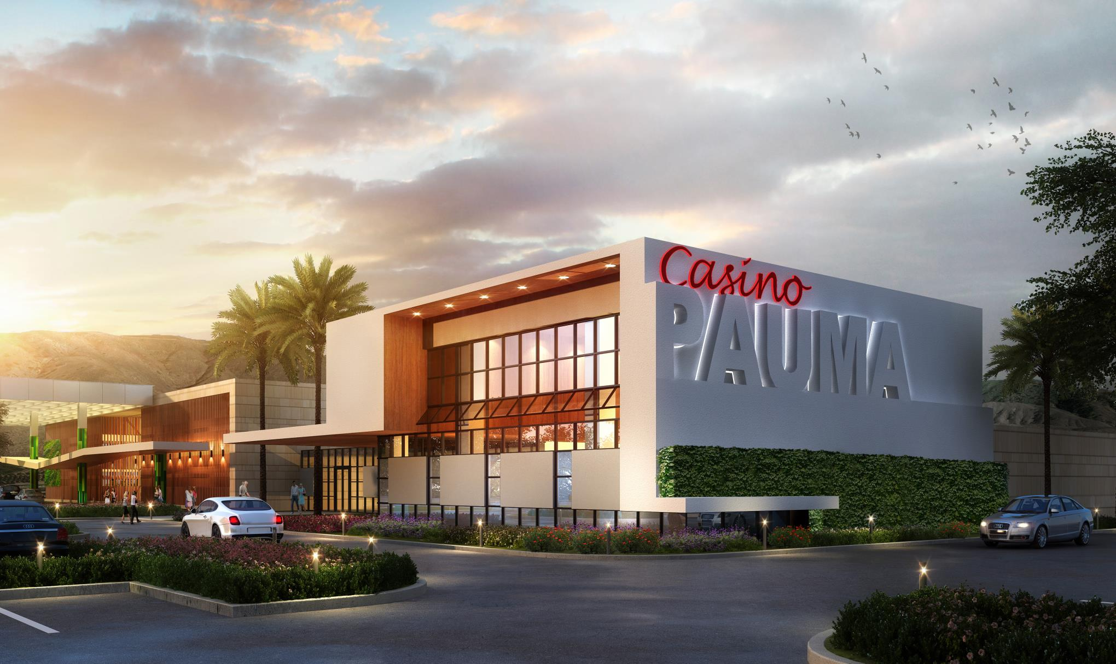
Casino Pauma
Pauma Valley, CA

Slide 22
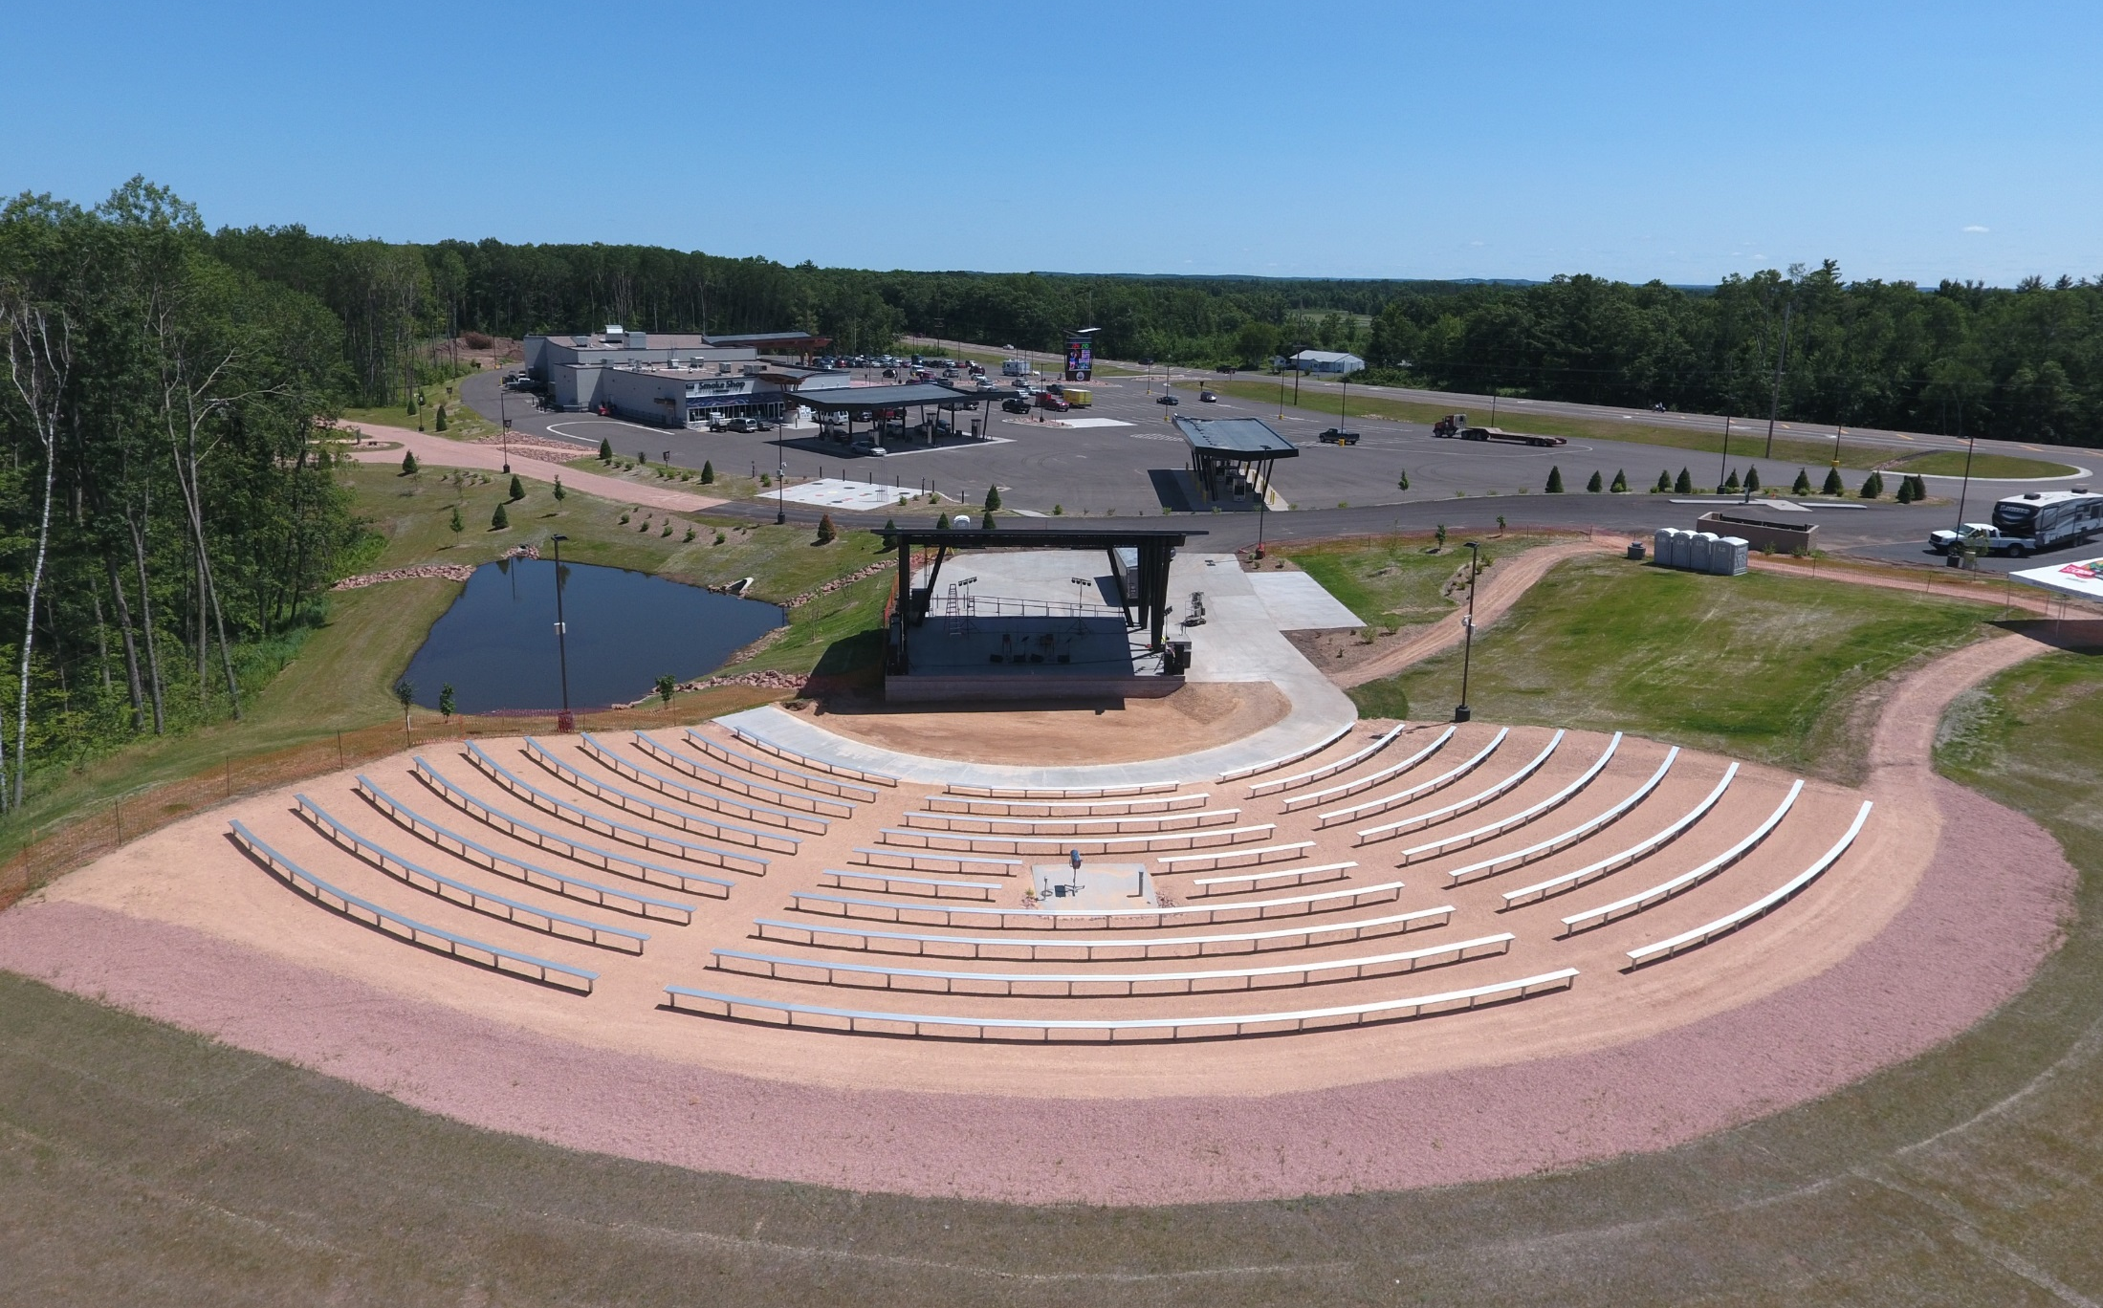
ST. CROIX CASINO
Hertel, WI

Slide 23
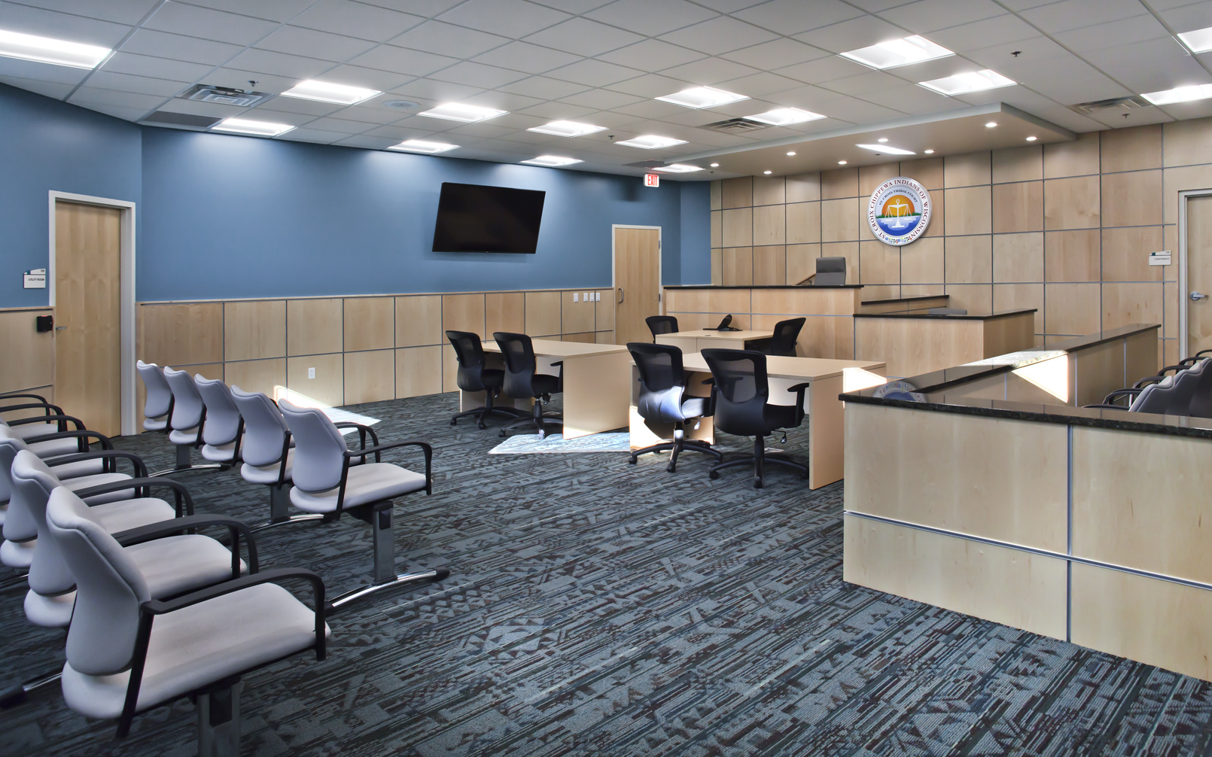
ST. CROIX JUDICAL CENTER
Hertel, WI

Slide 24
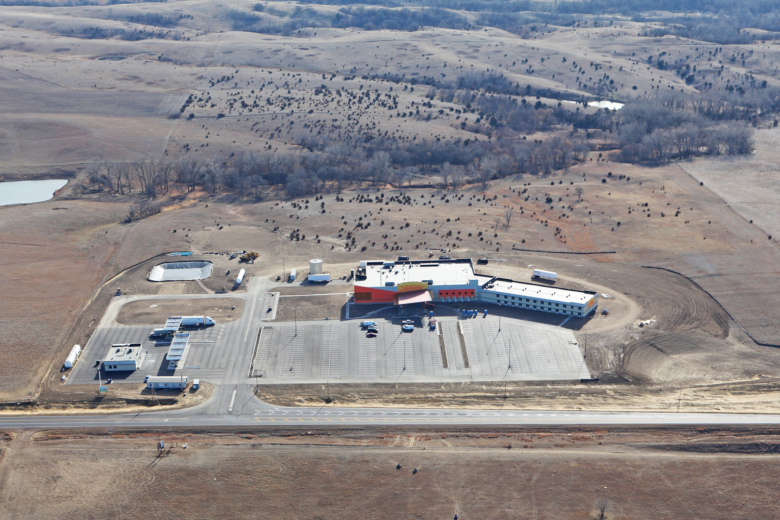
OHIYA CASINO
Niobrara, NE

Slide 25
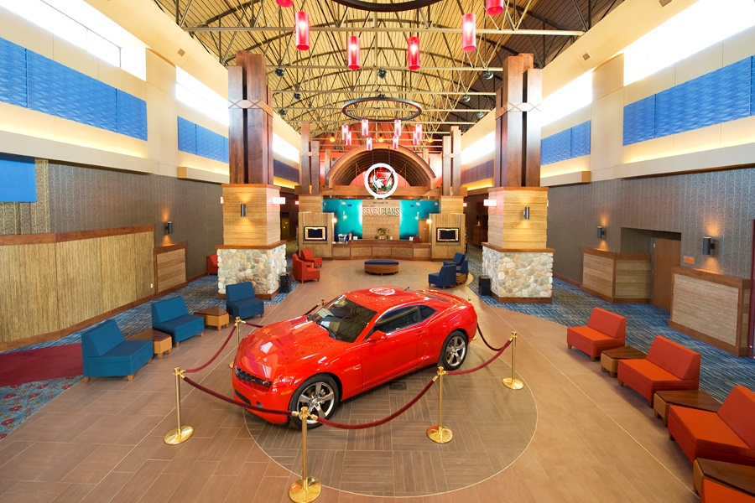
SEVEN CLANS CASINO RED LAKE
Red Lake, MN

Slide 26
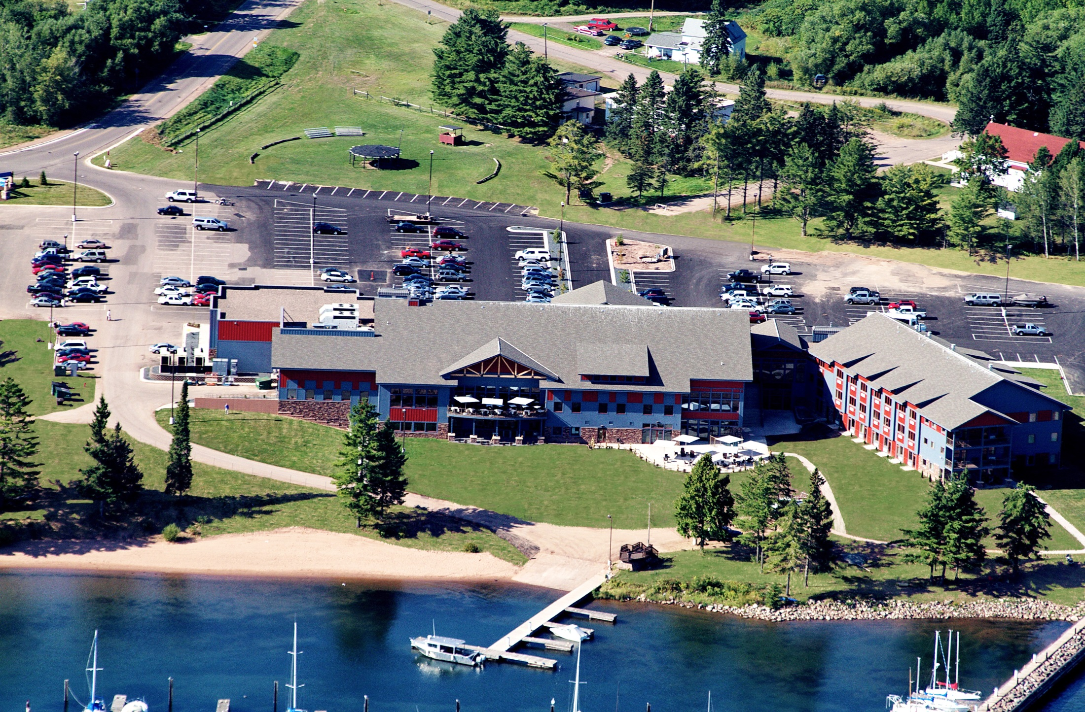
LEGENDARY WATERS HOTEL & CASINO
Bayfield, WI

Slide 27
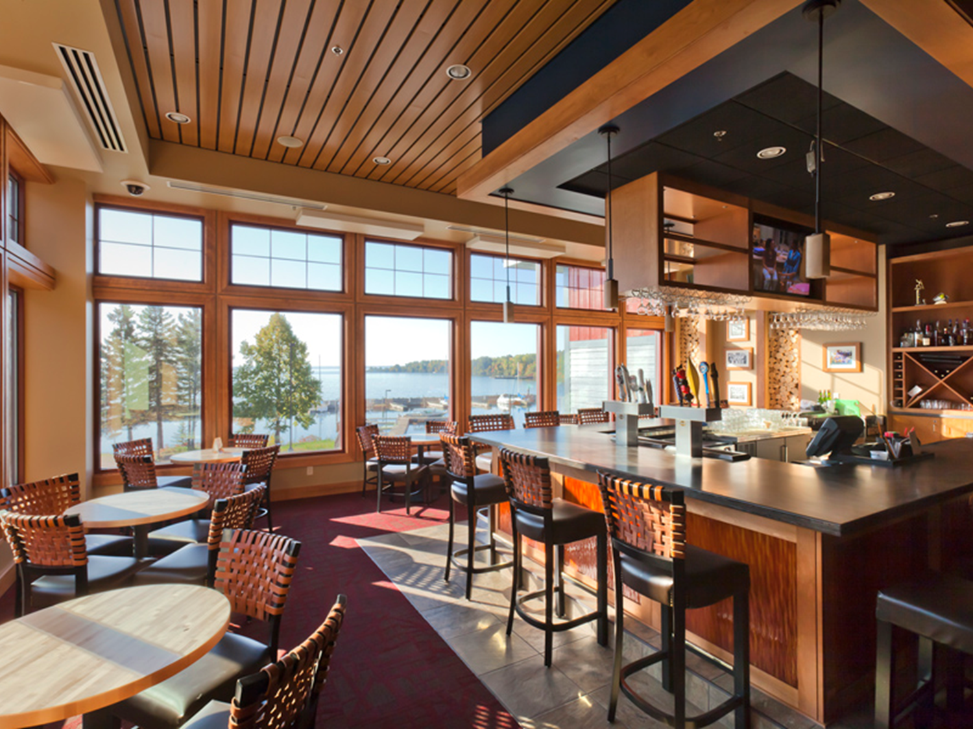
LEGENDARY WATERS HOTEL & CASINO
Bayfield, WI

Slide 28
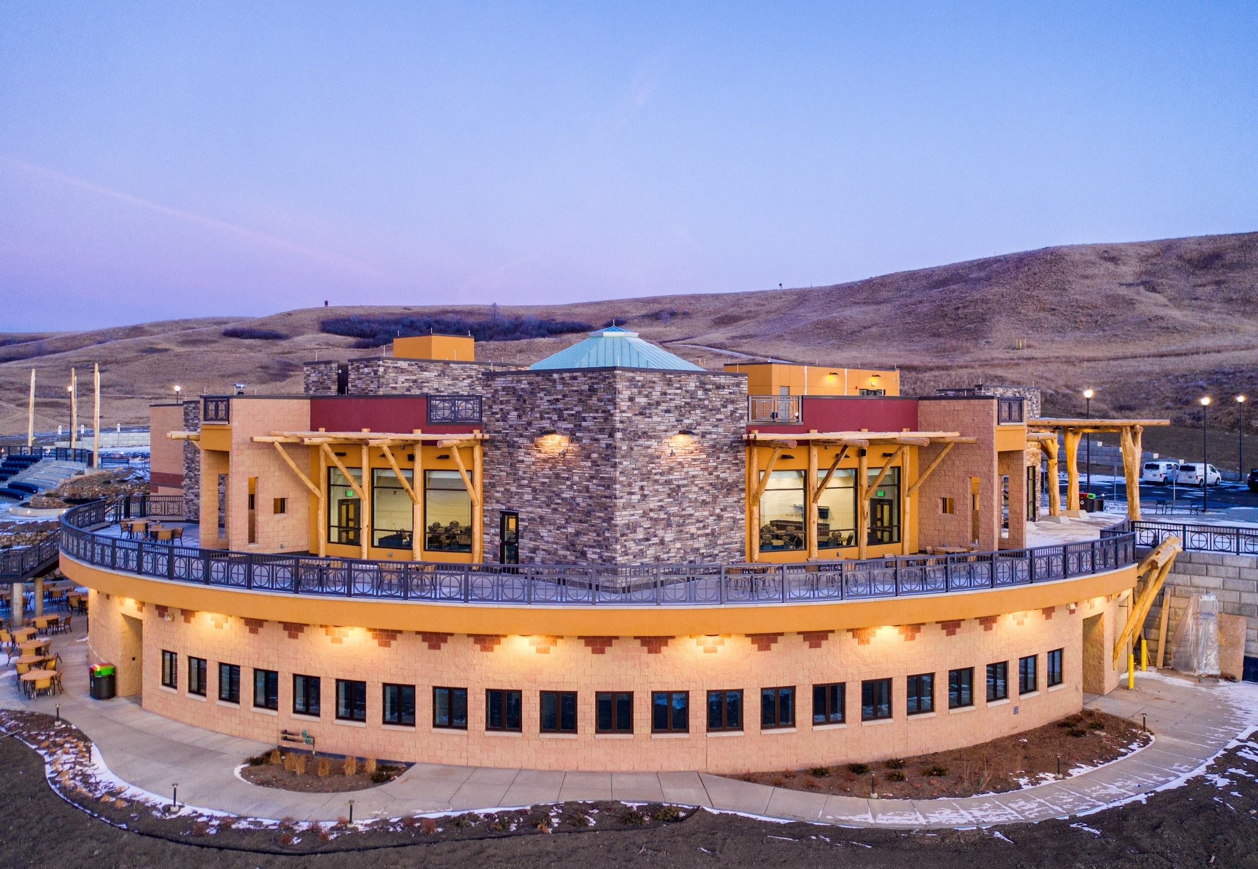
MHA Nation Interpretive Center
New Town, ND

Slide 29
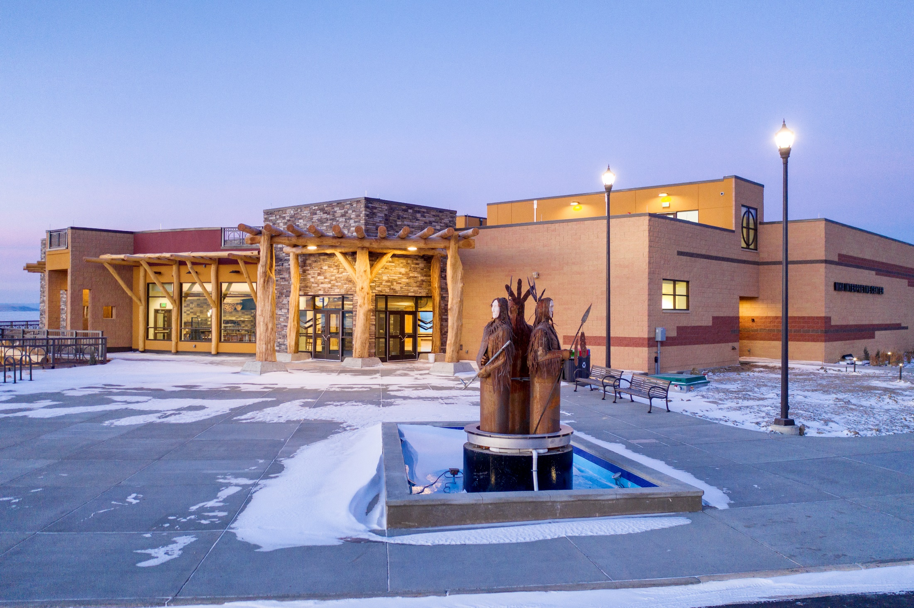
MHA Nation Interpretive Center
New Town, ND

Slide 30
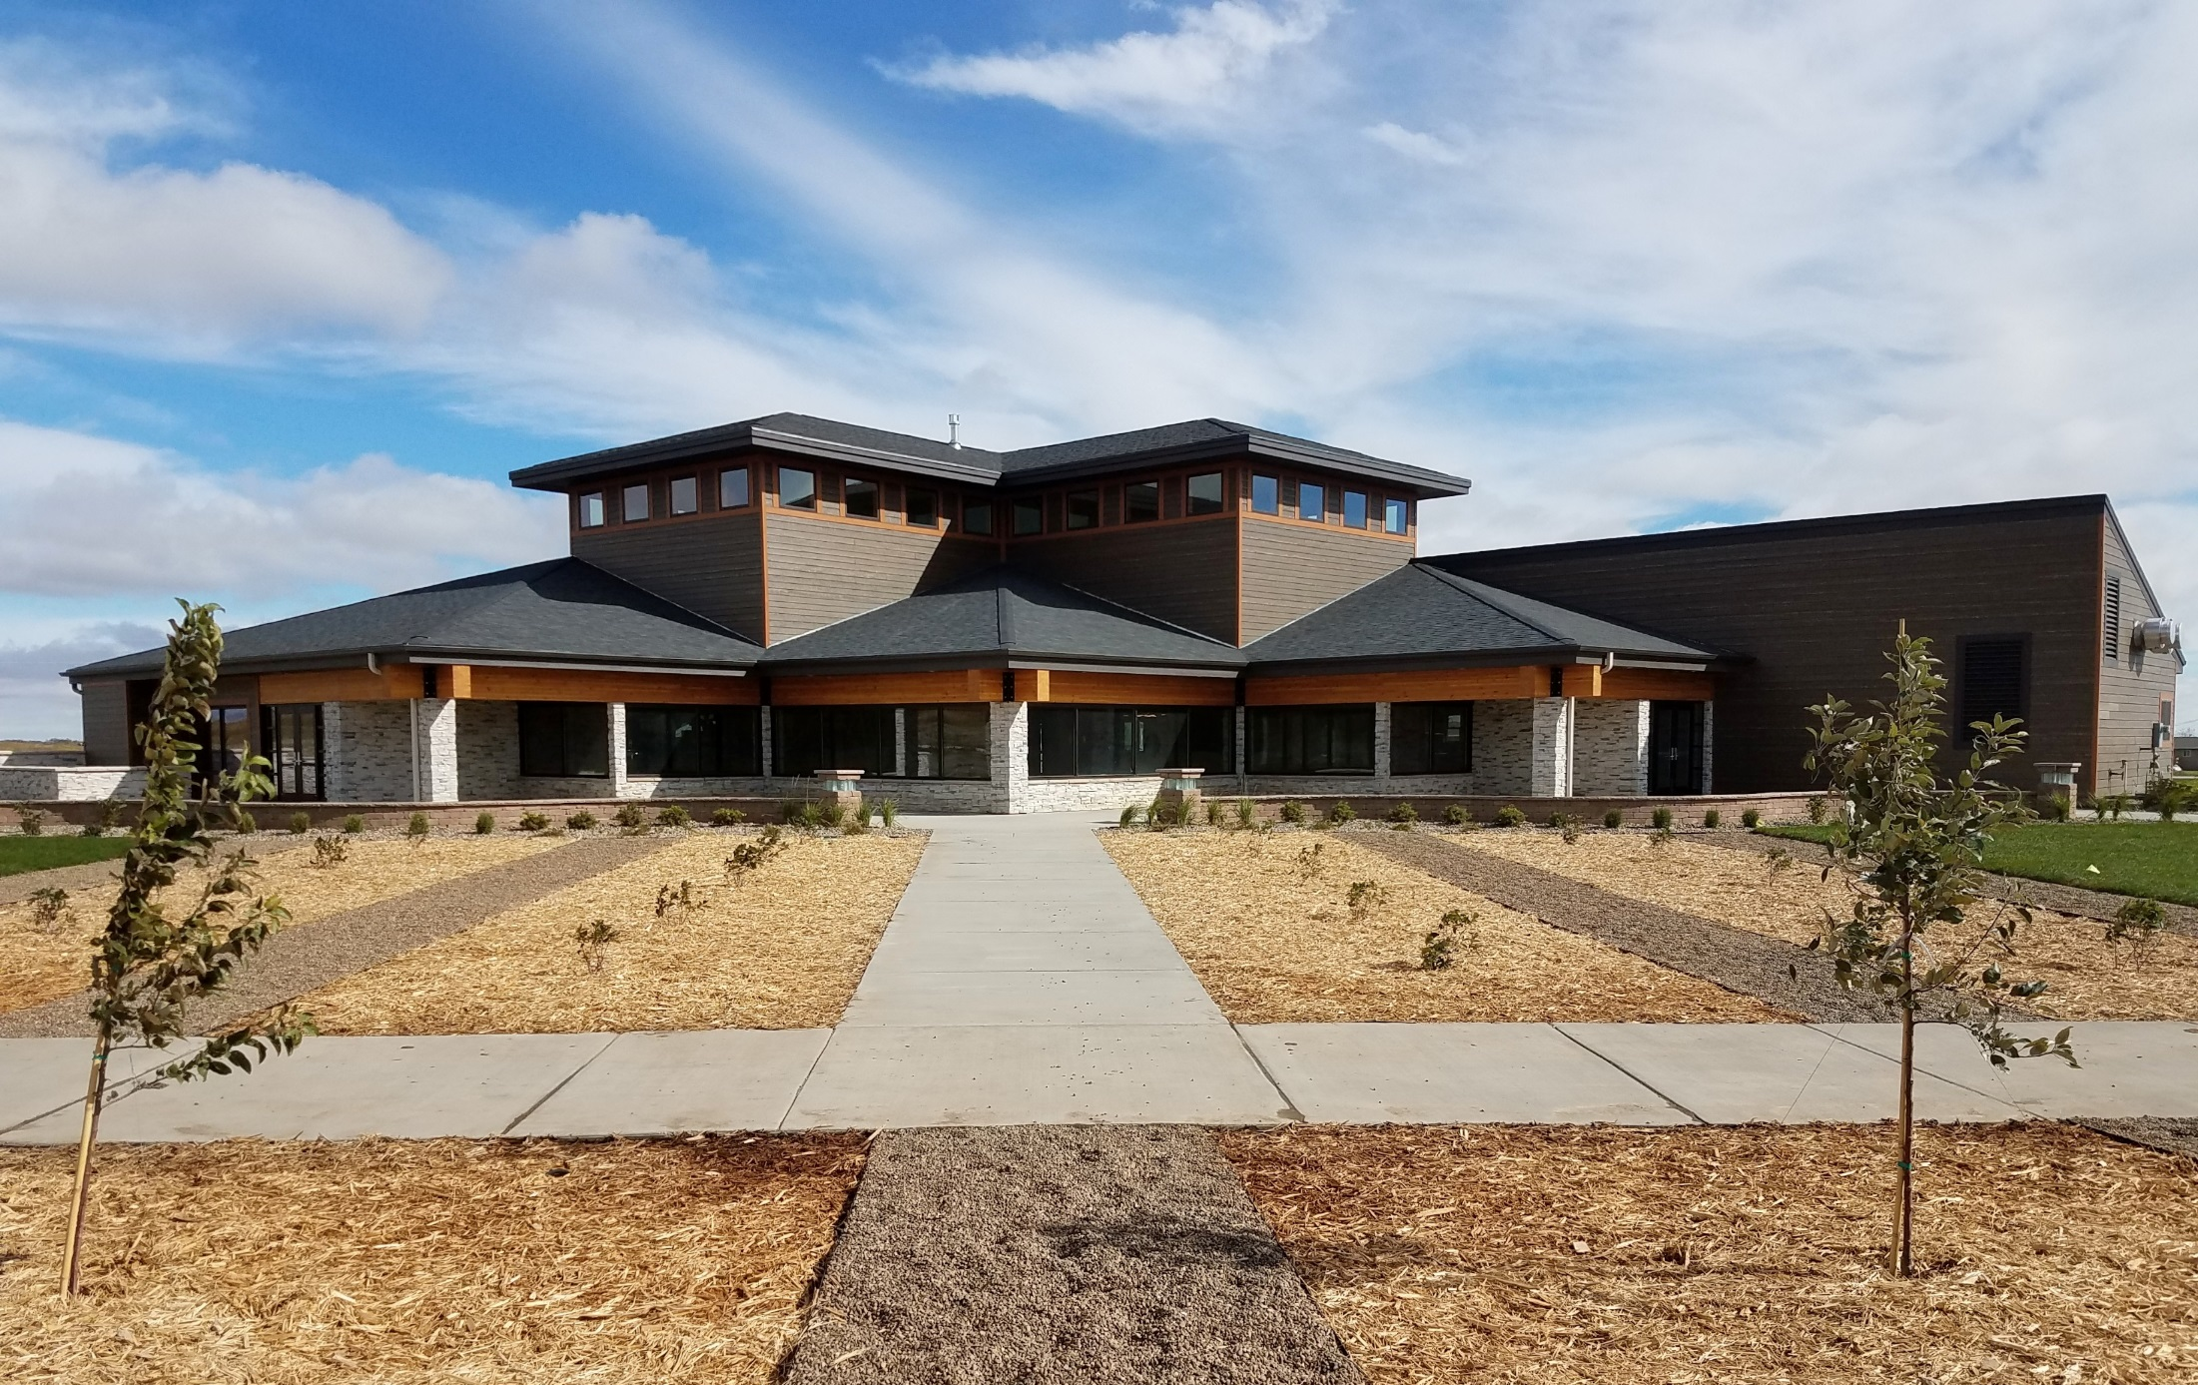
TWIN BUTTES ELDER CENTER
Twin Buttes, ND

Slide 31
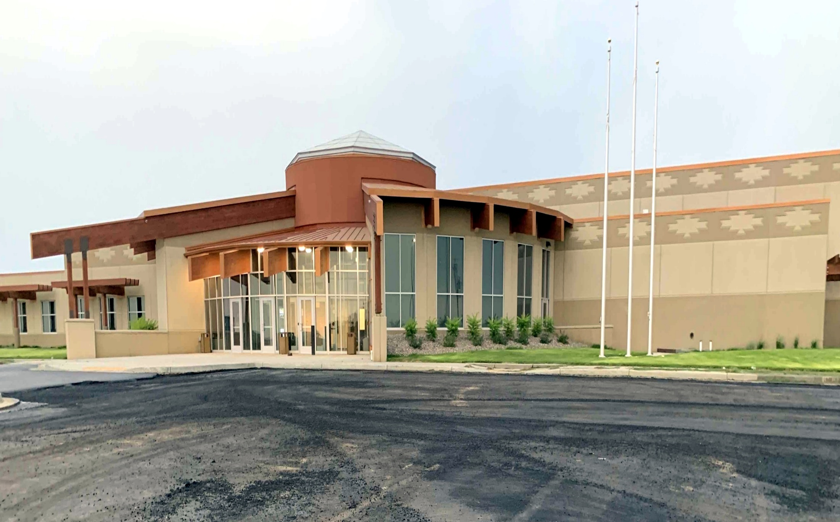
Twin Buttes Community Center
Twin Buttes, ND

Slide 32
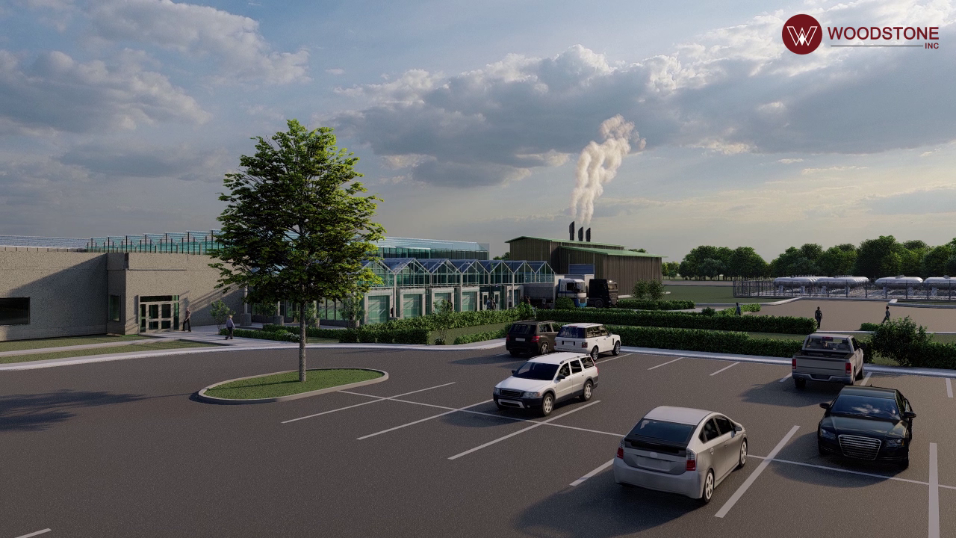
Gas Capture Greenhouse
Parshall, ND

Slide 33
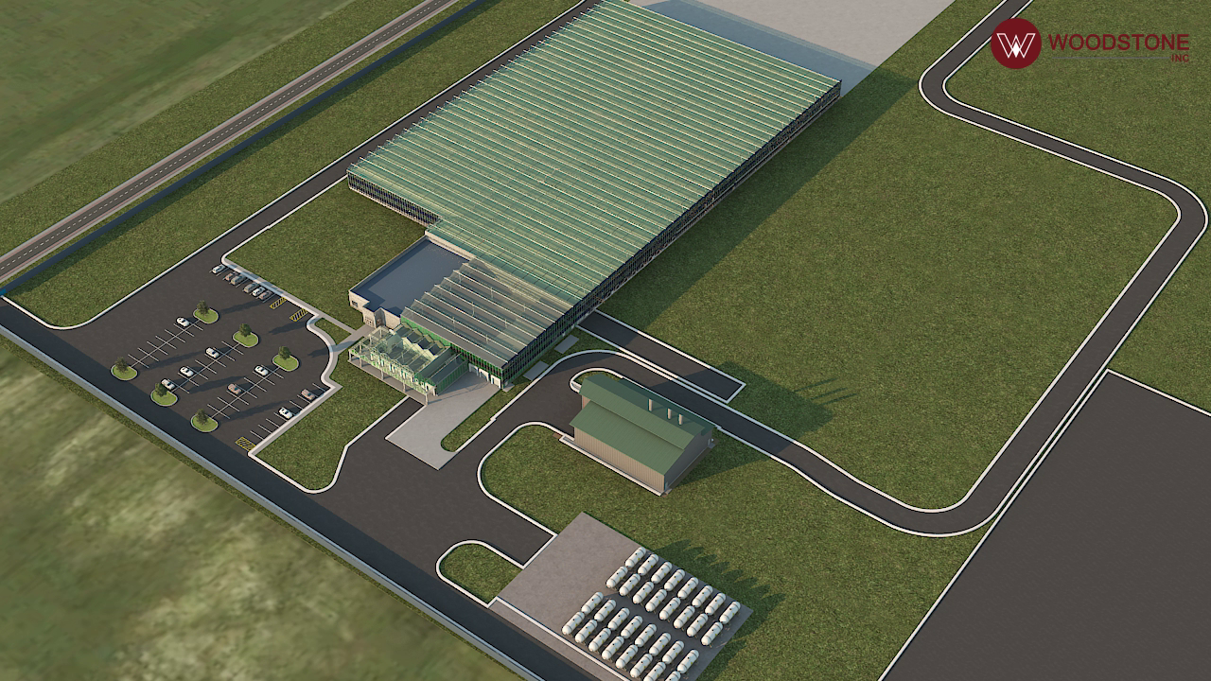
Gas Capture Greenhouse
Parshall, ND

Slide 34
MHA Parshall Assisted Living Facility
Parshall, ND

Slide 35
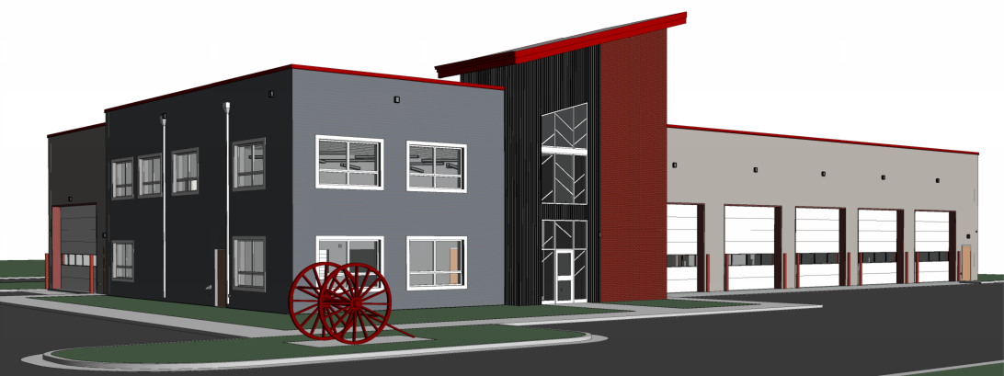
Dunseith Emergency Response Center
Dunseith, ND

Slide 36
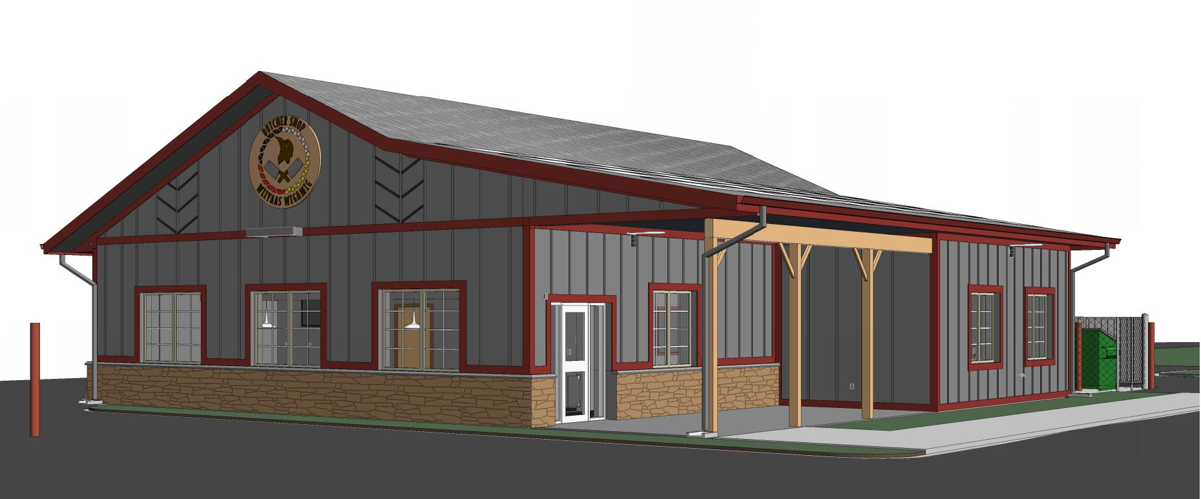
Dunseith Butcher Shop
Dunseith, ND

Slide 37
Dunseith Emergency Response Center
Dunseith, ND

Slide 38
Turtle Island Water Park
Belcourt, ND

Slide 39
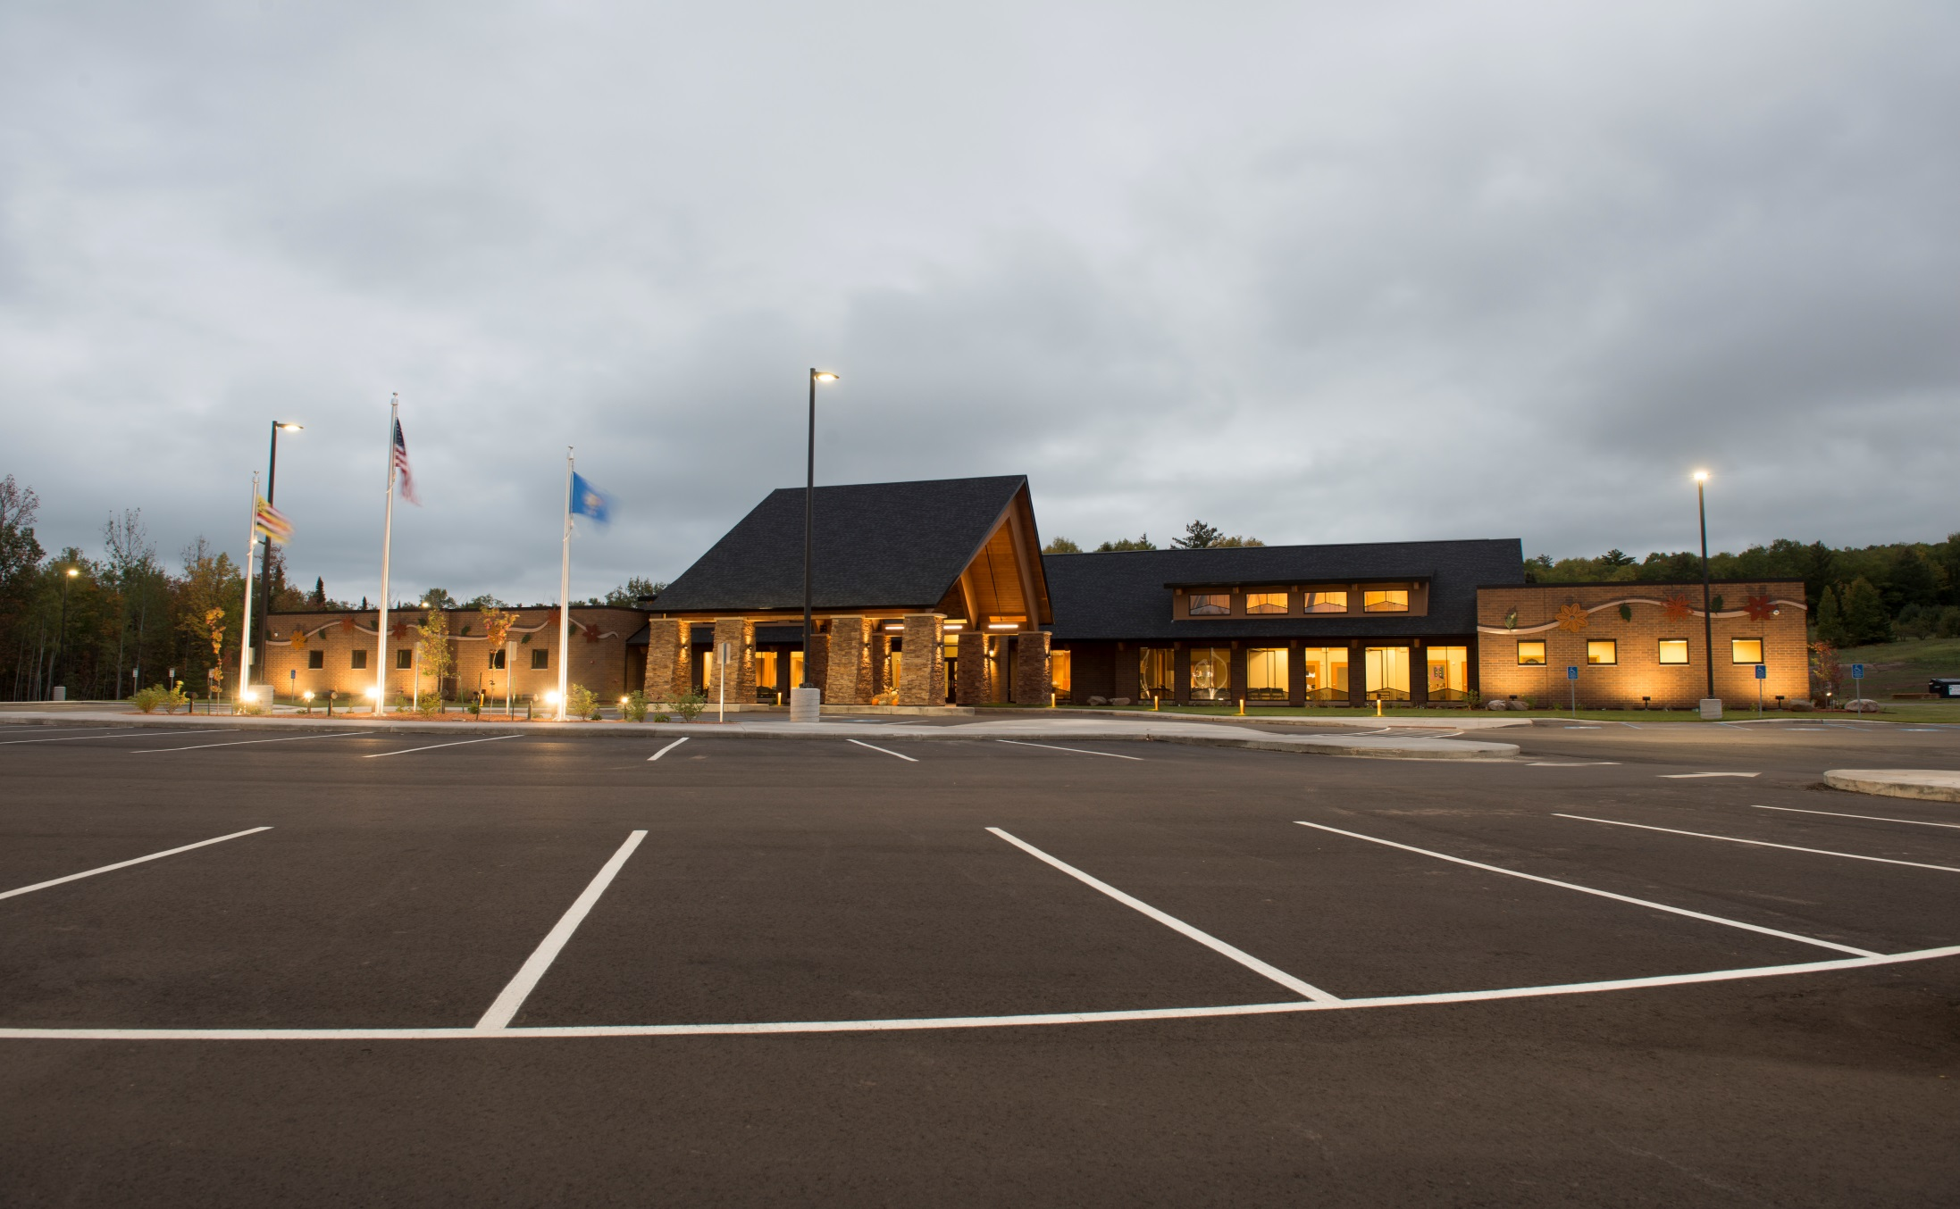
RED CLIFF MEDICAL CLINIC
Red Cliff, WI

Slide 40
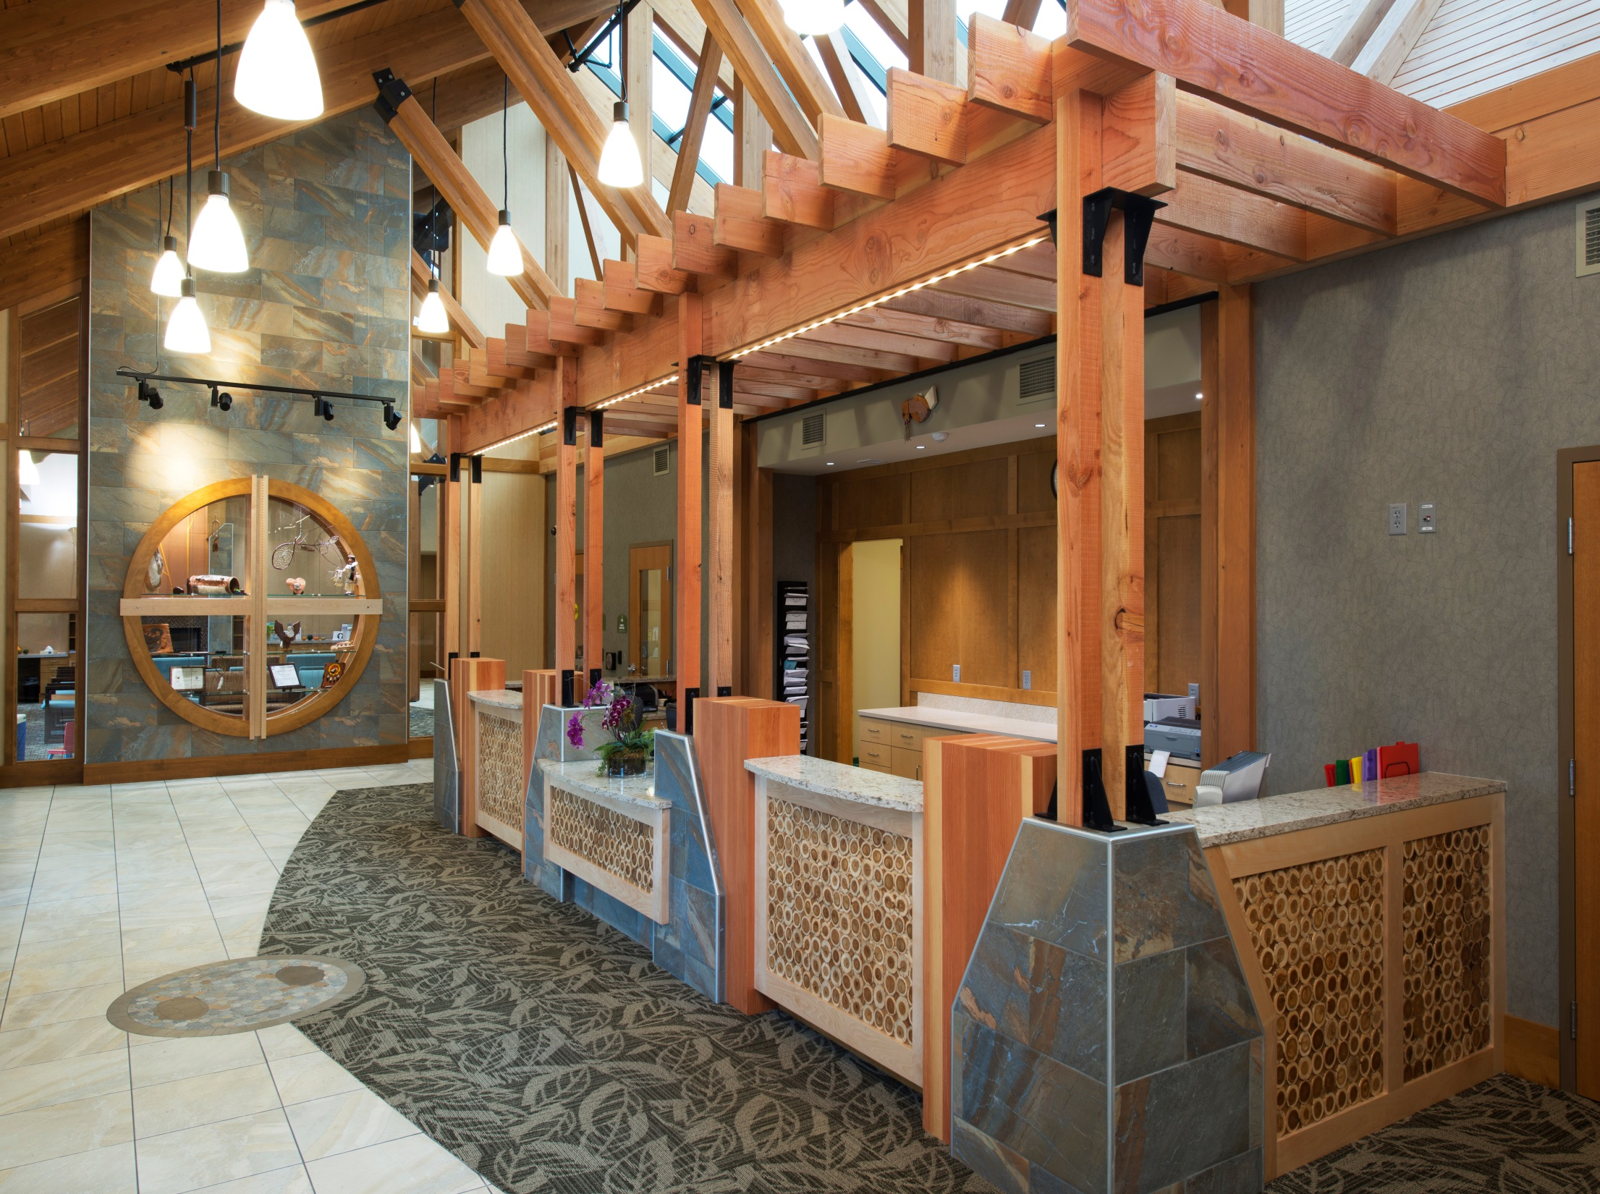
RED CLIFF MEDICAL CLINIC
Red Cliff, WI

Slide 41
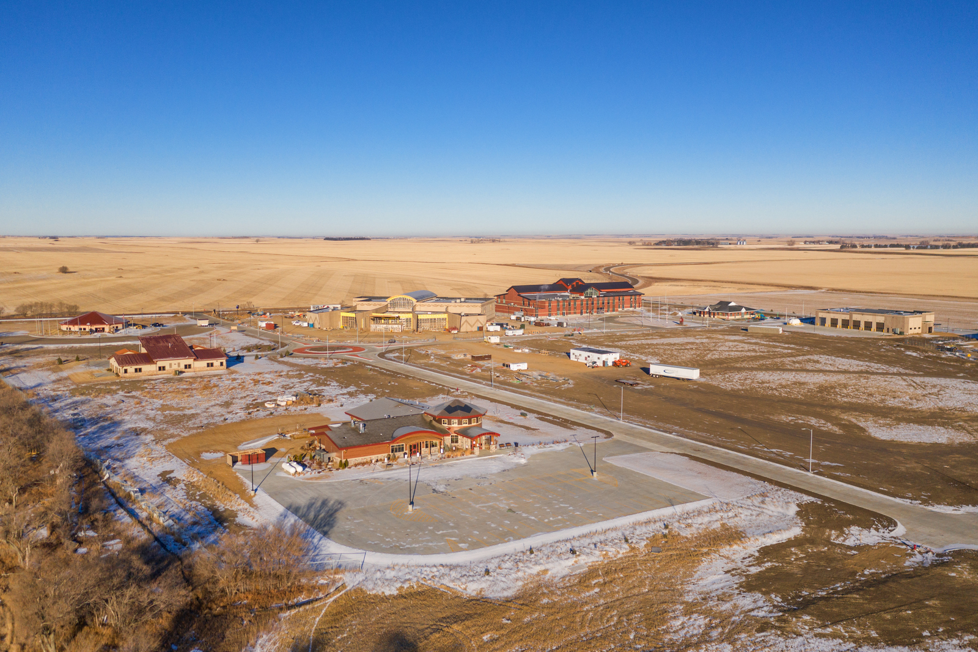
White Shield Master Plan
White Shield, ND
Ralph Wells
Community Center
Head
Start
Admin
Building
Bus
Garage
Medical
Clinic
Nishu Lodge
Elder Center

Slide 42
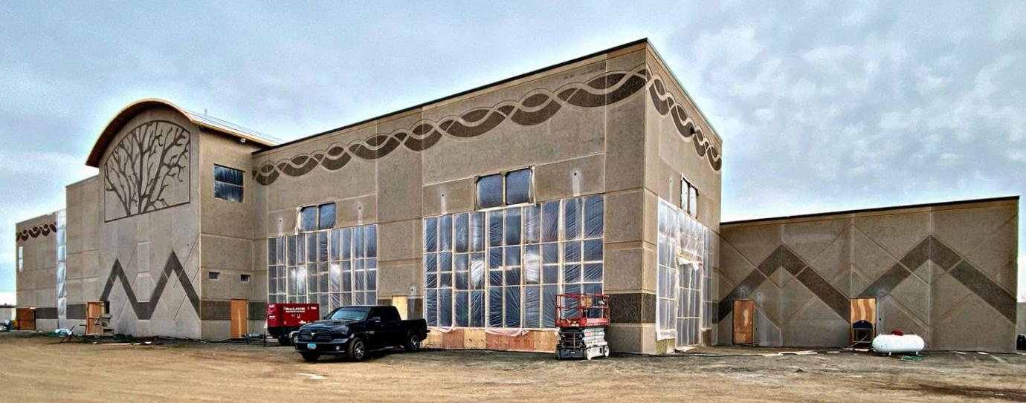
Ralph Wells Community Center
White Shield, ND
Ralph Wells
Community Center
Head
Start
Admin
Building
Bus
Garage
Medical
Clinic
Nishu Lodge
Elder Center

Slide 43
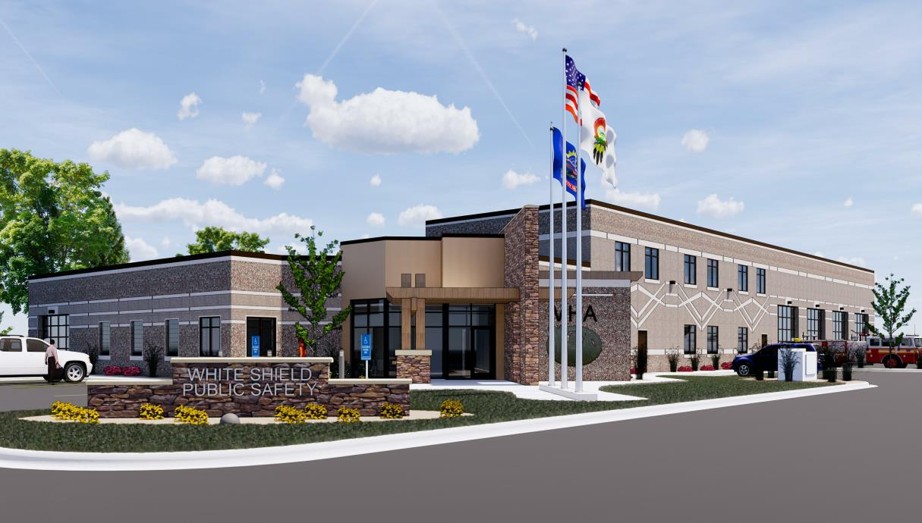
White Shield Public Safety
White Shield, ND
Ralph Wells
Community Center
Head
Start
Admin
Building
Bus
Garage
Medical
Clinic
Nishu Lodge
Elder Center

Slide 44
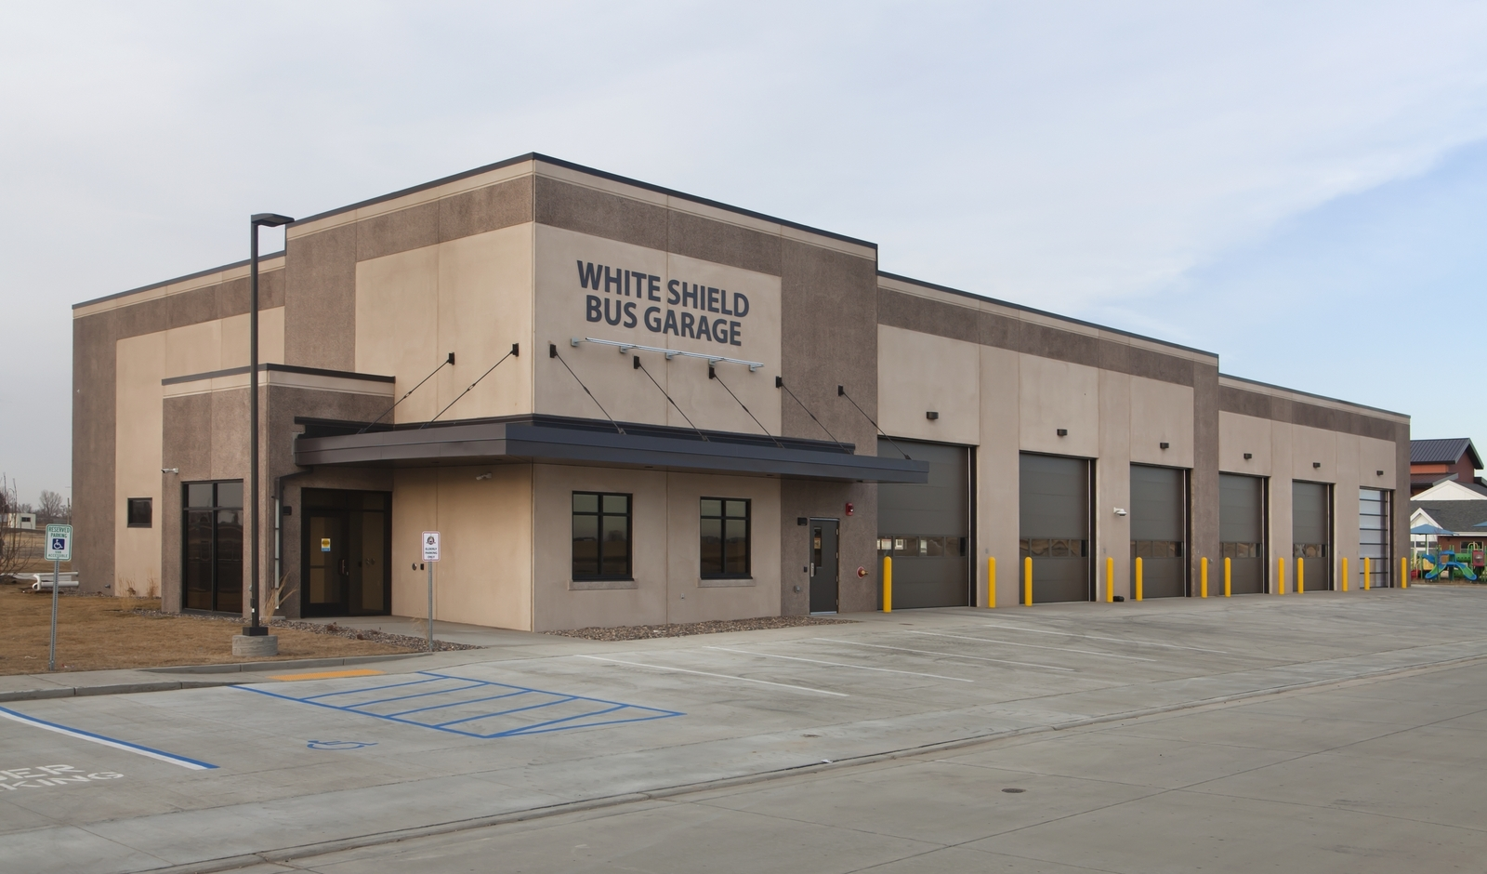
White Shield Bus Garage
White Shield, ND

Slide 45
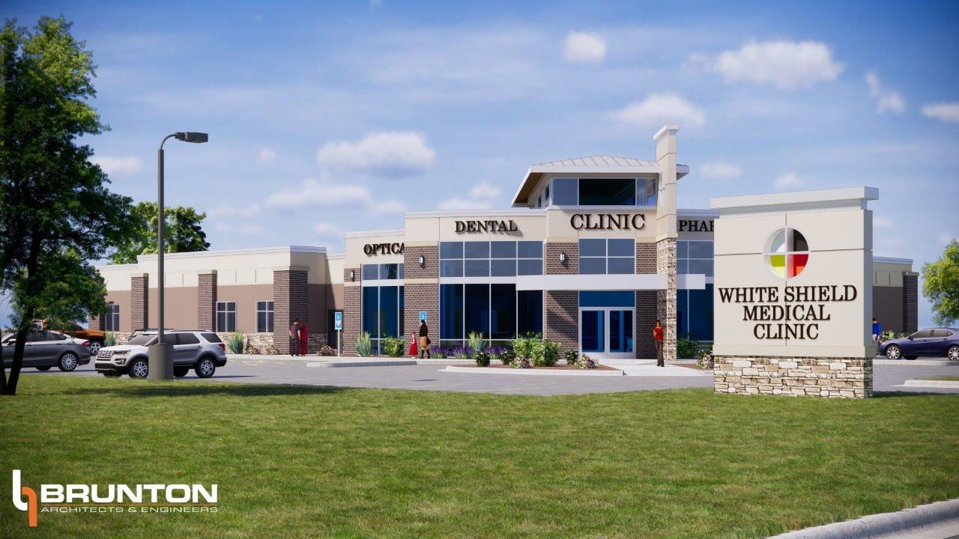
White Shield Medical Clinic
White Shield, ND

Slide 46
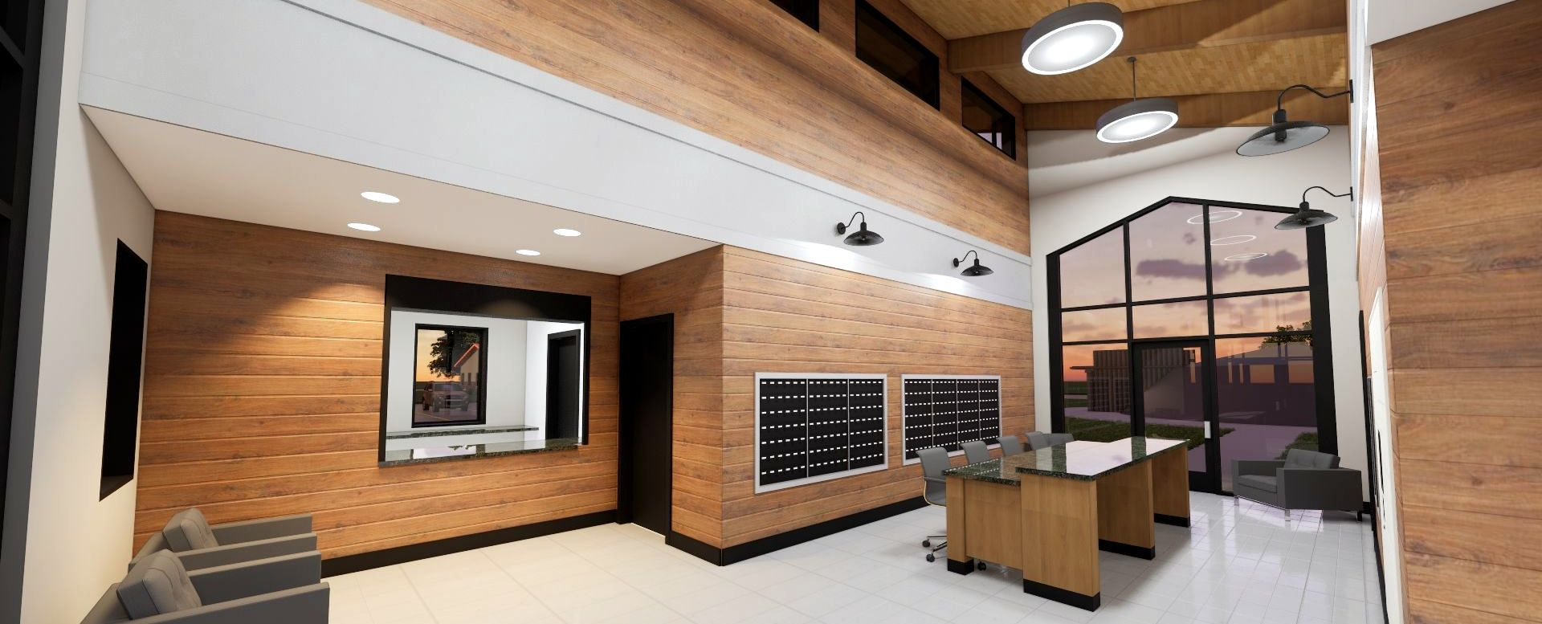
White Shield Post Office
White Shield, ND

Slide 47
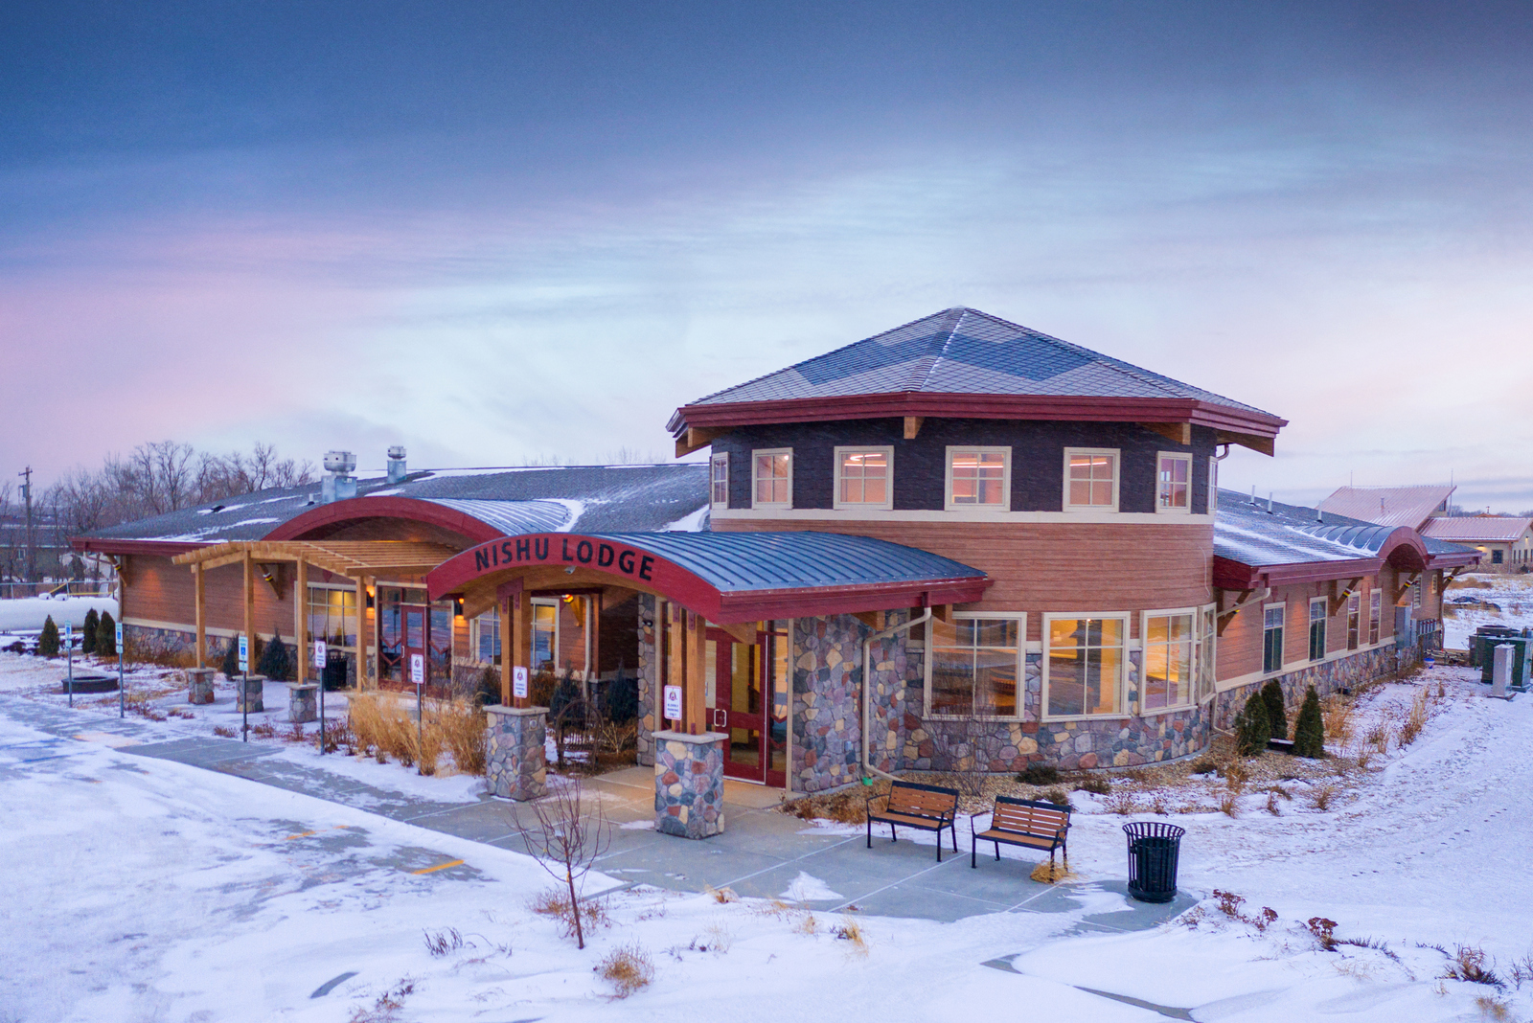
White Shield Elder Center
White Shield, ND

Slide 48
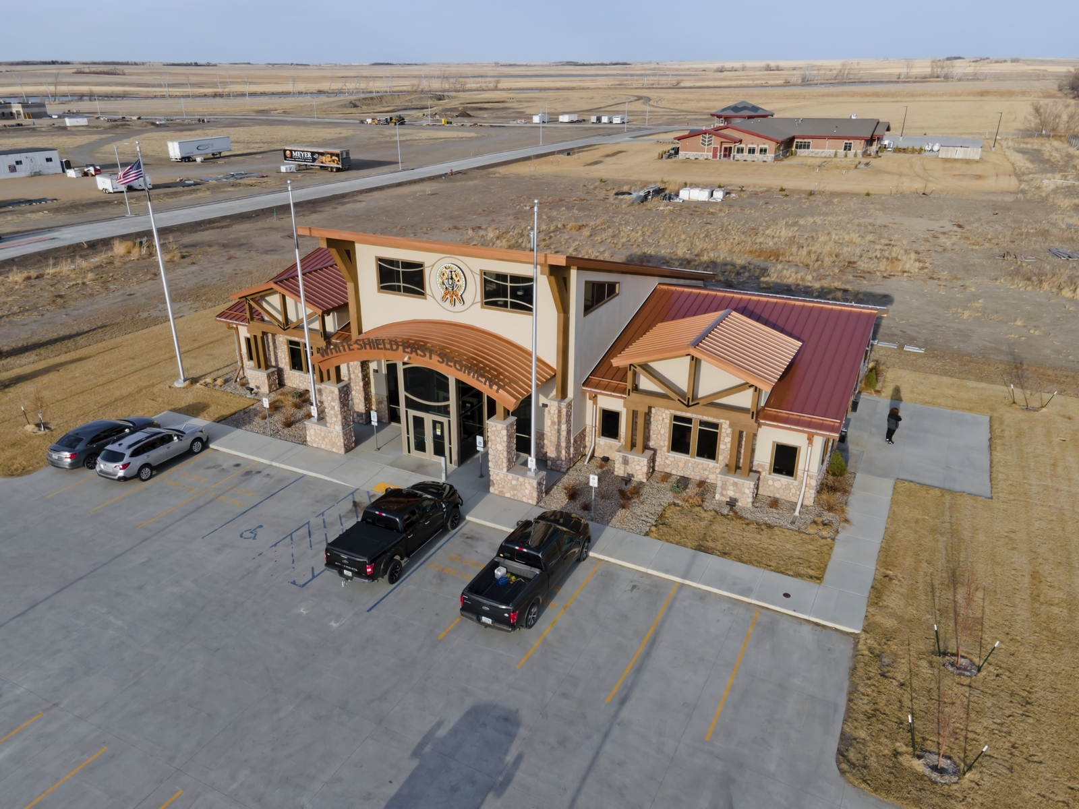
White Shield Admin Building
White Shield, ND

Slide 49
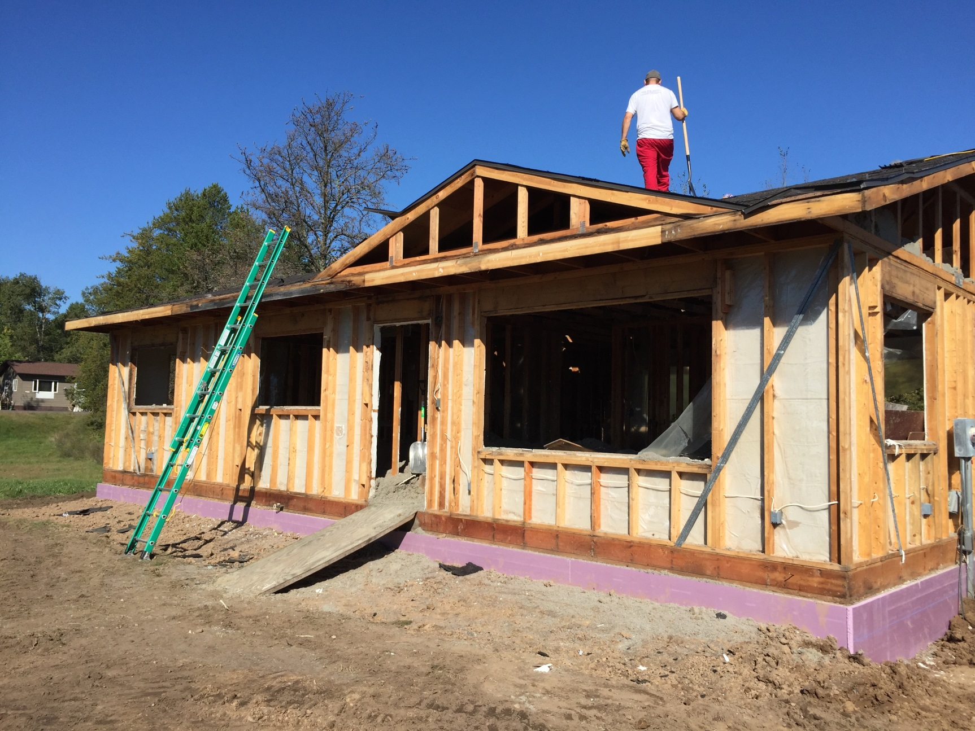
LCO HOUSING MODERNIZATION
Hayward, WI

Slide 50
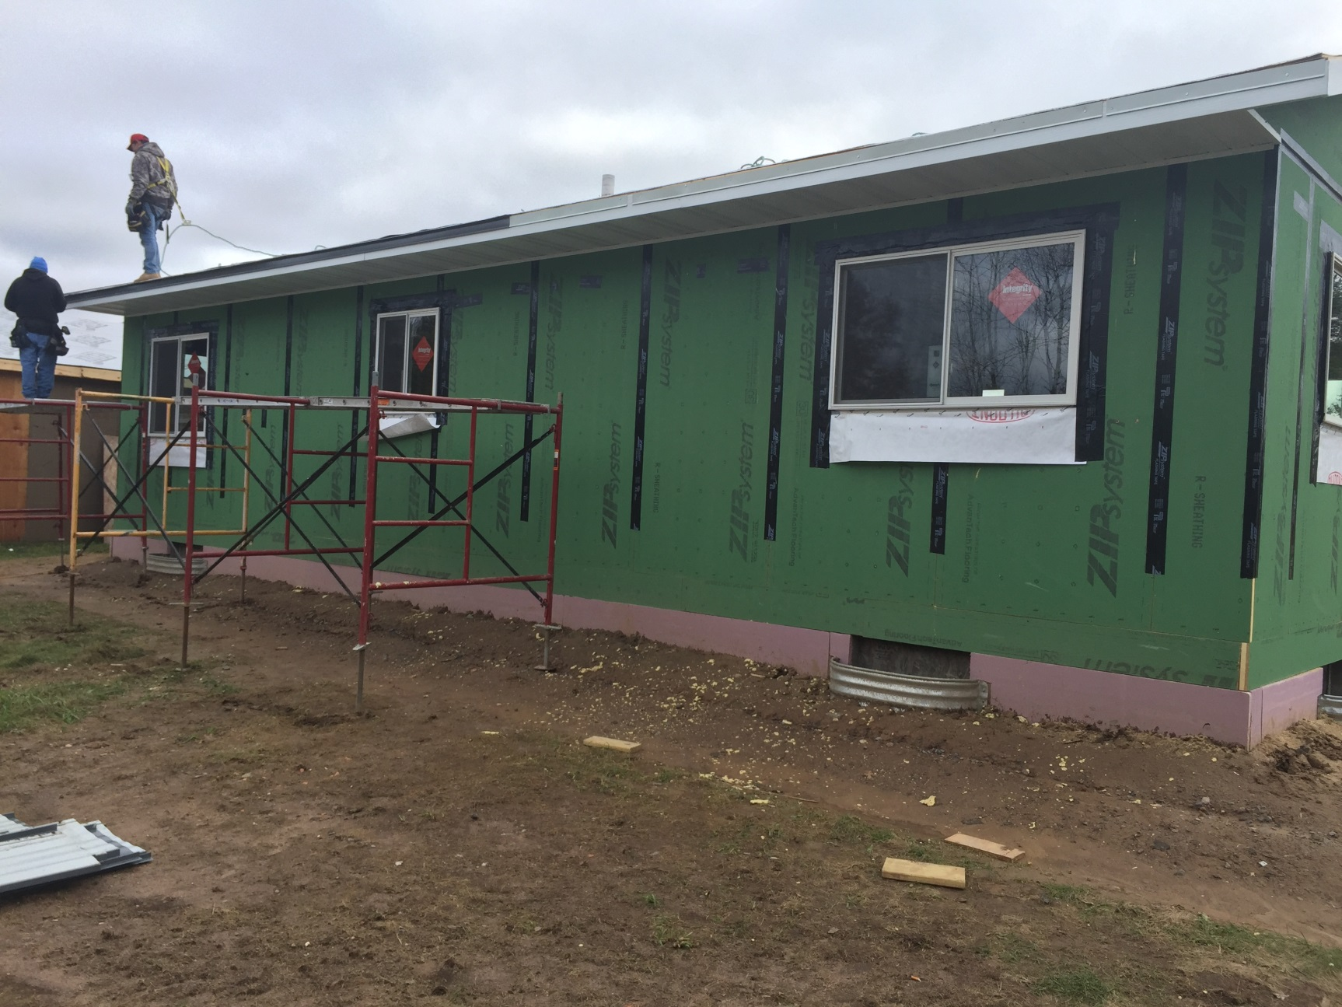
LCO HOUSING MODERNIZATION
Hayward, WI

Slide 51
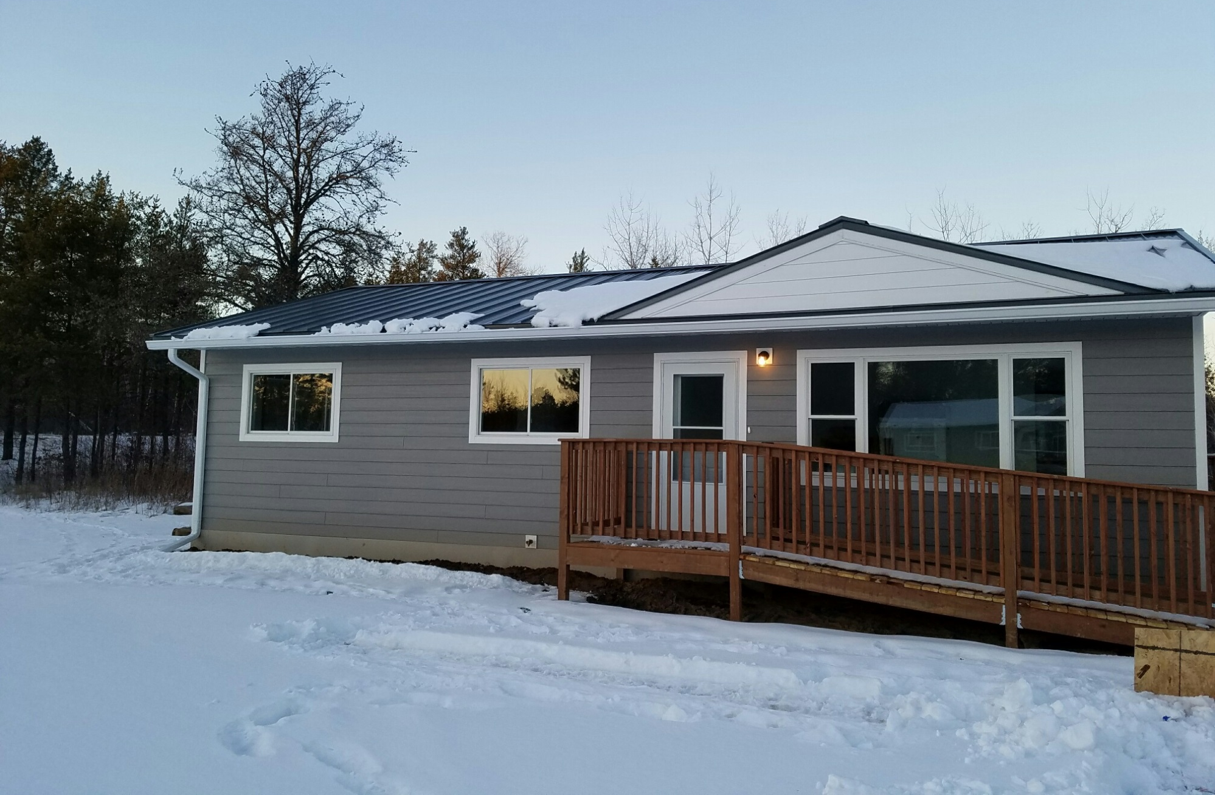
LCO HOUSING MODERNIZATION
Hayward, WI

Slide 52
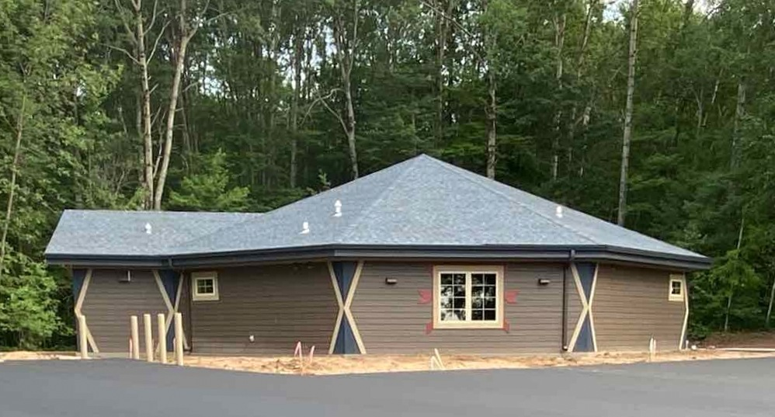
St. Croix Ceremonial Drum Building
Webster, WI

Slide 53
Mistequa Hotel
Chewelah, WA

Slide 54
JOB FAIRS AND MATTER OF RESPECT LUNCHEONS

Slide 55
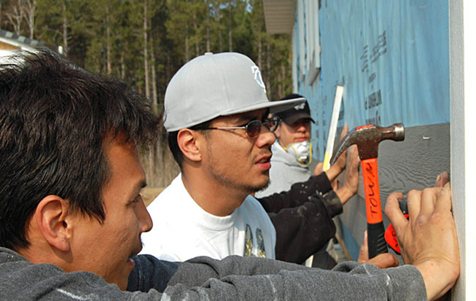
JOB FAIRS
Approach to Native American Employment
Provide a maximum opportunity for Native American involvement.
Meet or exceed employment goals for the Tribe.
Help further the economic development of Tribal members.

Slide 56
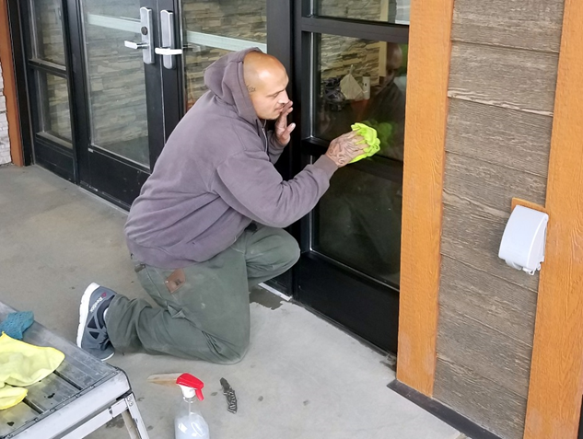
JOB FAIRS
Approach to Native American Employment
4. Work with the Tribe to determine what opportunities are available in the project for training, employment, and sub contracting. 5. Create a project specific action plan that would outline opportunities. This would enable the maximum number of Tribal Members to take advantage of the program.
6. Ensure that the Tribe’s money is going into the households of your Members.

Slide 57
JOB FAIRS
Approach to Native American Employment

Slide 58
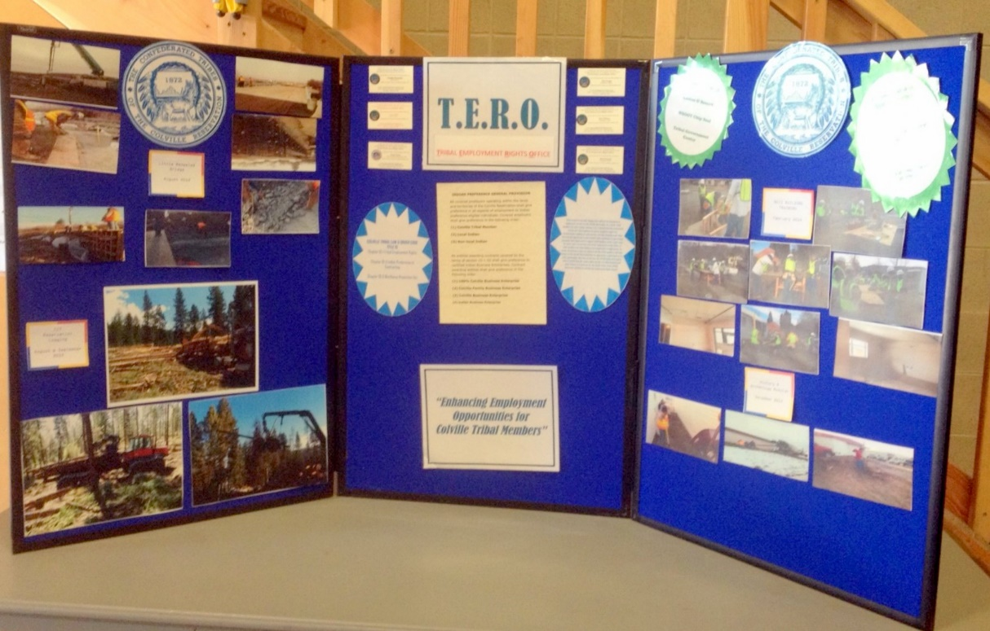
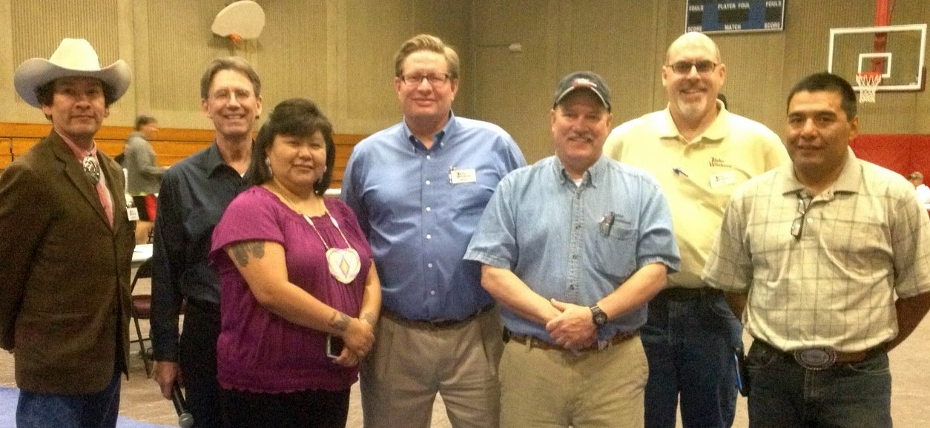
JOB FAIRS

Slide 59
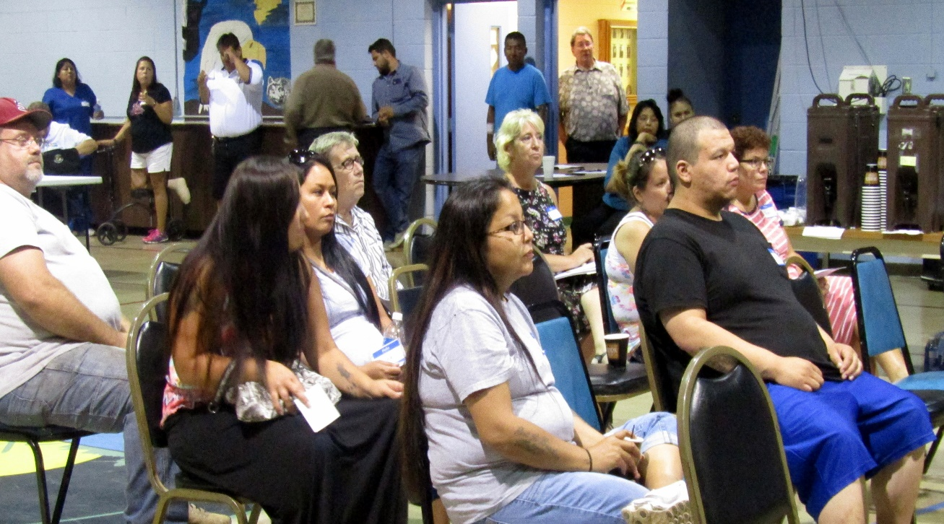
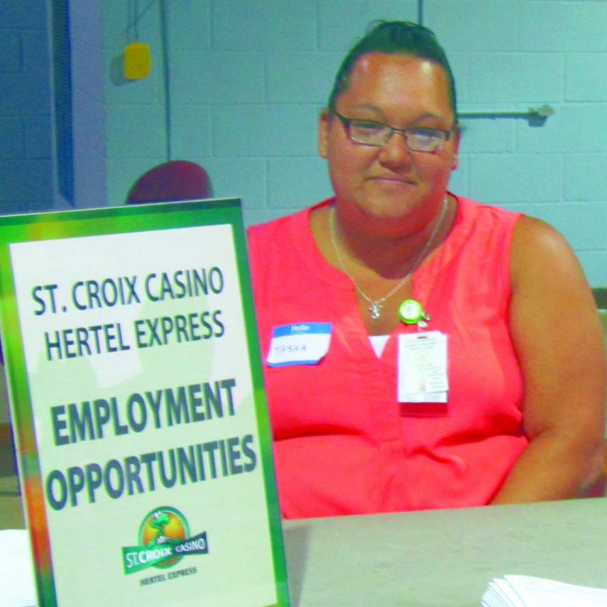
JOB FAIRS

Slide 60
Safety & Matter of Respect Luncheon

Slide 61
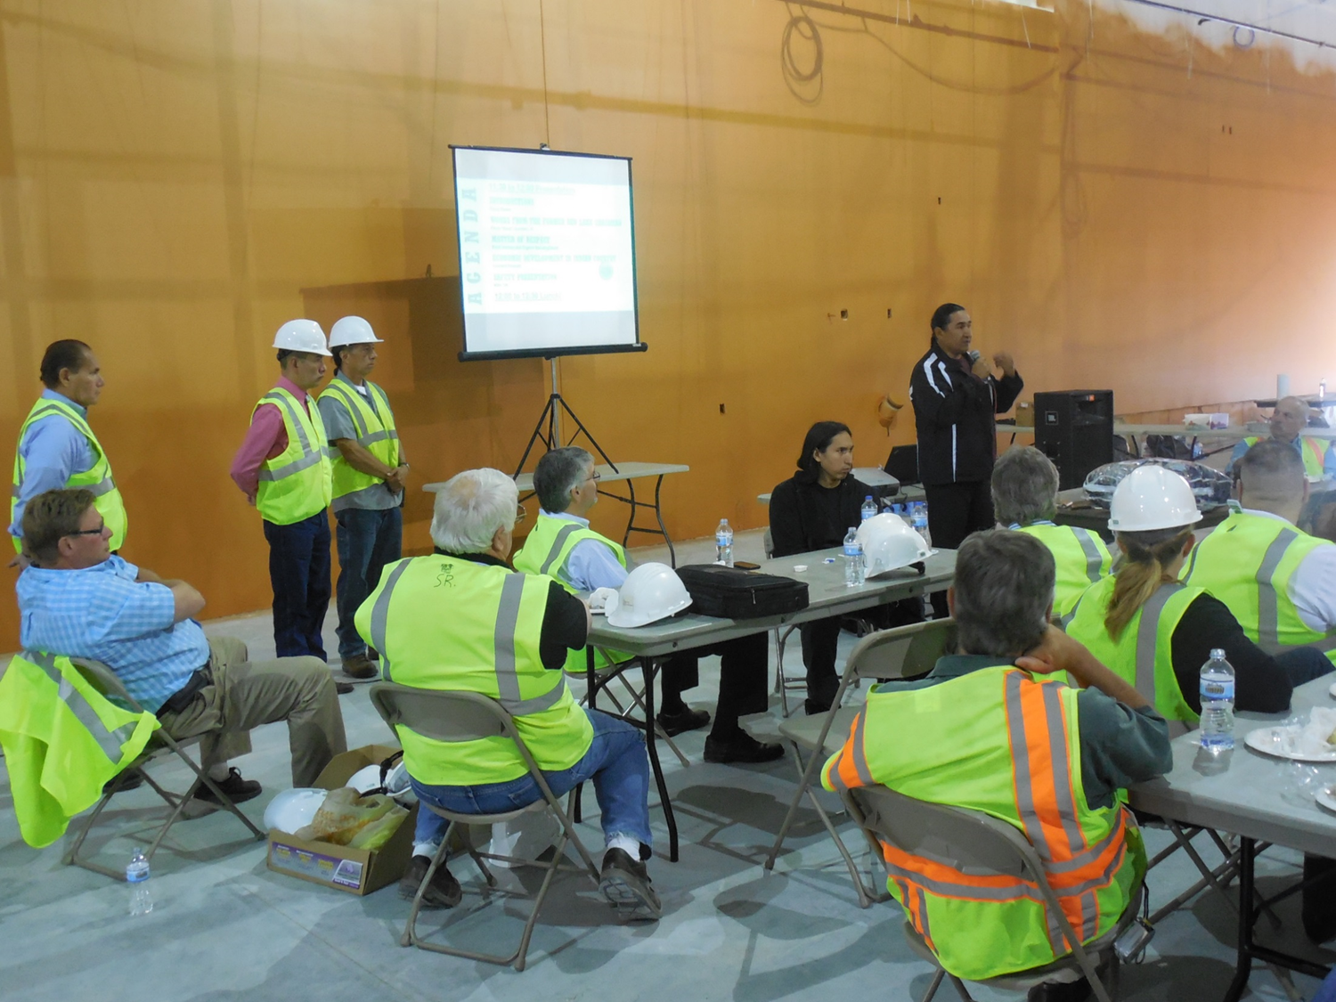
Safety & Matter of Respect Luncheon

Slide 62
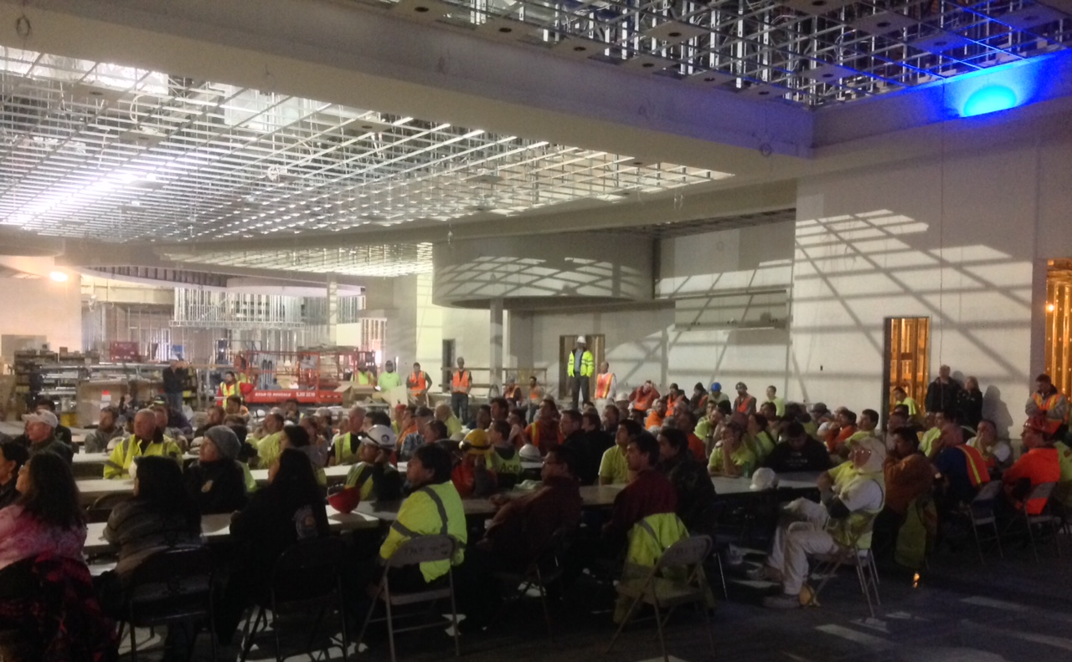
Safety & Matter of Respect Luncheon

Slide 63
TRIBAL HIRING SUCCESS

Slide 64
TRIBAL HIRING
% of Tribal Employment of Non-Core Crew
Red Lake 52%
Warroad 47%
Legendary
Waters 67%
Shoshone
Rose 42%
Ohiya 46%
Omak 69%

Slide 65
CLOSING

Slide 66
Tribal Employment
Recommendation Letter from the Colville Tribe’s TERO Department

Slide 67
LETTERS OF RECOMMENDATION
Shakopee Mdewakanton Sioux Community

Slide 68
LETTERS OF RECOMMENDATION
Shakopee Mdewakanton Sioux Community

Slide 69
Questions?

