Slide 1
COVID19 & Workforce:
Before, During, After
Terri Henry, EBCI TERO Director
CTER Board of Directors

Slide 2
Before COVID19
State of Indian Nations
  Indian Healthcare
    Medical care
    Mental health resources
  Child Welfare
  Estate Planning
  Tribal Economies
Reality of Indian people’s existence
  Unemployment
  Food deserts
  Substance Abuse
  . . .
  . . .
  . . .

Slide 3
During COVID19:
Will we survive?
Health Crisis; Employment Crisis; Education Crisis
Shortages
  Food, Water
  Vehicles
  Construction materials
  Fuel
Supply chain production impacts
  Farmers plowed under fields; no workers (Immigration Laws)
Individual gardening
Shut-downs, Furloughs
Tribal internet/broadband connectivity
  Telework
  Telemedicine
  Virtual education
Infrastructure/Roads
COVID Grants & Loans
  Pay attention to the conditions of the grants, may impact Tribal Indian Preference laws
  Strategic plans to use these resources

Slide 4
After COVID19:
When will it end?
Reality check
  Kids with no parents
  Parents with no kids
Medical & Mental Health Affects
  ADA/ADEA ?
Impact on Tribal Justice System
  Child placement
  Property distribution of deceased
What strategies will meet the basic needs of our People?
Economic development strategies
Health impacts
Employment/Workforce Development
  Historical grief & trauma
  “Hang around the fort”
Notes:
Learn to do for ourselves

Slide 5
Resilience:
Workforce Development
What strategies can we develop to begin changing the mindset of our people that “poverty is acceptable”?
  What are our basic needs?
    Shelter & Subsistence  Physical & Mental Health  Personal Safety  Personal Economy  Spiritual Harmony & Balance  . . .
  What are the “ends”?
    Home & Food/Water  Positive Life Experience  . . .
  How do we get to the “ends”?
    Employment
Can we develop a public relations campaign or marketing strategy to encourage our people towards EMPLOYMENT as a means to the ends?

Slide 6
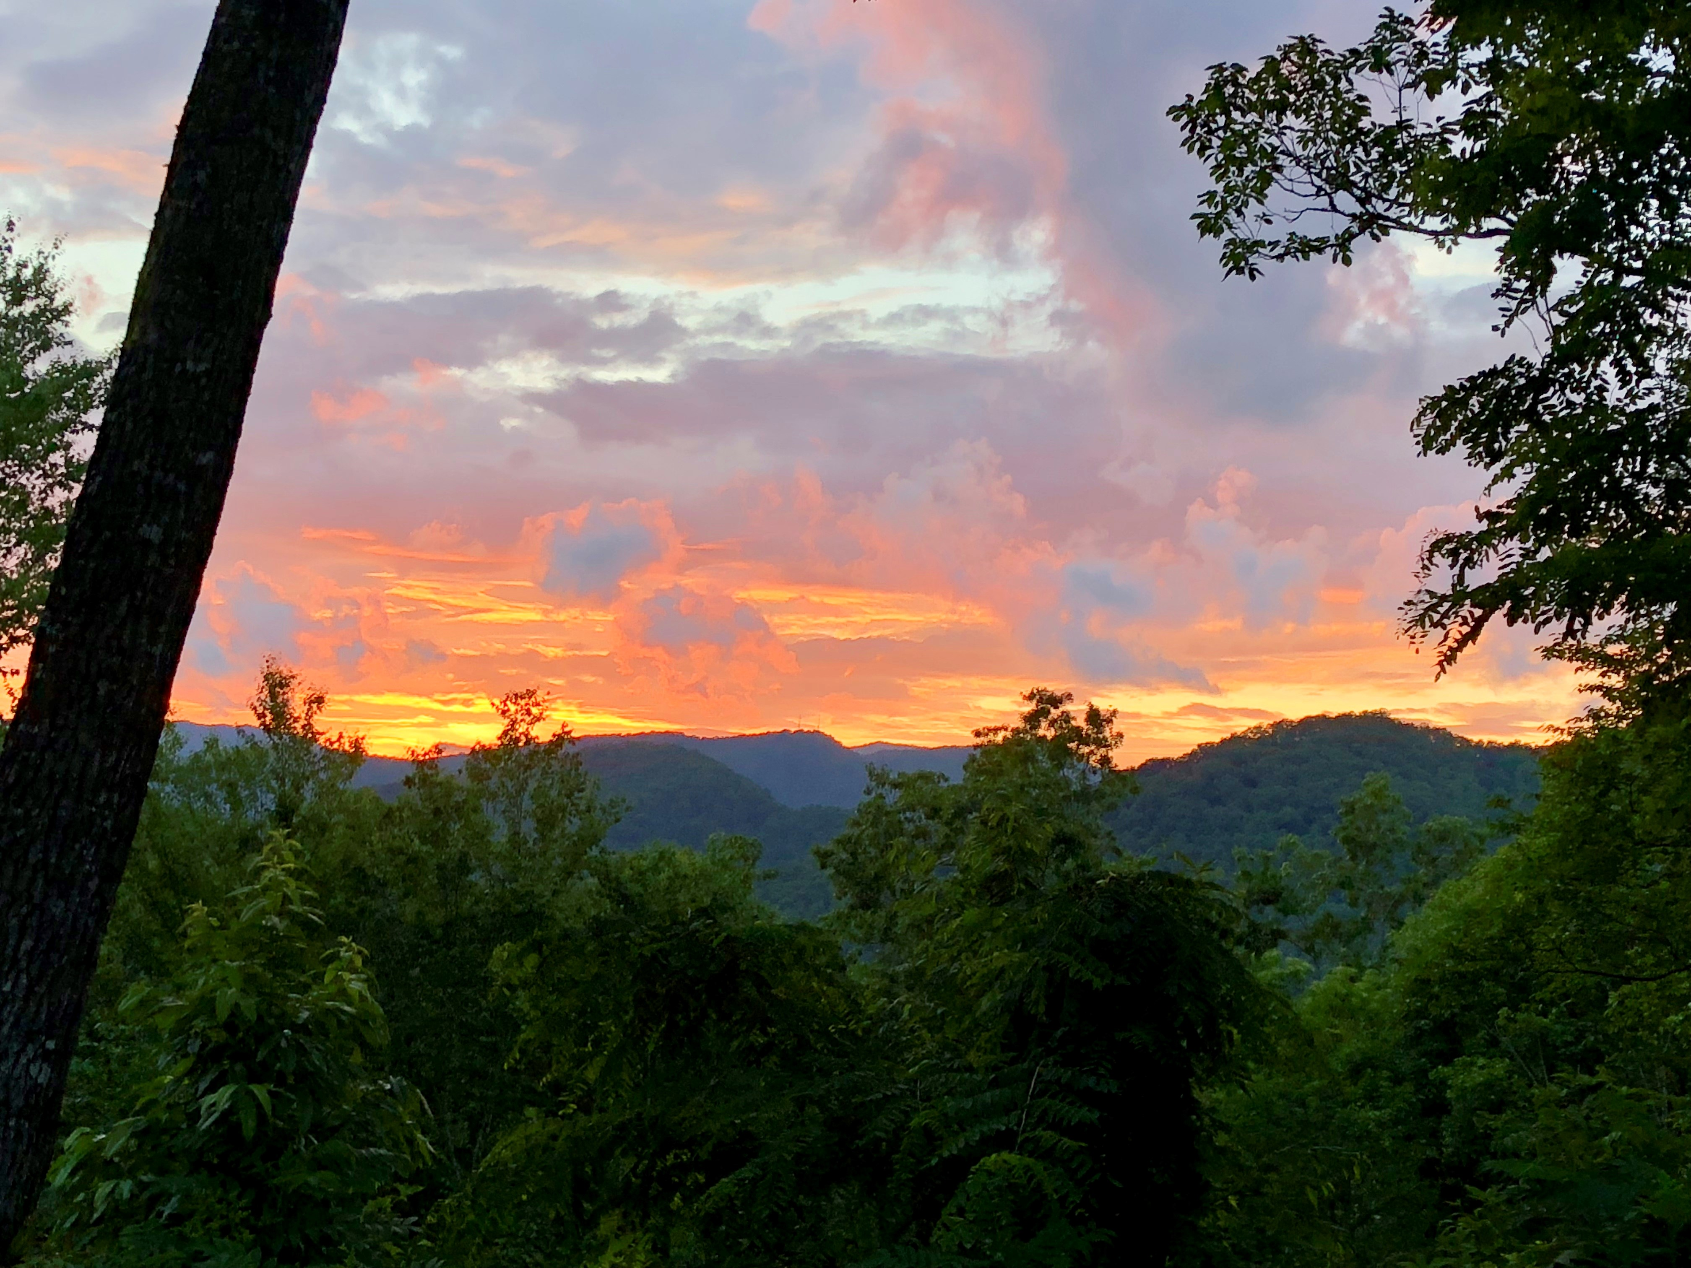
Thank you!

