Slide 1
Basic & advanced tero officers & commissioners training

Slide 2
TERO THE EMPOWERED WARRIORS "

Slide 3
TERO LEGAL FRAMEWORK

Slide 4
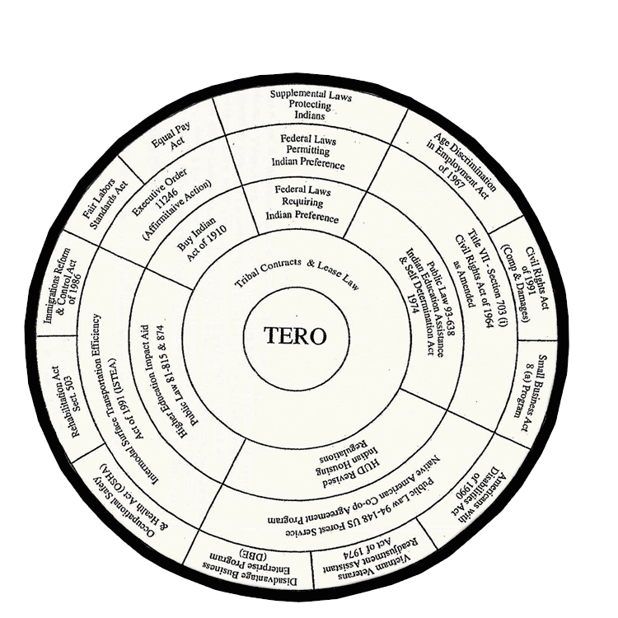

Slide 5
THE TERO ORDINANCE
Will not be covered in this presentation but is the core of tribal Indian preference Law.
The previous slide show’s the full scope of laws TERO’s tools use to protect there people

Slide 6
TRIBAL WORKFORCE PROTECTION ACT
WHAT:
Sovereignty-based legislation enacted by Tribal Governments to protect their diverse workforces from discrimination, harassment & disparate treatment based on race, color, gender, sexual preference, religion, national origin, or tribal affiliation.

Slide 7
TRIBAL WORKFORCE PROTECTION ACT
WHY NEEDED:
Tribes as sovereign governments are exempt from:
Title VII of the 1964 Civil Rights Act
Americans With Disabilities Act
Equal Pay Act
Americans With Disabilities Act
Section 503 of the Rehabilitation Act
Viet Nam Era Veterans Readjustment & Assistance Act
Occupational Safety & Health Act
Executive Order 11246 (Affirmative Action)
Notes:
7

Slide 8
TRIBAL WORKFORCE PROTECTION ACT
BEYOND PREFERENCE
WHAT DOES ACT DO?
Closes gaps in protection –Tribal Exemptions
Non-Indian Workforce
It’s good responsive, responsible government
It strengthen and legitimizes tribal sovereignty
It reduces the likelihood of federal intrusion into intramural employment matters.
It reduces the likelihood of union organizing
It’s the right thing to do

Slide 9
TRIBAL WORKFORCE ACT BEYOND PREFERENCE
BASIC REQUIREMENTS
Preference
Prohibits Discrimination (Title VII, age, sex etc.)
Sexual Harassment
Wage & Hour
Safety (TOSA)
Family Medical Leave

Slide 10
PART FOUR FEDERAL EMPLOYMENT LAWS

Slide 11
PART FOUR FEDERAL EMPLOYMENT LAW
Major Federal Laws that require
Indian Preference
INDIAN SELF-DETERMINATION & EDUCATION ASSISTANCE ACT (PL 93-638) SECTION 7b.
Preference required in:
Employment;
Training;
Sub-contracting.
* Key note: Tribal Preference OK

Slide 12
PART FOUR FEDERAL EMPLOYMENT LAW (CONTINUED)
Enforcement Authority/Responsibility
Bureau of Indian Affairs (BIA)
Indian Health Service (IHS)
Tribal Housing Authority (IHA)
*Key Point: Tribal Preference allowed under 1990 Amendments
**Ideal TERO /Agency Relationship: Collaboration

Slide 13
PART THREE FEDERAL EMPLOYMENT LAW
NAHASDA -HUD INDIAN PREFERENCE REGS.
Housing regulations 1003.510 & PL 93-638 -Section 7b Applies
Preference is required in:
Employment;
Training;
Contracting;
Sub-contracting.
*Enforcement: Tribal Housing Authority

Slide 14
Major Federal Laws That Permit Indian Preference
TITLE VII of the Civil Rights Act (1964)
General Provisions:
Prohibits discrimination on the basis of race, color, religion, sex or
national origin.
Act amended in 1978 to include the Pregnancy Discrimination Act.
Coverage: All employers with 15 or more employees

Slide 15
TITLE VII of the Civil Rights Act (1964)
Coverage:
Key Points relative Indian Preference 703(i):
Indian Preference is not race based…it is based on unique status of Indian people with US GOV
Permits Indian Preference - does not require
Requires employer to post public announcement
Does not allow Tribal Preference
Law exempts Tribal governments /enterprises
Enforcement : EEOC / Contracted TEROs

Slide 16
TITLE VII of the Civil Rights Act (1964)
EEOC / TERO CONTRACTS:
Government to Government agreement;
Authorize TERO to take Title VII Charges;
30 days to conciliate then defer to EEOC;
Fixed contracts of $25,000;
Annual professional training;
T/A assistance on request

Slide 17
TITLE VII of the Civil Rights Act (1964)
SEXUAL HARASSMENT
Is described as unwelcome sexual advances, requests for sexual favors, and other verbal or physical conduct of a sexual nature constitute sexual harassment when this conduct explicitly or implicitly affects an individual's employment, unreasonably interferes with an individual's work performance, or creates an intimidating, hostile, or offensive work environment.

Slide 18
TITLE VII of the Civil Rights Act (1964)
A HOSTILE WORKPLACE ENVIRONMENT: Is described as:
“A workplace where an employee work performance is affected because they experience workplace harassment, unwelcome actions, offensive, and intimidating behavior and results in their dreading going to work because of the oppressive and uncomfortable atmosphere created by the harasser”

Slide 19
TITLE VII of the Civil Rights Act (1964)
GENETIC DISCRIMINATION
Under Title II of GINA, it is illegal to discriminate against employees or applicants because of genetic information. Title II of GINA prohibits the use of genetic information in making employment decisions, restricts employers and other entities covered by Title II from requesting, requiring or purchasing genetic information, and strictly limits the disclosure of genetic information.

Slide 20
EXECUTIVE ORDER 11246
General Provisions:
Prohibits Discrimination
Calls for Affirmative Action
*Indian Preference under EO 11246:
Allows Indian Preference on or near;
Prohibits Tribal Preference
Defines “on or near reservation”
Enforced by OFCCP
TERO / OFCCP Relationship
37yrs MOU Partnering Relationship
Provides Training T/A & Support

Slide 21
FHWA EMPLOYEMNT REGULATIONS & INDIAN PREFERENCE
FHWA REGULATIONS 23 U.S.C. Section 140(d) – Permits Indian Preference;
TITLE VII-Section 703(i) – Permits Indian Preference
EXECUTIVE ORDER 11246 – Permits IP on or near reservations.
* FHWA NOTICE

Slide 22
GENRAL EEO/AFFIRMATIVE ACTON LAW
ADA–Prohibits discrimination against handicapped;
FMLA-12 weeks leave for family illness;
FLSA-overtime/compensatory time;
ADEA- Prohibits discrimination against people 40yrs and over;
EPA-must pay equal pay for equal work
Davis Bacon Act-Must pay prevailing wage
OSHA-protects work place safety
503 RA-Prohibits discrimination of handicapped and Require reasonable accommodation.
** TERO also uses State Employment Laws

