Slide 1
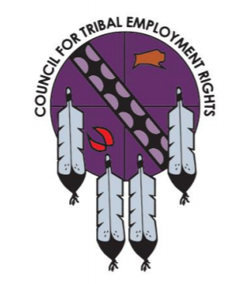
Council for Tribal Employment Rights
Legal Update 2019 – Las Vegas, Nevada
Dan Press & Laura Jones

Slide 2
Legal Basis for Tribal Employment Authority
Sovereignty
American Indian Tribes are independent political entities, whose sovereign authority existed long before the formation of the United States government.
Tribes possess inherent sovereignty to “make their own laws and be ruled by them.” Williams v. Lee, 358 U.S. 217, 220 (1959)
Statutory Authority
Tribes’ sovereign right to govern employment issues has been recognized by federal statute, e.g.:
Title VII of the Civil Rights Act of 1964; Americans with Disabilities Act
Judicial Case Law
Federal courts have upheld tribes’ authority to govern tribal employment/tribal hiring preference, e.g.:
Morton v. Mancari, 417 U.S. 535 (1974); EEOC v. Cherokee Nation, 871 F.2d 937 (10th Cir. 1989)

Slide 3
Indian Preference
A tribe may use its sovereign governmental powers to require employers on its reservation to give preference to Indians – if that employer is subject to the tribe’s jurisdiction.
Foundation for Indian preference in Title VII
Title VII contains general non-discrimination principles for employers. But Section 703(i) allows certain employers to exercise employment preference in favor of Indians.
Morton v. Mancari, 417 U.S. 535 (1974) – Indian preference in hiring is not racial discrimination

Slide 4
Tribal Jurisdiction over Non-Indians
Montana v. United States, 450 U.S. 544, 565 (1981)
General rule that Tribes lack civil jurisdiction/regulatory authority over non-Indians on non-Indian fee land within the reservation. There are two exceptions to this general rule (the Montana Test):
A tribe may regulate the activities of nonmembers who enter consensual relationships with the tribe or its members; or
A Tribe may regulate “the conduct of non-Indians on fee lands within its reservation when that conduct threatens or has some direct effect on the political integrity, the economic security, or the health and welfare of the tribe.”

Slide 5
Montana’s Exceptions are Narrow
Montana’s limitations only apply to tribes’ regulation of non-Indians on non-Indian land – not on tribal land.
New Mexico v. Mescalero Apache Tribe, 462 U.S. 324, 333 (1983):
“A tribe’s power to exclude nonmembers entirely or to condition their presence on the reservation is . . . well established.”
Montana did not apply to a case regarding a tribe’s regulatory authority over nonmembers on trust land because “Montana concerned lands located within the reservation but not owned by the Tribe or its members”

Slide 6
Tribal Jurisdiction over Rights-of-Way (State Highway Projects over the Reservation)
Strate v. A-1 Contractors, 520 U.S. 438, 454 (1997)
Auto collision occurred on a road that went through the Ft. Berthold Reservation in North Dakota. The road was built on a right-of-way that was granted to North Dakota and was maintained and controlled by the State.
Applying the Montana Test, the Court found that it did not meet either of the exceptions

Slide 7
What this means for TERO
When thinking about enforcement of Tribal employment authority, it is important to consider whether the Tribe has jurisdiction over the employer
For rights-of-way, under the BIA’s updated Right-of-Way Regulations that were released in 2016, Tribes can negotiate to ensure that TERO laws and regulations are mandatory for activities that occur on the right-of-way (construction, maintenance, etc)

Slide 8
VNF Native Affairs
Dan Press
DPress@vnf.com
Laura Jones
LJones@vnf.com

