Slide 1
Bruin TERO Presentation
December 4, 2019

Slide 2
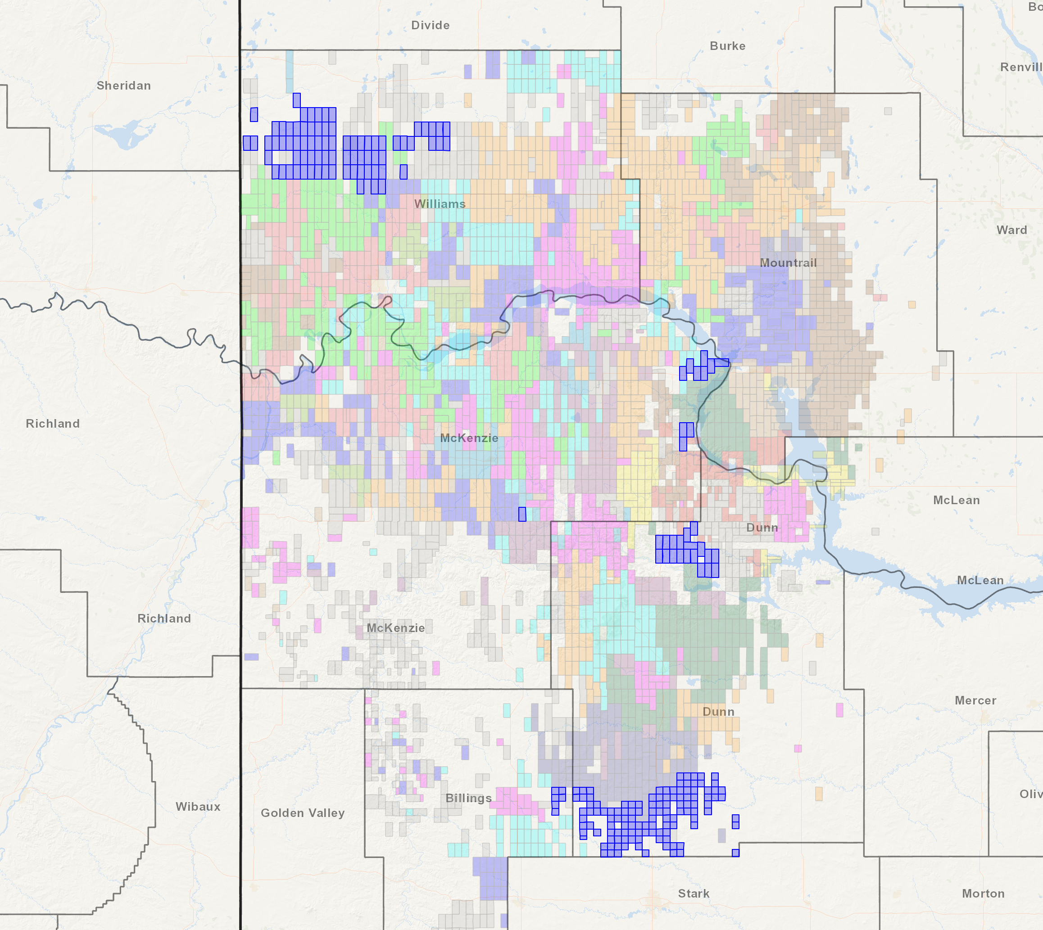
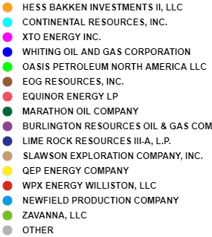
Company Overview
Asset Map
Summary
Bruin is an independent exploration and production company backed by affiliates of ArcLight Capital
Bruin is focused on operating and developing oil & gas properties in the core of the Bakken and Three Forks formations in the Williston Basin in North Dakota
Key Metrics:
99% operated, 99% HBP
Net acres: 156,999 (80% WI / 66% NRI)
Gross operated producing wells: 438
3Q19 net sales: 35.5 mboe/d (81% oil)
Williams
100% operated, 99% HBP
Net acres: 68,489 (75% WI / 62% NRI)
Gross producing wells: 109
3Q19E net sales: 6.4 mboe/d (93% oil)
Fort Berthold Indian Reservation
99% operated, 100% HBP
Net acres: 29,475 (74% WI / 61% NRI)
Gross producing wells: 268
3Q19 net sales: 28.4 mboe/d (79% oil)
Bruin Operated Unit
Russian Creek
100% operated, 99% HBP
Net acres: 59,035 (87% WI / 71% NRI)
Gross producing wells: 61
3Q19E net sales: 0.7 mboe/d (90% oil)

Slide 3
Company History
Acquisition
Bruin acquired operated properties from Lime Rock Resources for $32mm effective August 1, 2016 in Dunn County and Billings County, North Dakota
Results
Acquisition
Bruin Self Training
Bruin acquired 103,700 acres of operated properties from Halcón Energy Properties, Inc. and certain of Halcón’s affiliates effective June 1, 2017 for $1.4 billion.
Bruin Completed Third Party Safety Audits for Drilling, Completions and Workovers
TERO Training
2015
2016
2017
2018
2019
Formation
Bruin E&P Partners, LLC was formed on July 29, 2015 with $125mm of backing from ArcLight (Fund VI). Management team composed of key members from Ursa Resources II
Acquisition
Results
Results
Results
Safety/Environmental
Bruin next acquired non-operated properties from Enerplus Resources
(USA corporation) for $292mm effective November 1, 2016 in Dunn County, McKenzie County and Mountrail County, North Dakota
First Bruin operated drilled and completed wells come online in June 2018
Commenced operations in the basin in January 2017. Built out field staff and opened field office.
Began optimizing production in Russian Creek field. Grew production by ~150 boe/d and held flat since
Took over operations from Halcon and completed first wells in November 2017. Production meeting type curve. Running 1 rig
Bruin completed EPA Self Audit

Slide 4
MHA TERO Requirements
MHA TERO Regulations: Approved by MHA Tribal Business Council January 19, 2018
It is the obligation of all employers to learn, understand, and comply with Tribal Employment and Contract rights requirements
All Covered Employers awarding contracts or subcontracts for supplies, services, labor and materials in an amount of $25,000.00 or more where the majority of the work on the contract or subcontract will occur within the jurisdiction of the MHA Nation, shall give preference in contracting and subcontracting to Certified Firms who have a preference level 1.
Any Covered Employer planning to issue a bid, request for proposal, or other action leading to the employment of a contractor who would be covered by the TERO Regulations shall notify TERO of its plans no fewer than twenty days prior to issuing notice to bidders or other potential contractors

Slide 5
MHA TERO Bidding Procedure
The Bidding Requirements for Covered Employers releasing bids are as follows:
a. The Covered Employer must go to the TERO list of Certified Indian Contractors and determine if there is a contractor that provides that service. If there is one, the Covered Employer shall enter into negotiations with the contractor for a reasonable price.
b. If there is more than one contractor, the Covered Employer shall open the project to bids from the qualified contractors for that project.
c. It is the responsibility of the Covered Employer releasing the work to obtain a current list of Indian Contractors.
d. The Covered Employer must provide TERO the list of contractors the invitation to bid was sent to.
e. The Covered Employer shall receive and maintain the sealed bids.
f. After a minimum time allowance of 10 days for an Indian Contractor to generate a bid, the sealed bids must be opened at the TERO office with all or part of the TERO team present.
g. The Covered Employer shall notify TERO of the award. If the contractor selected was not the lowest bidder, a justification of why the lowest bidder was not selected shall be provided to TERO in writing

Slide 6
Bruin Procedures for TERO Compliance
October 17, 2017: Bruin distributed internal memorandum outlining procedures for TERO Compliance (including bidding process, payment and use of vendors).
November 14, 2017: Bruin’s management team and operational teams met with TERO Representatives in New Town, ND and received training on TERO compliance from Mr. Kelcey Packineau.
December 7, 2017: Bruin representatives attended TERO conference in Las Vegas, NV.
January 2018: Bruin distributed MSA amendments to all Bruin Tier 1 Vendors clarifying Tribal Court in New Town, ND as agreed court in case of dispute.
February 2018: Bruin management attended TERO Commission meeting, including receiving guidance from TERO Commission and Duane Youngbird on bidding continued services.
March 19, 2018: Bruin distributed correspondence to all Tier 1 Vendors and subcontractors outlining requirements that for all work on FBIR the Tier 1 Vendor will be the invoicing party and party to be paid.
August 23, 2018: Bruin distributed notice to all Tier 1 Trucking Companies requesting confirmation and agreement that any subcontracting will be only to Tier 1 Native American Owned Trucks.
November 13, 2018: Bruin CEO, General Counsel and Equity Provider make presentation to TERO Commission concerning Bruin operations and compliance practices.
February 2019: Bruin’s General Counsel provides training to Bruin Employees on TERO compliance.
July 2019: MHA TERO provides on location training to Bruin personnel in Houston.
October 2019: Bruin’s General Counsel, Procurement Manager and Regulatory Manager provide field visit to TERO and TERO’s new attorney.

Slide 7
Bruin Tier 1 Vendors
Agility Resources, Equipment rental and transportation
AH, Inc., Electricians
All Nations Oilfield Services, LLC, Wireline and electrical service
Baker Consulting, LLC, Workover, service, rigs
Bear Mountain LLC, Equipment rental, water hauling.
Beaver Creek, LLC, Trucking, Site Construction
Bell Energy Services, LLC, Injection well operator
Bell Rock, Water Transport
Bison Builders, Parts supplier
Blue Integrity, Inc., Snow removal and pipeline maintenance
BTJ Energy Services, LLC, Pump and Vac Trucks
Burning Feathers Oilfield Services, LLC, Contract pumping, flowtesting
BW Energy Inc., Commissioning
Charging Eagle Enterprises, LLC, Oilfield Construction
Chief Oilfield Services, LLC, Oilfield Equipment and Rentals
Creek Oilfield Services, LLC, Well site installation, fuel, rental and supplies
Dakota Chemical, Inc., Chemical Distributor
D’s Hydro Testing & Oilfield Services, LLC, Hydro testing
Ft. Berthold Services LLC, Fluid Hauling
Gemini Resources, Group LLC, Cellar installation
Hunting Bear LLC, Well flow measurement
Iron Crow Energy Services, Wireline Services
J&J Rental, LLC, Equipment rental
Longbow Logistics, LLC, Transportation and logistics
Mann Enterprises, LLC, Transportation of oil and water, spill remediation
Oilfield Support Services, Inc., Crane services
Pale Horse Services, Inc., Roustabout, Flowtesting, Pumping, Excavation
Running Horse, LLC, Trucking and Hauling
Sakakawea Energy, LLC, Transportation, equipment, well construction, casing, well fracturing, slickline, coil tubing
Slick Energy Services, Heating Oil
Steel Hawk Energy Services, Inc., Roustabout, installation, maintenance, construction
Steelhorse Oilfield Services, LLC, Trucking
Synergy Oil Field Services, Well operating
Tee Bench, Inc., Construction
TEK Energy Services, Trucking and Hauling.
TJD Consulting LLC, Hauling of contaminated soils
Triple C Oilfield Services, Production and water hauling
Trustland Oilfield Services, LLC, Trucking, electrical, instrumentation, hydrovac, welding
War Pony Land & Energy, LLC, Land services
White Buffalo Oilfield Services LLC, Trucking
Ziman Trucking, LLC, Freight Hauling

Slide 8
Health, Safety, Environment
Overview
Recent Highlights
Bruin management is focused intently on employee and contractor safety, premier stewardship of land and water resources and compliance with all environmental and other government regulations
Safety and accountability are core values inherent within Bruin and continuous training and focus on these issues are prioritized
Personnel, from CEO to the field staff, are taught and believe that when working the assets, to be proactive and make every effort to prevent accidents before they occur
Using this methodology Bruin can safely manage, improve, and make operations more efficient
Monthly employee training
Hazard communication
Hat work
Compliance
3 Operational trainings held at least 3 times a month in North Dakota offices
HSE management plan in place
1.07 TRIR YTD Aug 2018
Pre Bruin takeover: 2.38 TRIR FY 2017
Continuous training with expert third party safety organizations
Safety history record required prior to employments and frequent safety meetings held throughout the year
Finalized facility assessment of Bruin Operated Wells
HSE plan
Leak detection and repair plan Incident reporting and investigation plan
Technically enhanced naturally occurring radioactive materials
Air quality permitting
Vendor safety program
Operations and Maintenance Plan
Engaged 3rd party consultant to perform well control audits (drilling, completion, and production)
At Bruin, it is our duty to create value for all of our stakeholders: investors, landowners, leaseholders, employees, contractors, and communities in which we work and live We achieve this mission through responsible development; we operate in a safe, respectable, and sustainable manner

