Slide 1
TERO Vocational Training Center “Training for a Better Tomorrow”

Slide 2
TVTC History
Construction training was originally established in 2001
2003 Program goes under NACTEP grant
2013 TERO resumes
2014 TVTC becomes State recognized and partners with:
Carpenters
Laborers
Cement Masons
Sheet Metal Workers
Electricians
2015 New Accreditation
2018 transition sixteen weeks to eight weeks and an invitation to the second 8 weeks

Slide 3
TVTC offers
Students Supportive Services
Stipends, work clothes/tools, job placement & referrals
Classes Offered
Construction Industry Trades “Pre-apprenticeship”
Potential Education
Open Doors
21 and up
Potential Training
Operating Engineers
CDL training
Scaffold erection

Slide 4
TVTC
Partnerships
Tribes
WSDOT
WSATC
Apprenticeship programs
Renton Technical College & South Seattle College
Northwest Justice Project
Workforce Snohomish
Sharing resources to maximize the benefit for all TERO Clients

Slide 5
THE GOAL IS TO ENTER THE CONSTRUCTION INDUSTRY
Natives are taking the first step to successfully entering a construction career by attending the TVTC construction training.
They will earn 28 college credits upon completion.

Slide 6
STUDENTS COME FROM ACROSS THE COUNTRY
MONTANA
WYOMING
ALASKA
IDAHO
WASHINGTON

Slide 7
8 and 8 equals 16
TVTC has changed the 16 week program to 8 weeks and 8 weeks. The second eight weeks is by invitation only.
WHAT DOES A SUCCESSFUL STUDENT LOOK LIKE?
Focus on class work; turn in all your assignments
Good attendance
Participate in class discussion
Work hard on class and individual projects
Follow instructions without argument (though questions are welcome)
Help fellow students.
Respect self and others
Participate, ask questions, pay attention, take good notes; this is a college course
Work Safe, always have a tool buddy, and do not forget your PPE.
No texting, Facebook, or phone calls in classroom or shop unless it is an emergency
Turn their phone on vibrate
Notes:
STUDENTS ARE MET WITH INDIVIDUALLY ON THE 6TH WEEK FOR ENCOURAGEMENT WHETHER OR NOT NEEDED

Slide 8
THE DIFFERENCE IN 8 AND 8
The students took the training more seriously
The students entering apprenticeship has risen 50%
Increased entering the construction industry overall 75%
Increased 100% attendance
Increased high school diploma retrieval, 5 earned their high school diploma through Renton Technical College, last class
Students earn certificates during the first eight weeks and are still employable if not invited to the second eight weeks
Notes:
HSD, 8 this current class

Slide 9
SOFT SKILLS
Resume’
Cover letter
Interviewing
Attendance intervention
Dependable strengths
Notes:
Dependable strengths helps them recognize the strengths they pull on daily and gives them confidence
Interviewing helps them feel comfortable expressing their skills

Slide 10
SOFT SKILLS
Mock interviews
Invite industry representatives to sit on your interview panel; business owners, contractors, apprenticeship coordinators
During our last mock interview students were offered direct entry into apprenticeship

Slide 11
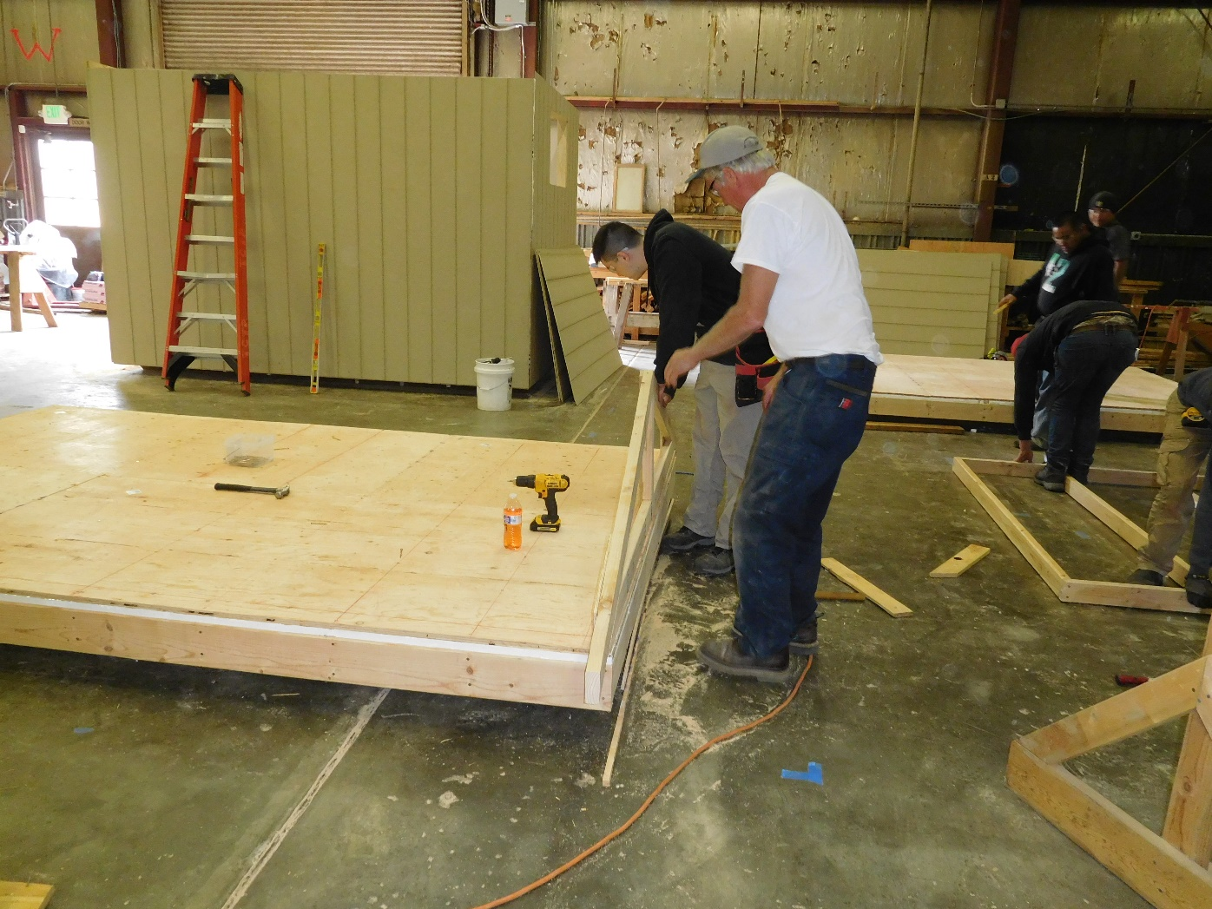
CARPENTRY

Slide 12
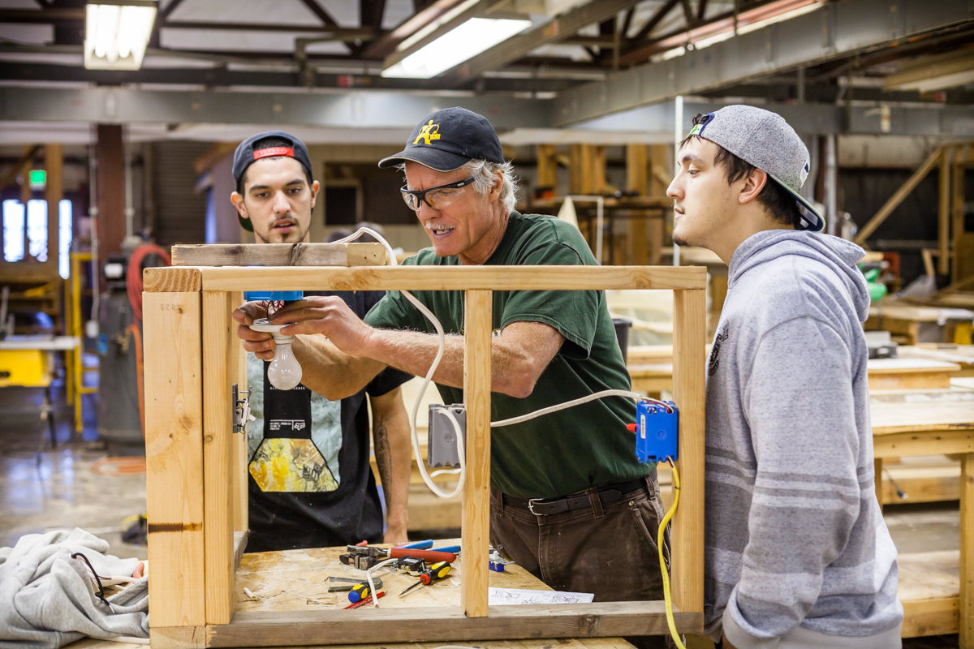
ELECTRICAL

Slide 13
TRY A TRADE DAYS
The class attends a variety of apprenticeship programs to tour or try their hand at the trade.
The students tour job sites

Slide 14
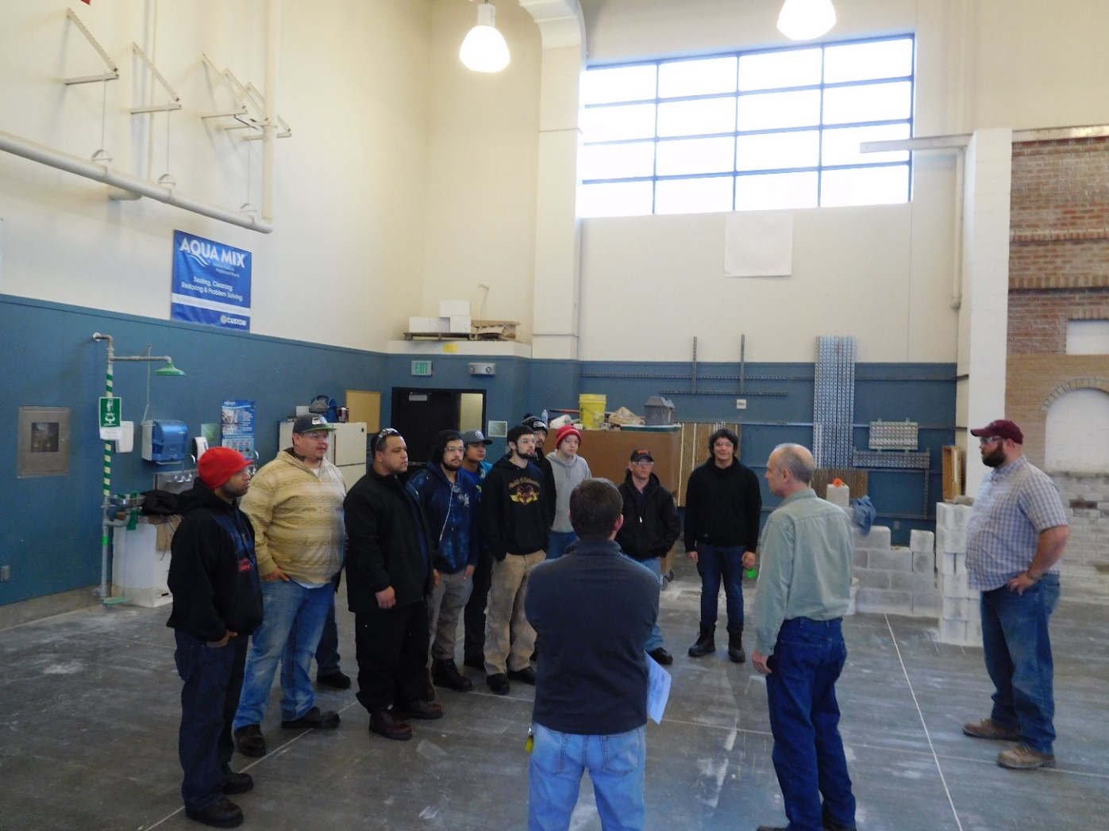
WESTERN WASHINGTON MASONRY TRADES

Slide 15
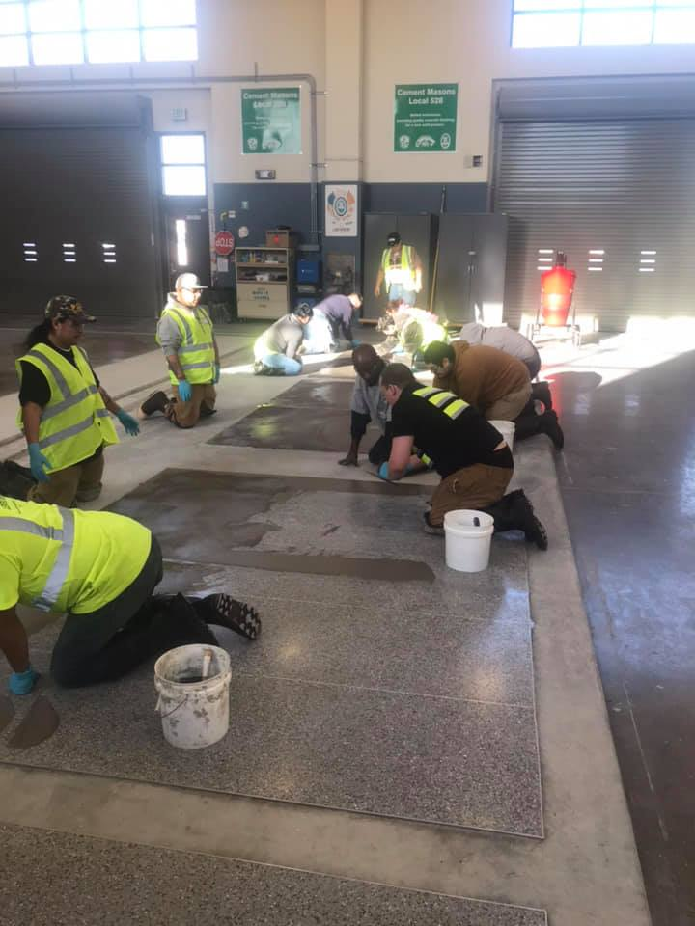
WESTERN WASHINGTON MASONRY TRADES

Slide 16
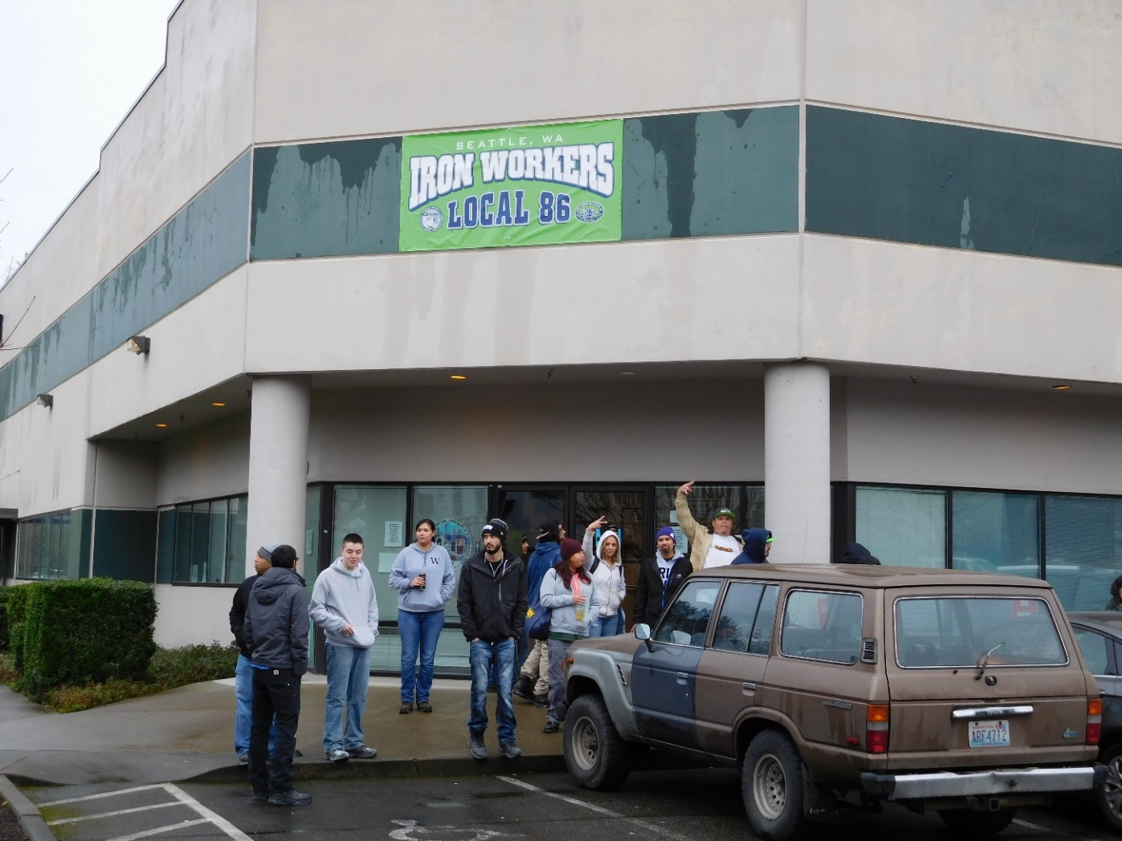
PACIFIC NW IRONWORKERS JATC

Slide 17
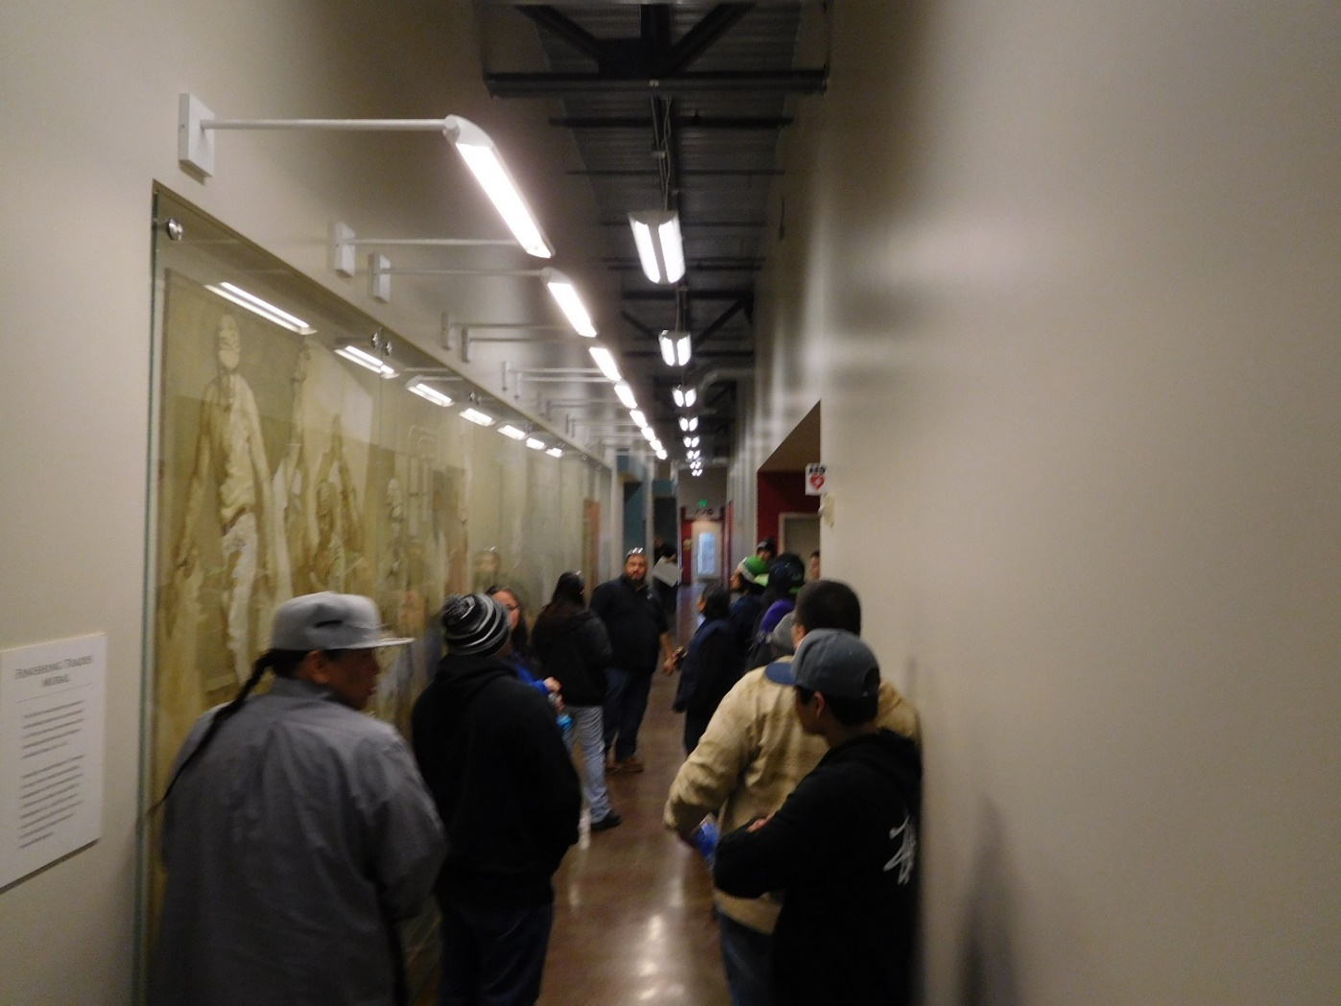
FINISHING TRADES

Slide 18
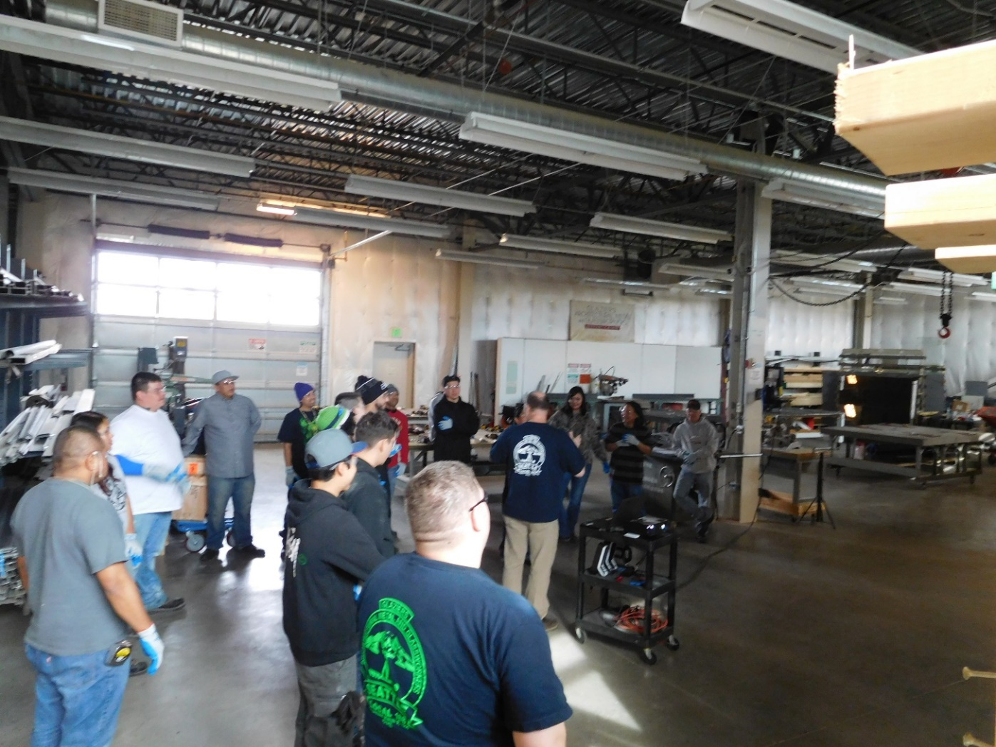
GLAZIERS

Slide 19
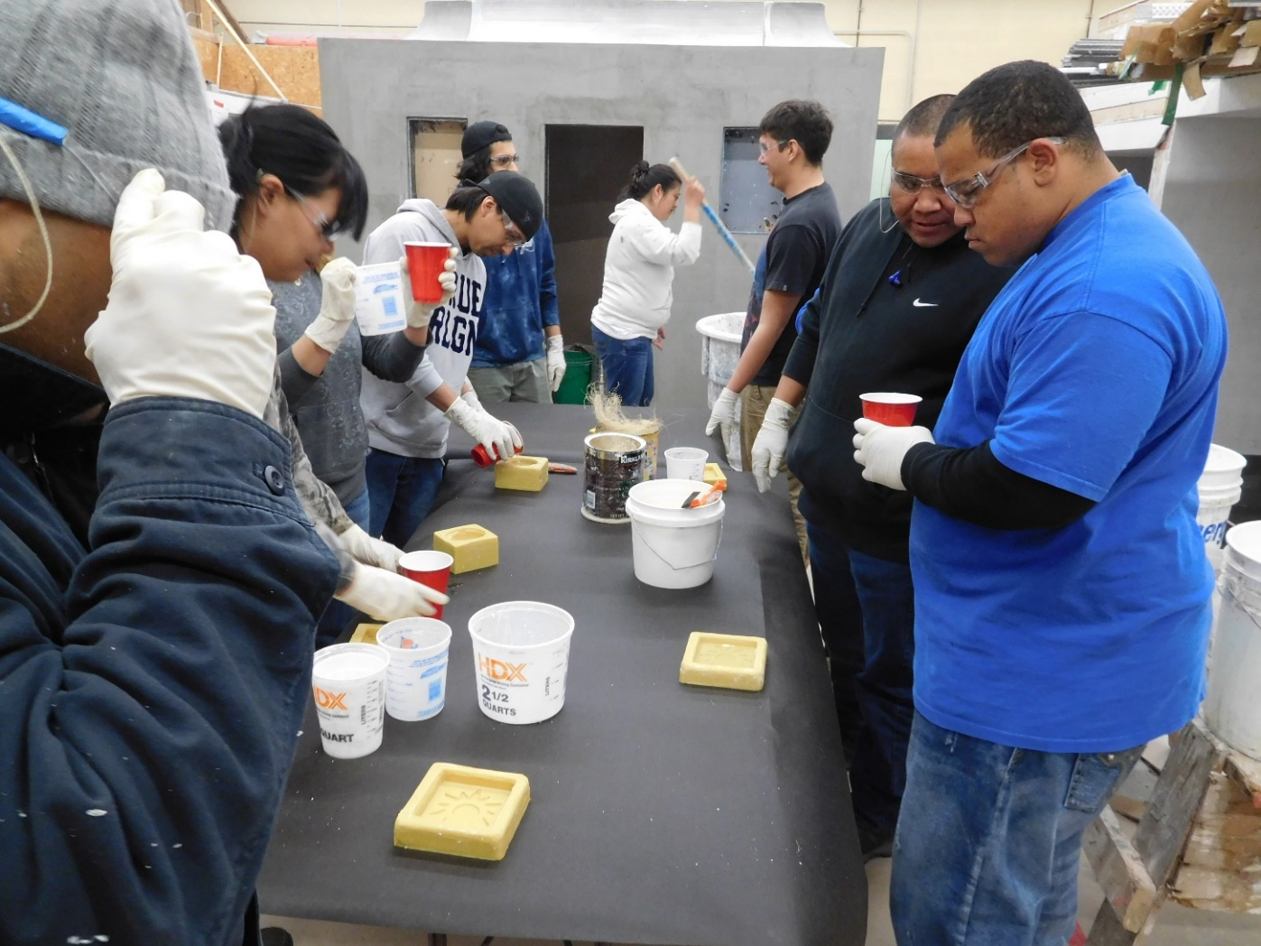
PLASTERERS

Slide 20
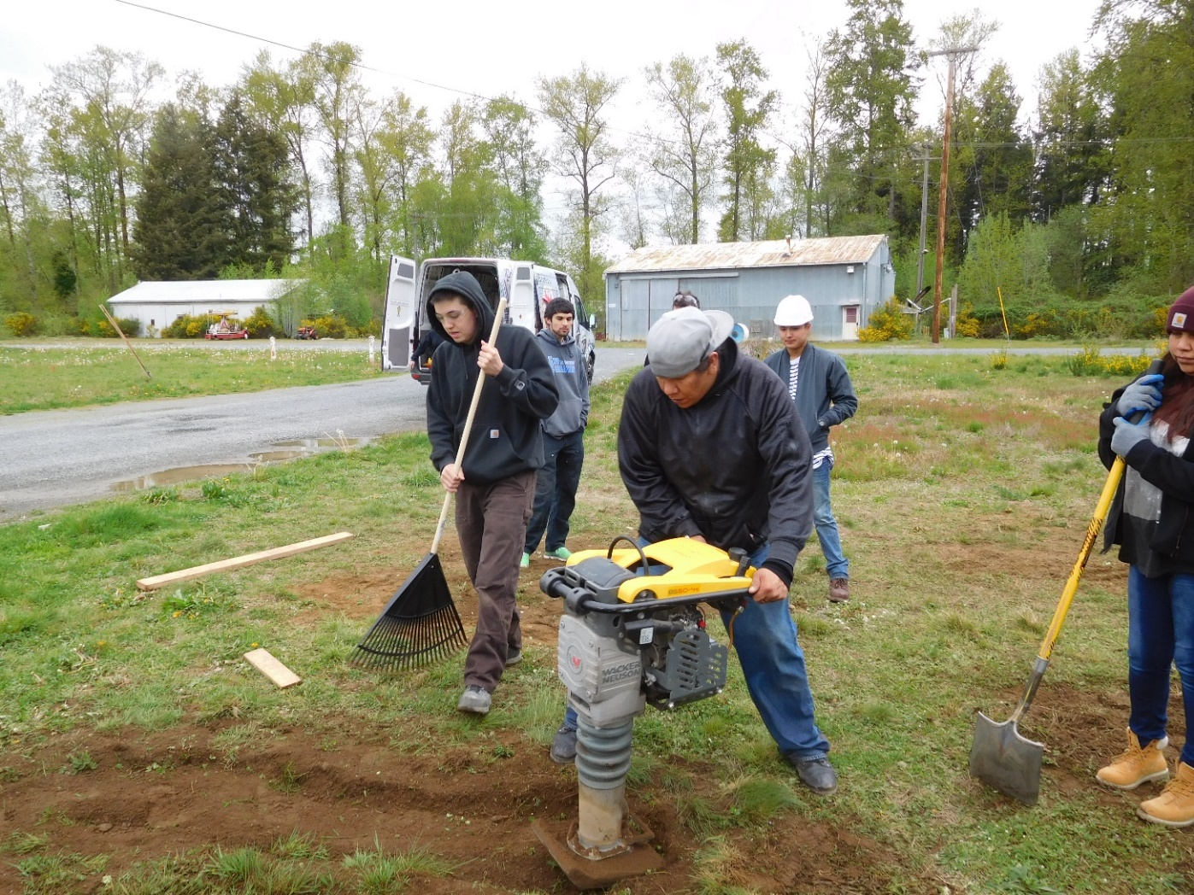
NW LABORERS

Slide 21
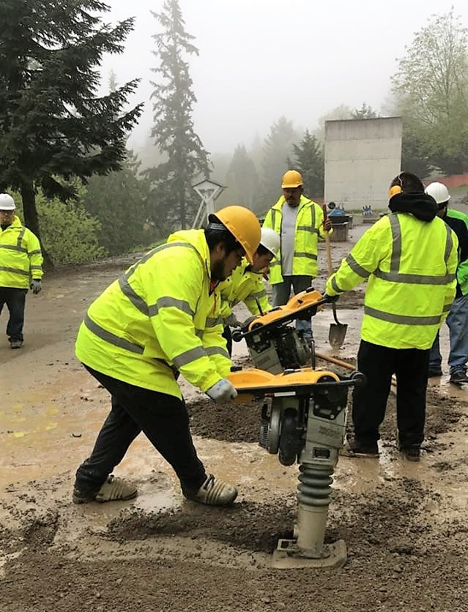
NW LABORERS

Slide 22
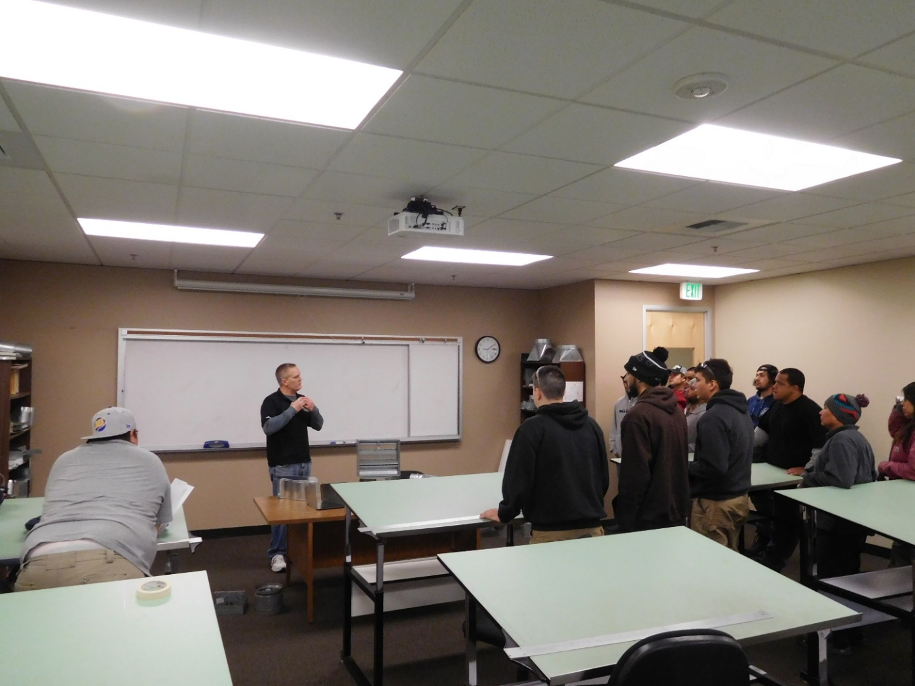
SHEET METAL

Slide 23
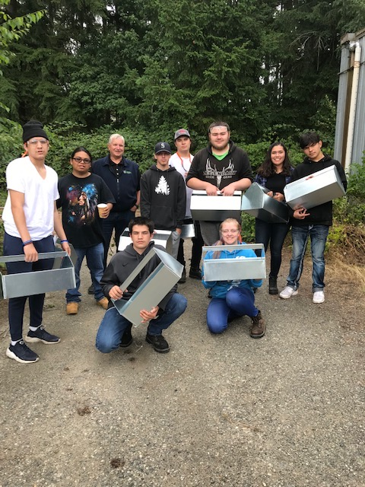
SUMMER YOUTH SHEET METAL

Slide 24
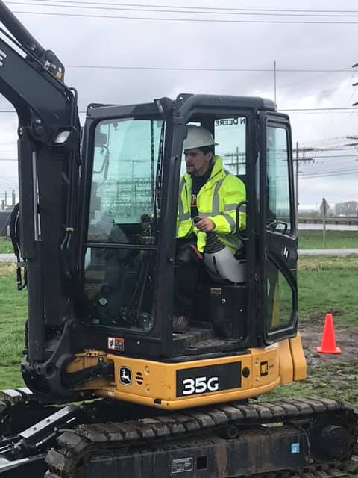
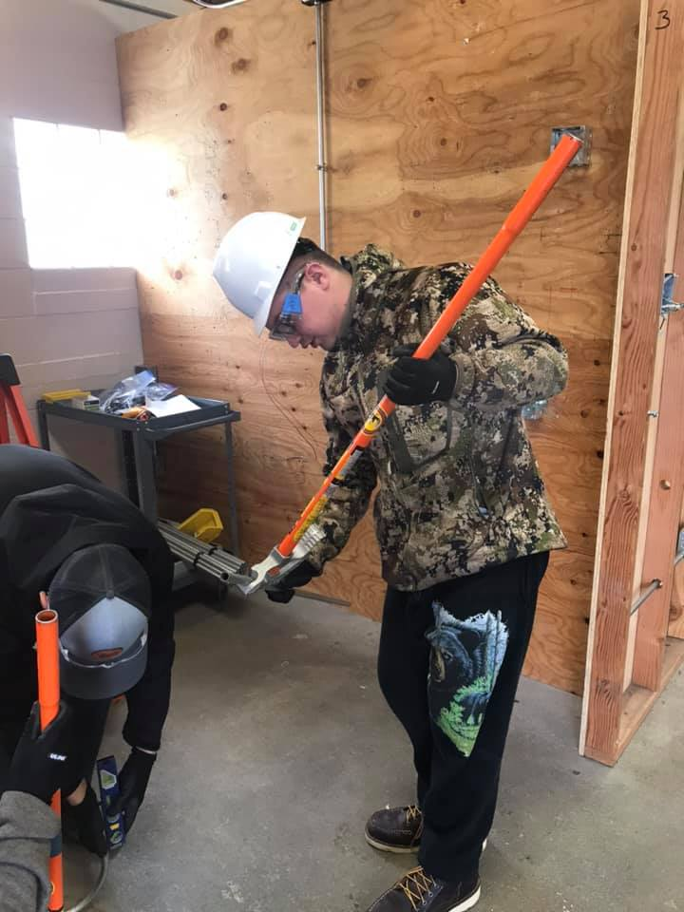
THE WAVE TOUR: LABORERS, ELECTRICIANS, PLUMBERS, PIPEFITTERS, OPERATORS

Slide 25
JOB SITE TOURS
See skills in action during job site tours
Ability to visualize themselves in the construction industry

Slide 26
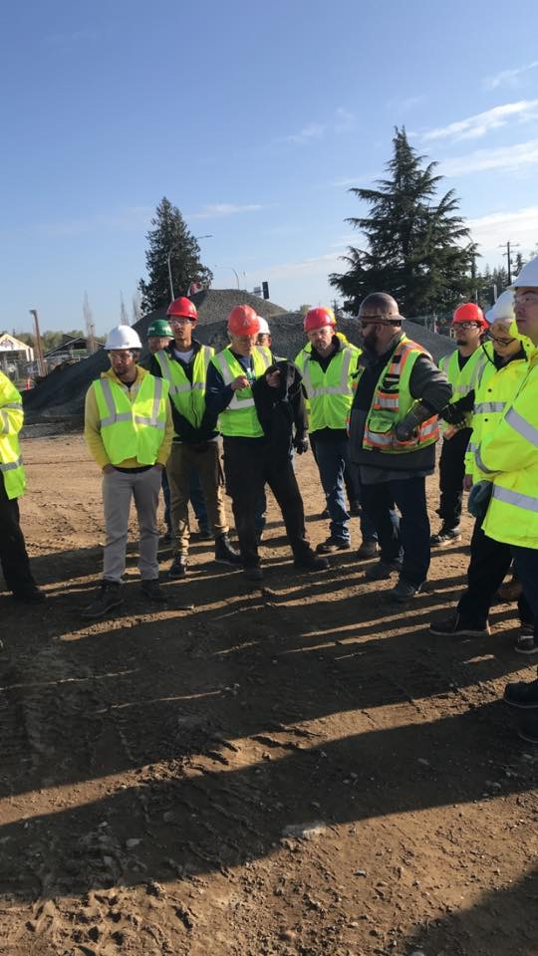
ANDERSON TOUR

Slide 27
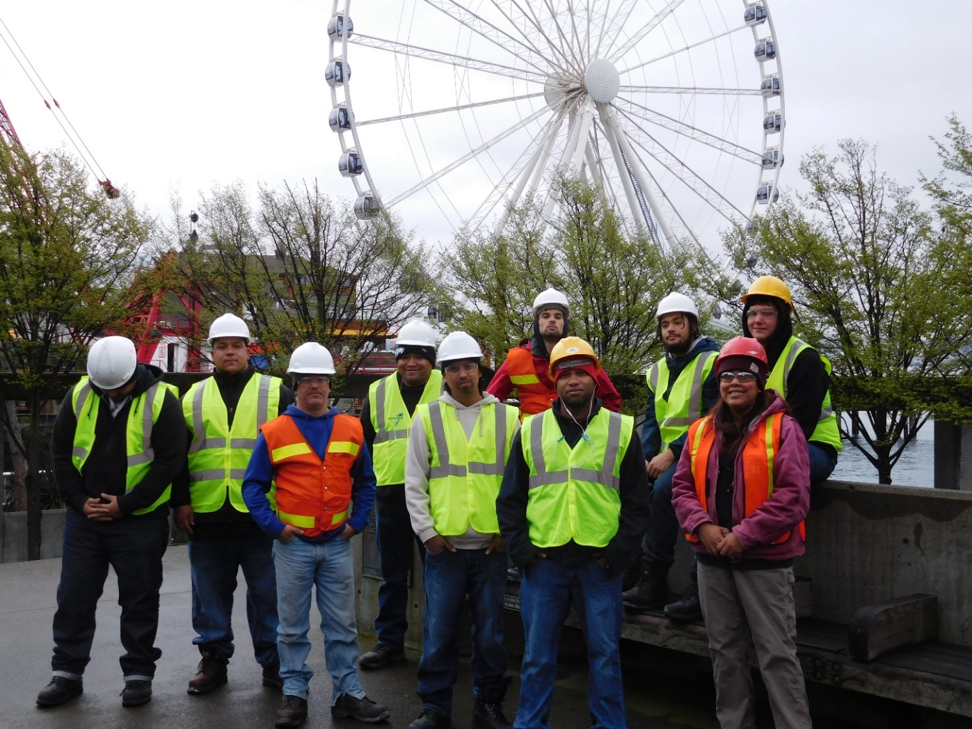
SEAWALL TOUR, THANK YOU MORTENSON-MANSON

Slide 28
CERTIFICATIONS
Forklift
Scissor lift
Boom lift
Flagger card
First aid/CPR/AED
OSHA 10
40 hour HAZWOPER

Slide 29
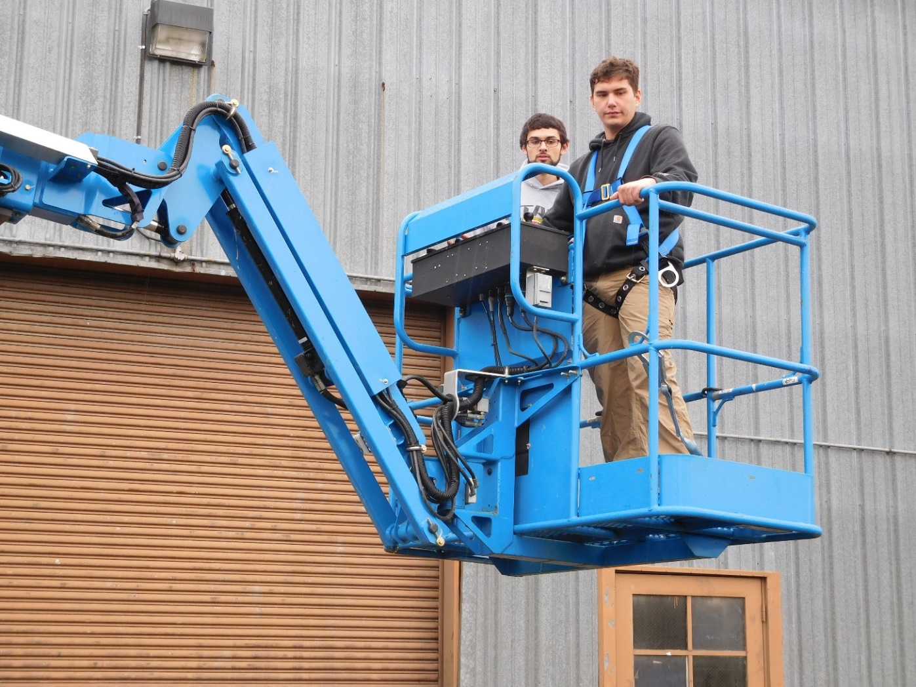
BOOM LIFT

Slide 30
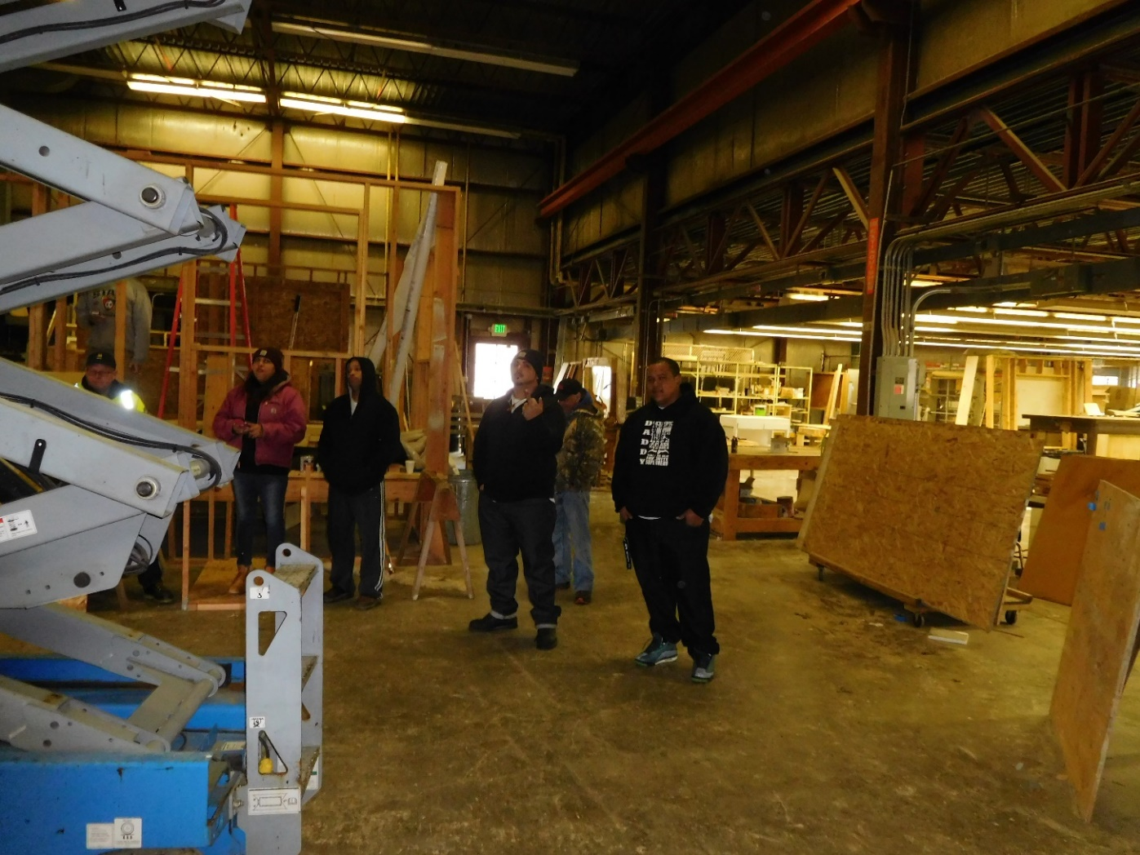
SCISSOR LIFT

Slide 31
CLASS SPEAKERS
Employers
Business agents
Graduates

Slide 32
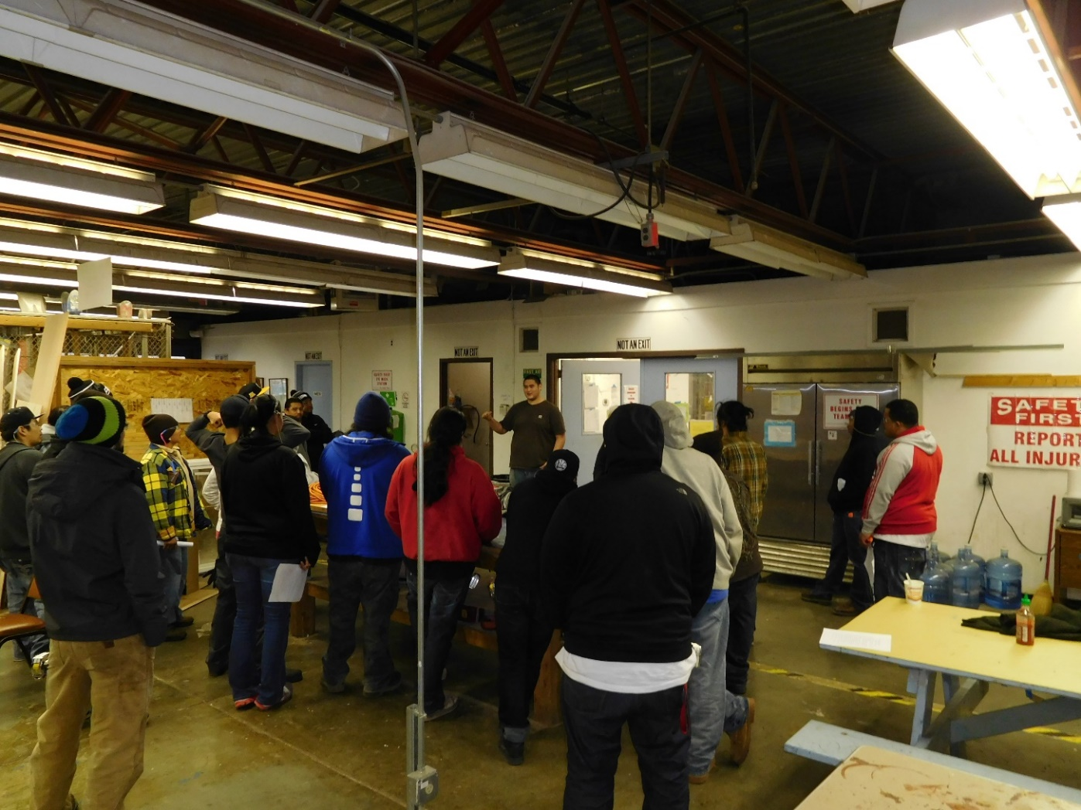
SUCCESSFUL GRADUATE RETURNS TO SHARE HIS CAREER EXPERIENCE

Slide 33
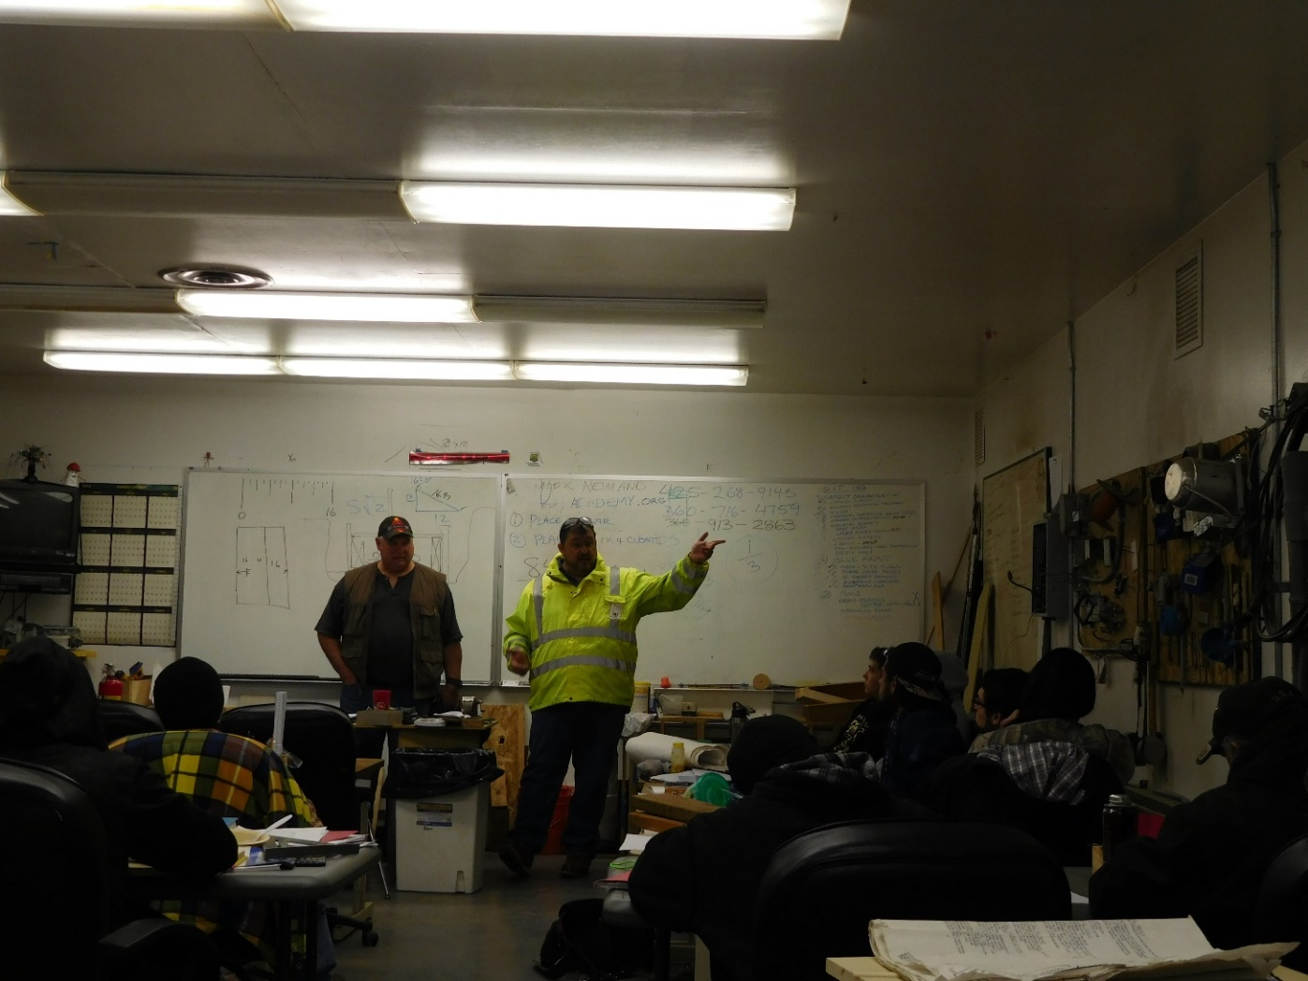
BUSINESS AGENTS

Slide 34
TWO GENERATIONAL APPROACH
Attendance intervention
Children’s school attendance
Safety at training and at home
Nutrition, Health and Dental care
Early learning and Literacy

Slide 35
FAMILY DAY Focusing on Literacy

Slide 36
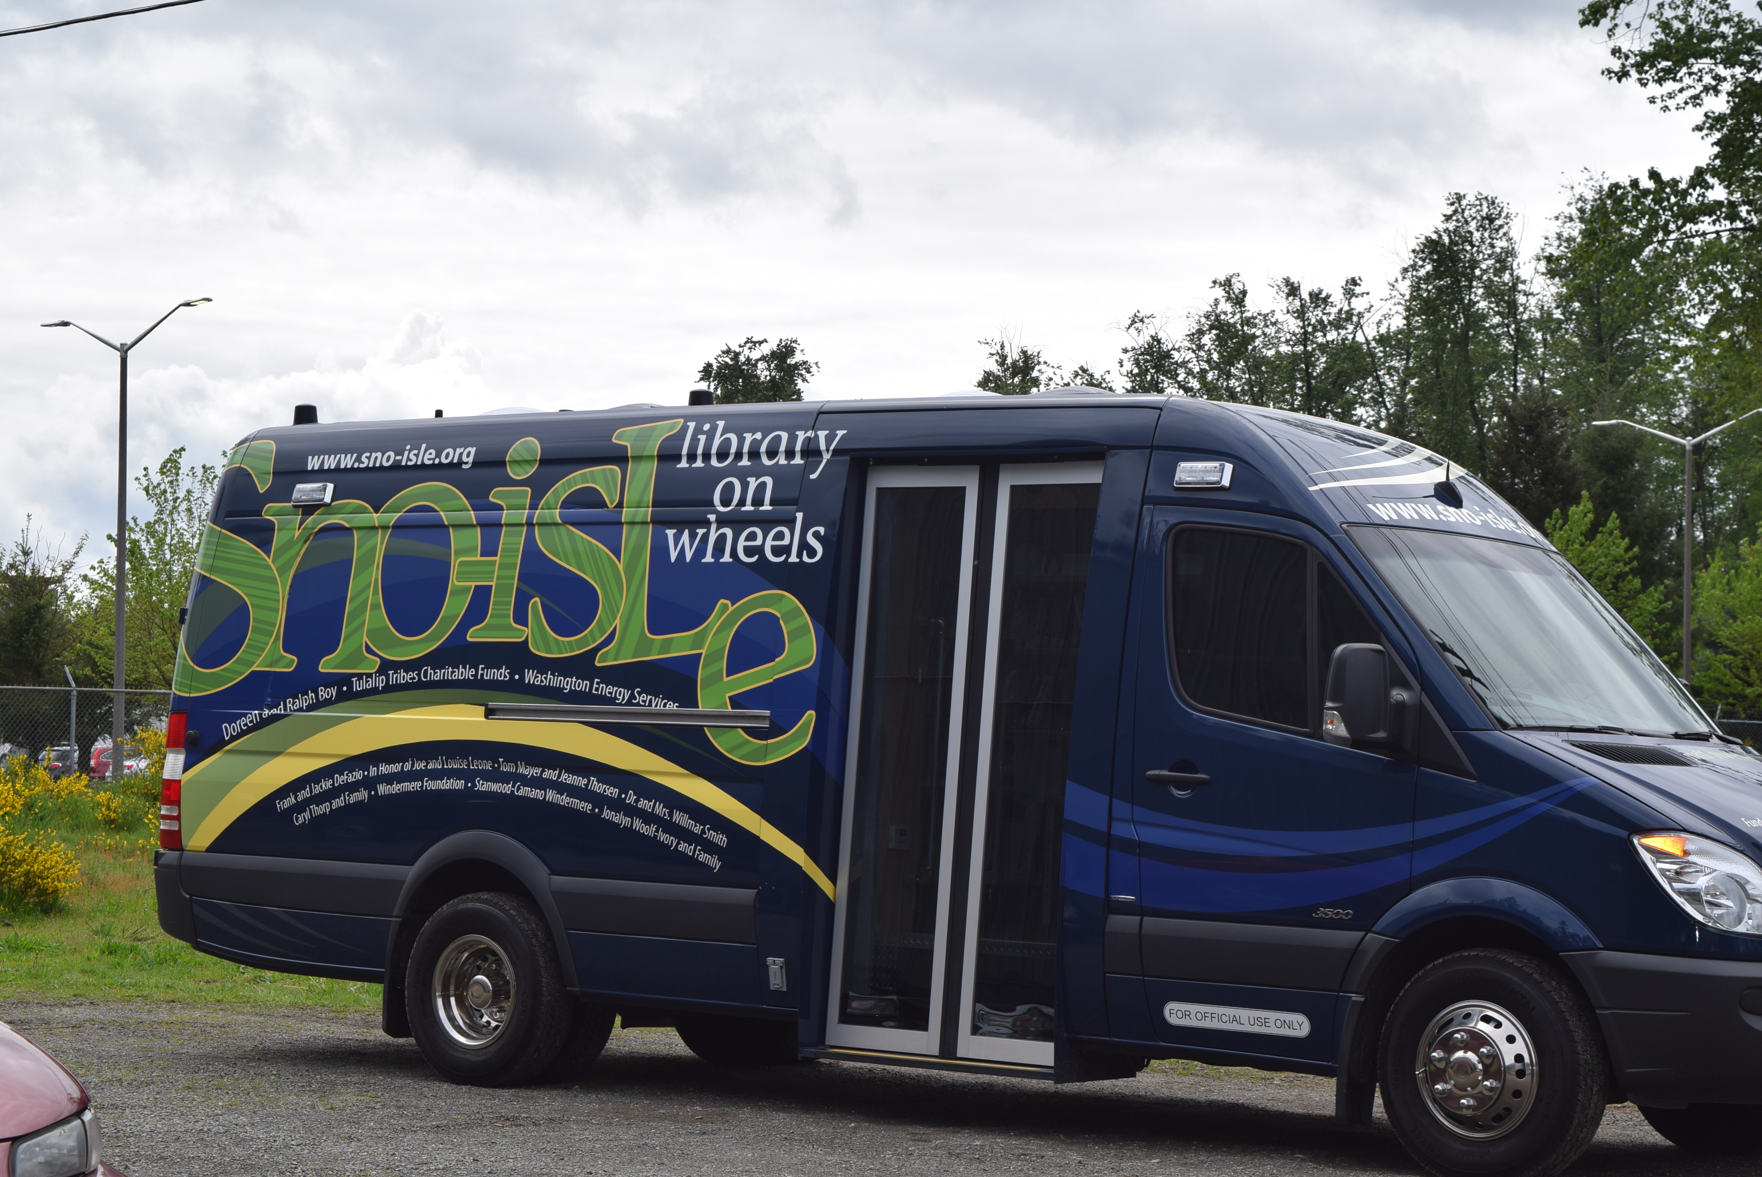
THANK YOU SNO-ISLE

Slide 37
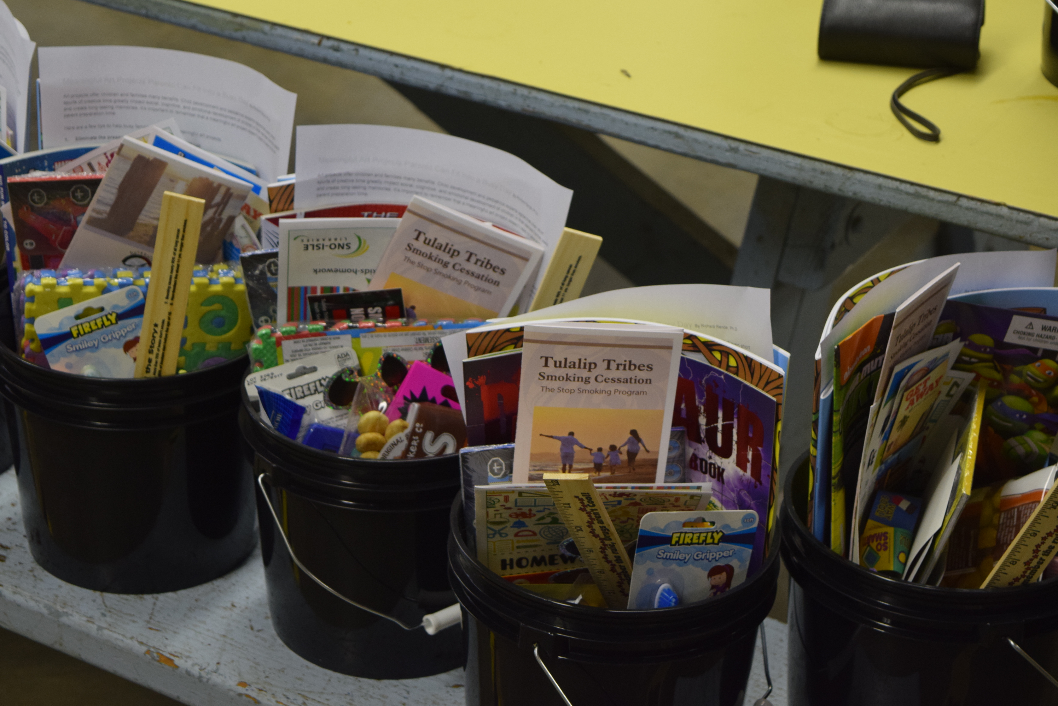
CHILDREN’S TOOL BOX

Slide 38
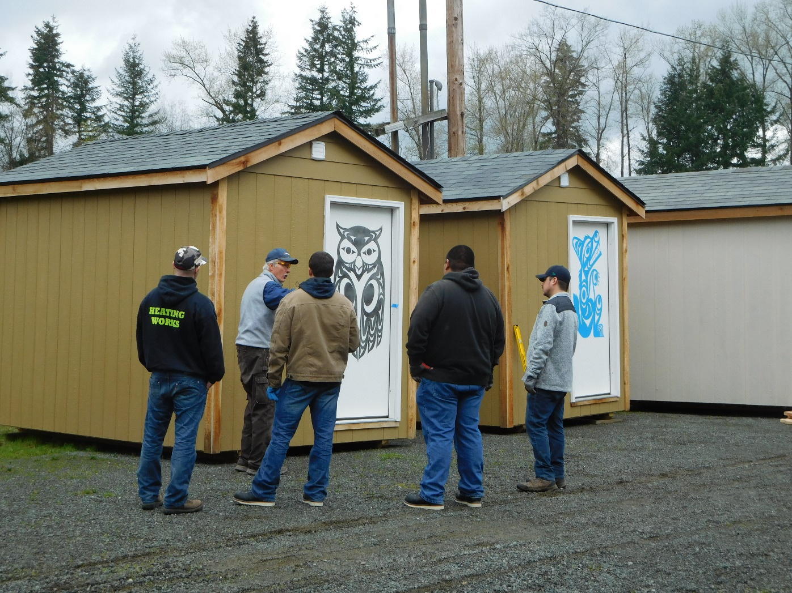
GIVING BACK TO THE COMMUNITY

Slide 39
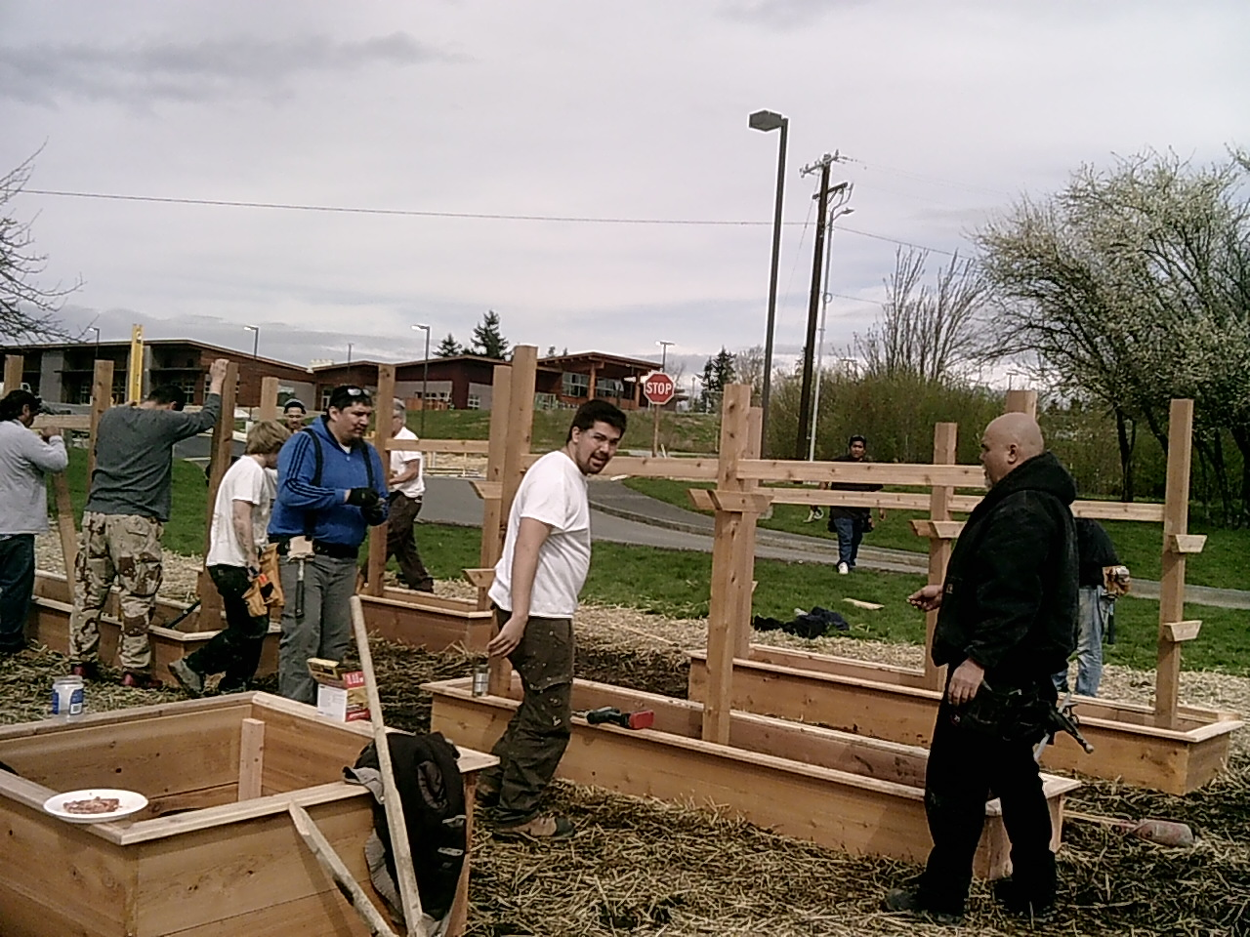
TULALIP HEALTH CLINIC PLANTER BOXES

Slide 40
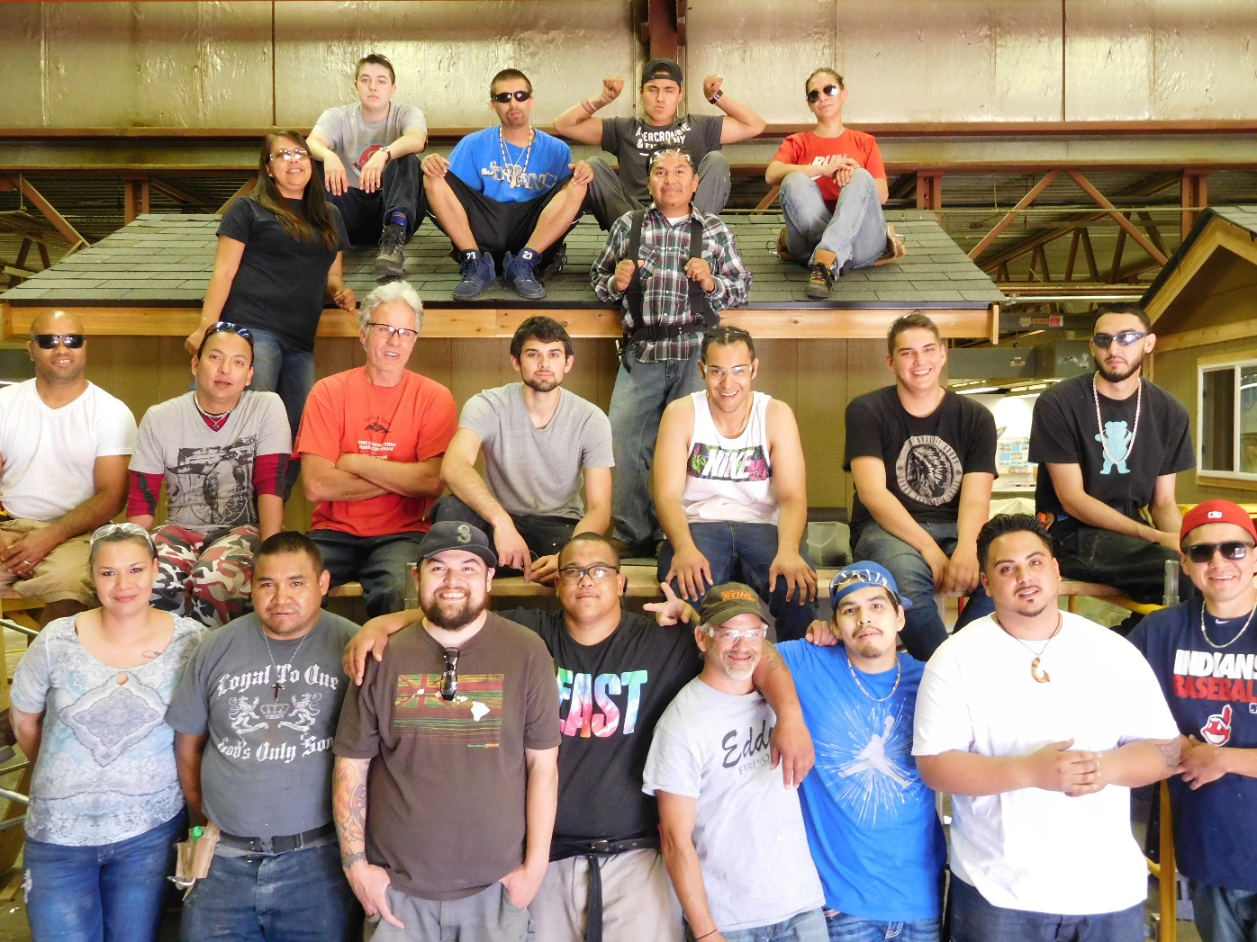
TINY HOMES FOR THE TULALIP HOMELESS SHELTER

Slide 41
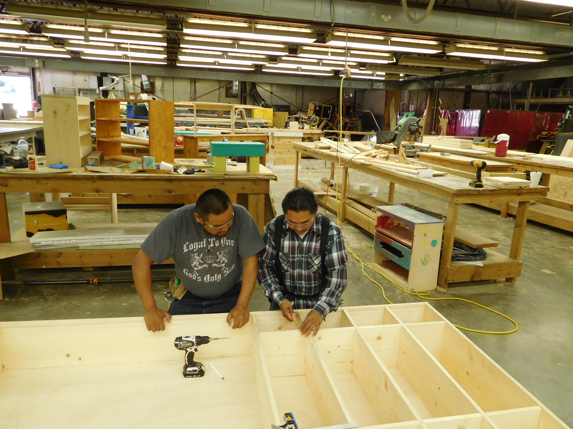
CUBBY’S FOR EARLY LEARNING

Slide 42
GRADUATION
BUT IT’S NOT OVER
They will start JOB CLUB
Job club will keep them connected and motivated. they will receive job postings, resume brush up, interview preparation and network with other graduates. AND MORE
They are always part of the TVTC family
Follow up

Slide 43
DOES IT WORK?
STATISTICS FOR OUR LAST FIVE CLASSES
118 Native Americans enrolled
94 graduated
12 earned their High school Diploma through 21 and up
25 entered a construction apprentice
20 entered construction
21 entered livable wage employment
The average placement rate is $21.04
Notes:
28 did not go to work but do not despair, you have planted a seed, they will eventually grow. That is why continuous follow up needs to happen. Bring in graduates as speakers to inspire

